Slide 1
Automating the security analysis and design of systems using models
Avi Shaked
&
Can Zhou
Supported by: Or Yaacobovich (Johnson & Johnson)
Notes:
Reflections on whether we can formally verify the security of systems

Slide 2
State of the Art I: TRADES
https://github.com/IAI-Cyber/TRADES
No automated analysis
Shaked, A., 2023. A model-based methodology to support systems security design and assessment. Journal of Industrial Information Integration.

Slide 3
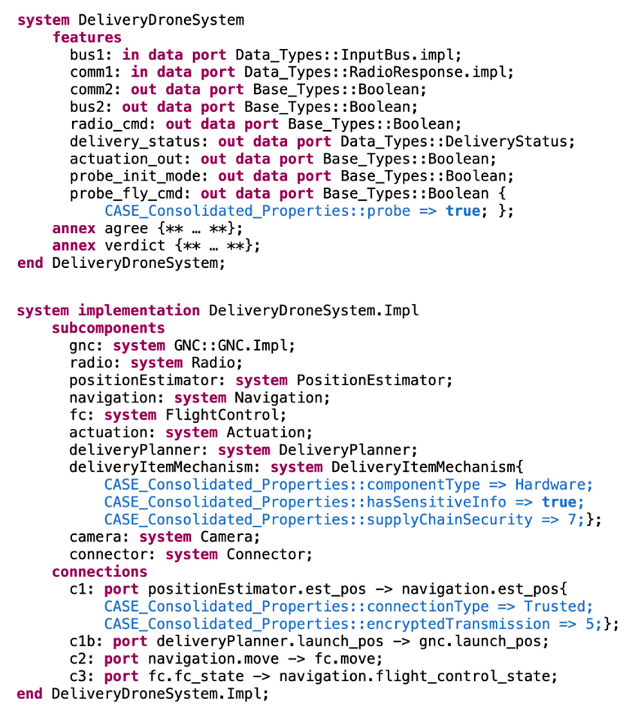
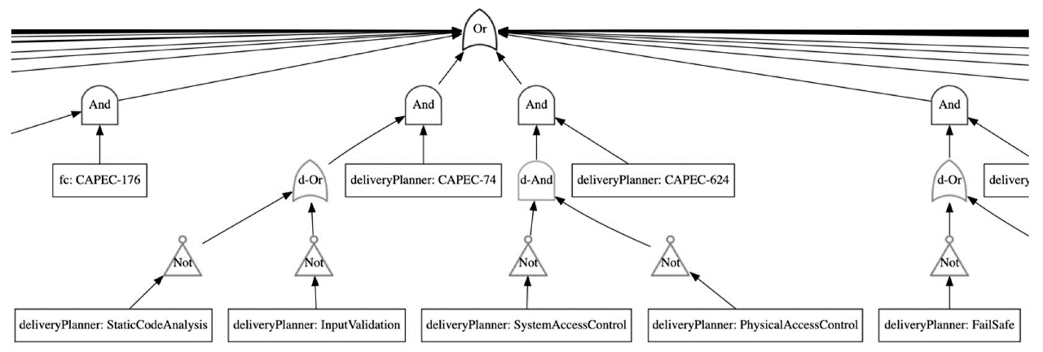
State of the Art II: VERDICT
1. No inclusion of threats/risks in the model
2. Analysis results (inc. allocated threats and security controls) are not in the form of an information model
Meng et al., 2021. Verdict: a language and framework for engineering cyber resilient and safe system. Systems.

Slide 4
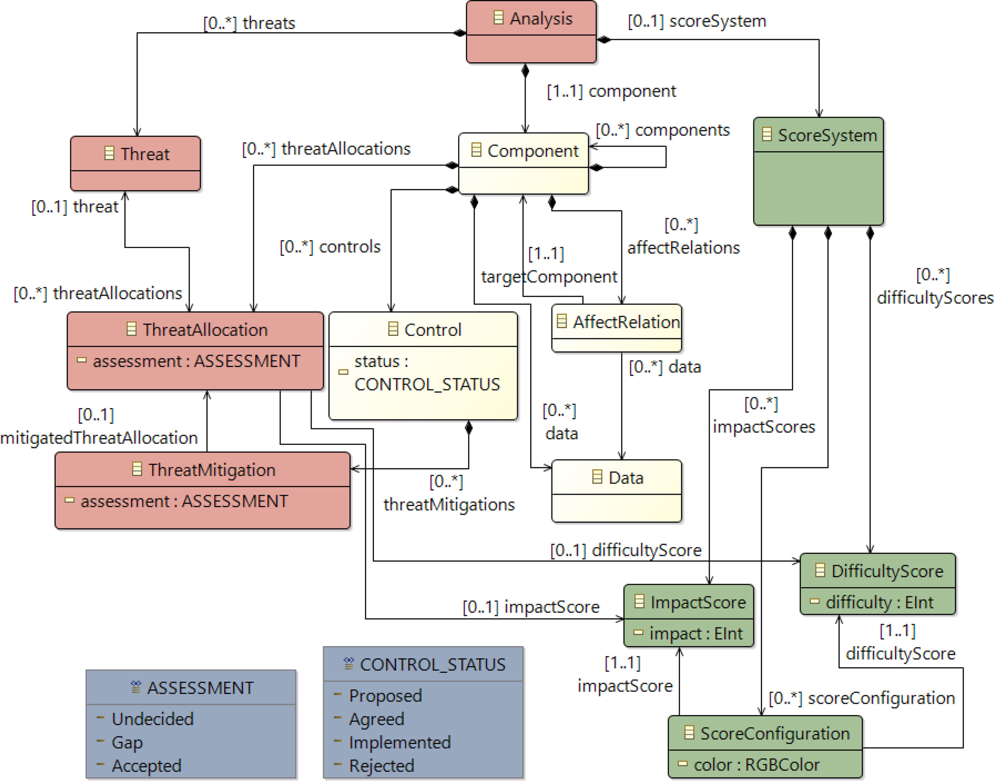
TRADES & VERDICT – Shared Domain Ontology
Hierarchical system composition
Directed information flows
Threats – inc. CAPEC – and Security Controls
Threat & Security Control allocations

Slide 5
Objectives
Integrate TRADES & VERDICT so that:
Users will be able to design systems graphically (TRADES)
Users will be able to analyse their design with respect to security roles (VERDICT)
System designs will be enriched with potential threats & proposed security controls (VERDICT to TRADES)

Slide 6
Method
Explore and understand the VERDICT implementation
Translate TRADES models into VERDICT
Incorporate VERDICT analysis output (non-model) into TRADES models
A bi-directional model transformation

Slide 7
Example: TRADES model
Temporary mechanism to represent VERDICT properties

Slide 8
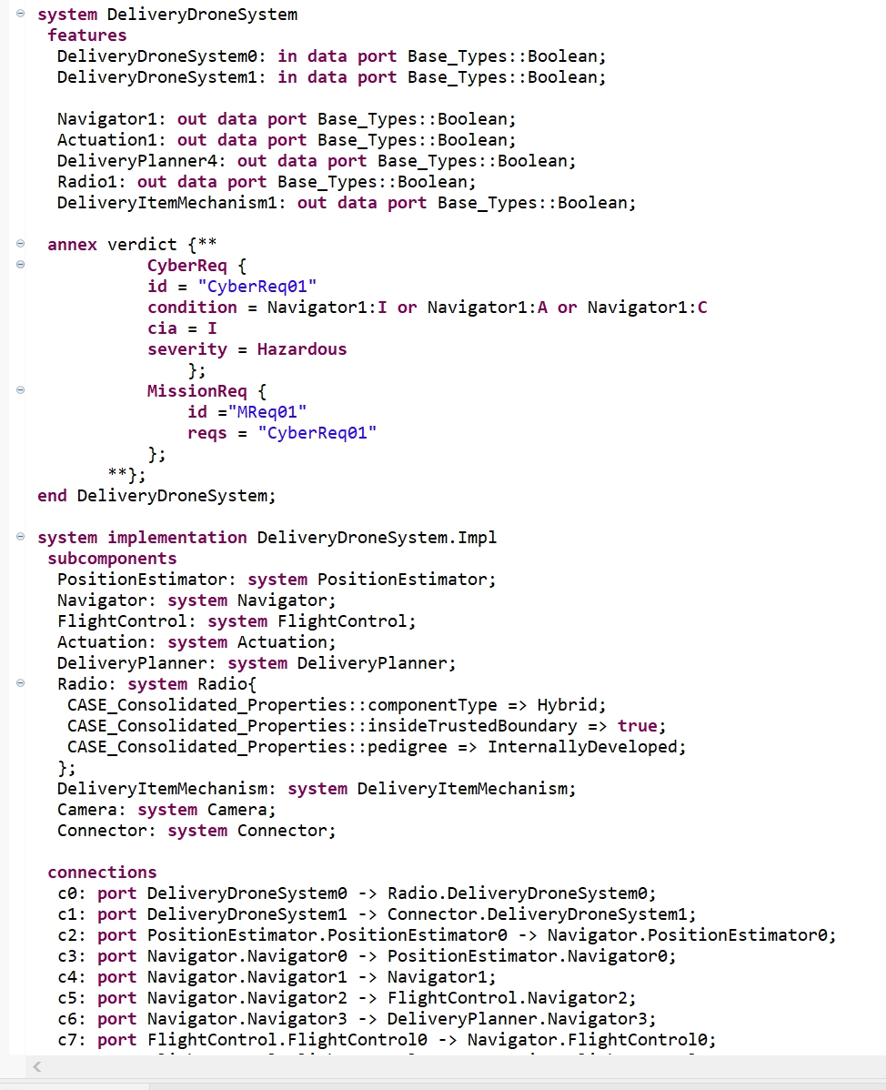
Example: auto-generated AADL
A non-trivial model transformation
Port definitions
System “declaration”
“Requirements” for analysis
Definitions for analysis
Definitions for analysis
System implementation
Properties for subsystem (implementation)
Flows

Slide 9
Example: VERDICT analysis output
Notes:
The most exhaustive tree

Slide 10
Example: Auto-revised TRADES model
To be completed

Slide 11
Limitation & Challenges
Works only with two hierarchies (VERDICT design!)
Input and output flows need to be specified from and to top-hierarchy component (reasonable design constraint)
Flows do not relate to Data elements (technical debt)
Add properties to TRADES metamodel (technical debt)
Requirements and connections are currently defined for exhaustive analysis
Can be narrowed down according to security focus
Run VERDICT analysis from TRADES Tool

Slide 12
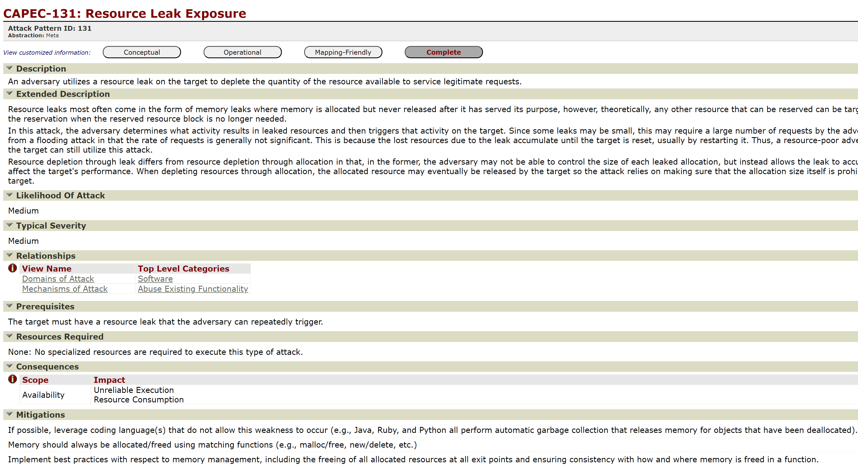
Potential: new reasoning rules (automated reasoning)
Source: https://capec.mitre.org/data/definitions/131.html

Slide 13
Discussion
Security by-design: an integrated model-based tool can revolutionise this
Model transformation: is there a generic model-driven approach?
Questions?
Thank You, MDENet!
https://github.com/IAI-Cyber/TRADES
Notes:
Although QVT has a broad scope, it does not cover everything that has been considered as a model transformation, view or query. For example, the QVT languages do not permit transformations to or from textual models, since each model must conform to some MOF 2.0 metamodel. Model-to-text transformations are being standardised separately by OMG (see MOFM2T).

Slide 14
Technical
VERDICT ontology adaptation:
BaseModel.owl defines types + mitigations association with threats
STEMRules.rules (SADL) defines reasoning rules

