Slide 1
Synthetic vs. Real: An Analysis of Critical Scenarios for Autonomous Vehicle Testing
Qunying Song,
Lunds Universiy
Supervised by
Dr. Mohammad Reza Mousavi,
King’s College London
Presented by
Avner Bensoussan,
King’s College London
Notes:
1

Slide 2
Presentation Structure
We measured the realism of generated scenarios
by comparing them to real collision data.
Notes:
2

Slide 3
Project Motivations
We measured the realism of generated scenarios
by comparing them to real collision data.
How realistic ?
→ Distribution of features
→ Causal attributes for realistic AV collisions
Improvement to generate more realistic critical scenarios
→ Guidelines for closing gaps
→ Guidelines for field testing with generated scenarios
Notes:
3

Slide 4
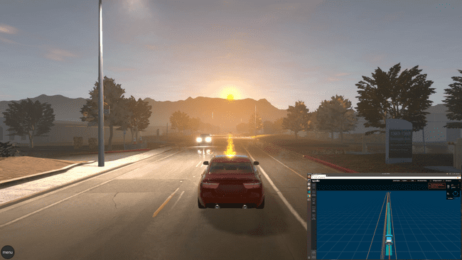
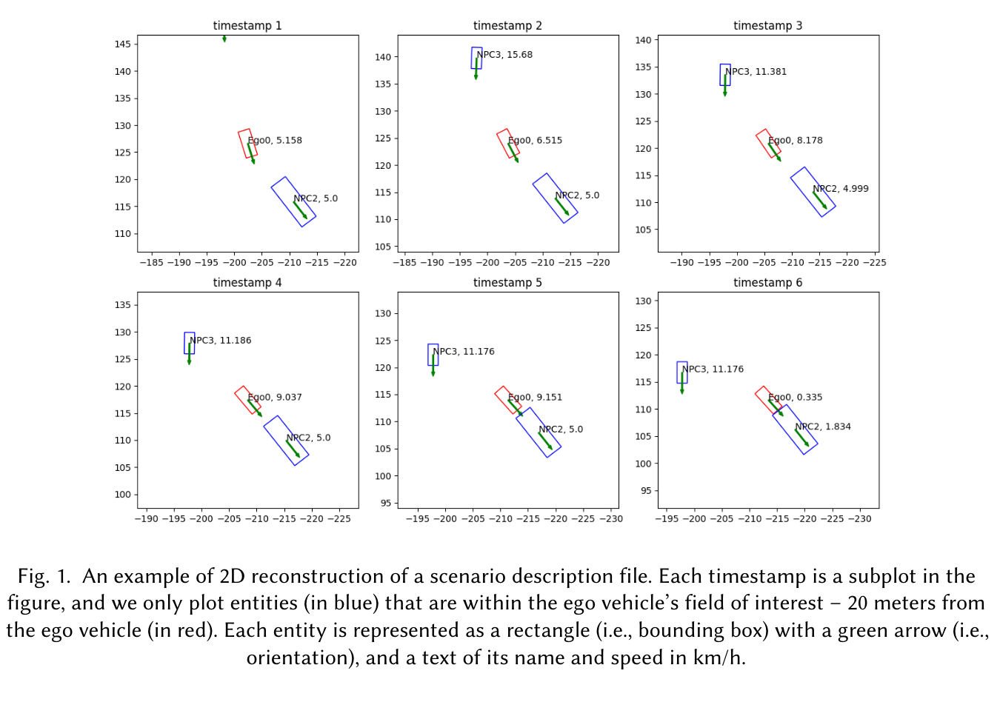
Datasets
We measured the realism of generated scenarios
by comparing them to real collision data.
Dataset available on Github for testing Avs
Used SVL simulator and three strategies
(i.e., random, greedy search, and reinforcement learning)
1050 collisions over 33 530 scenarios
Notes:
4

Slide 5
Datasets
We measured the realism of generated scenarios
by comparing them to real collision data.
→ AV manufacturers required to submit collision report within 10 days
Notes:
5

Slide 6
Measurement
We measured the realism of generated scenarios
by comparing them to real collision data.
No official method to evaluate realism
We used : - Single and Multi-factor Comparison
- Distance-Based techniques to evaluate how similar the two datasets are
such as Surprise adequacy
Notes:
6

Slide 7
Results – Single-Factor Comparison
We measured the realism of generated scenarios
by comparing them to real collision data.
Notes:
7

Slide 8
Analysis
We measured the realism of generated scenarios
by comparing them to real collision data.
DeepScenario used a subset of realistic parameters
→ Include more realistic parameter in synthetic scenario exploration (snow, construction…)
Evaluate the quality of the simulation
Include prior distribution of contextual parameters
Limits: - Computationally heavy
- Reality gaps between parameters effects on simulator and real world
Notes:
8

Slide 9
Results – Multi-Factor Comparison
We measured the realism of generated scenarios
by comparing them to real collision data.
Notes:
9

Slide 10
Analysis
We measured the realism of generated scenarios
by comparing them to real collision data.
Notes:
10

Slide 11
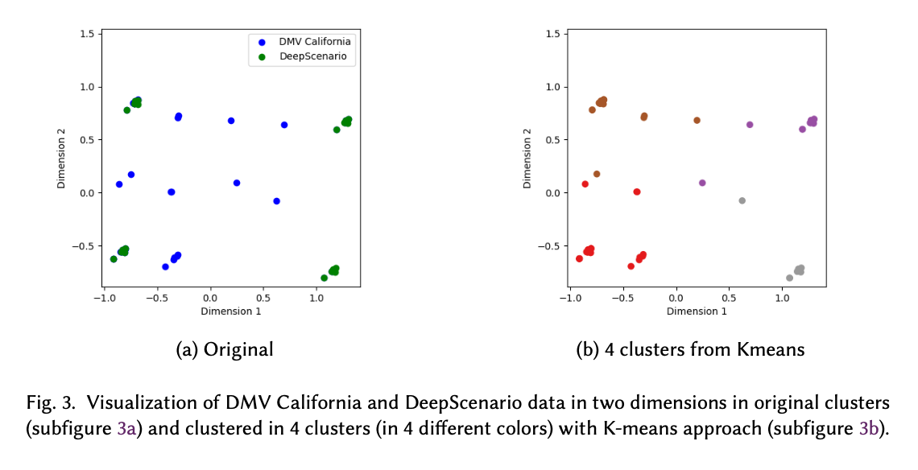
Results – Similarity Evaluation
We measured the realism of generated scenarios
by comparing them to real collision data.
Notes:
11

Slide 12
Analysis
We measured the realism of generated scenarios
by comparing them to real collision data.
Notes:
12

Slide 13
Conclusion
We measured the realism of generated scenarios
by comparing them to real collision data.
Notes:
13

