Slide 1
Automating LCA from CAD models for sustainable design feedback
Natural, Mathematical & Physical Sciences
06/12/2023
Dr Francesco Ciriello
Department of Engineering
Antoine El Adib
This work was supported by
Department of Engineering
MDENet Annual Symposium 2023

Slide 2
Learning Outcomes
Review the educational requirements for introducing LCA-driven decision-making systems in engineering design modules
Explain how physical properties are stored and retrieved with the hierarchy of CAD project
Critique the scope, assumptions, inventory and performance indicators in an LCA analysis
Review progress on the seedcorn project and next steps

Slide 3
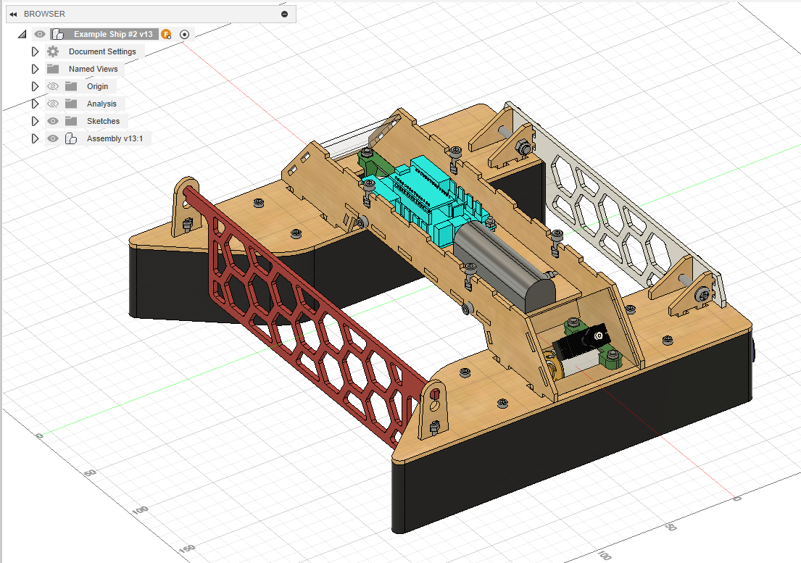
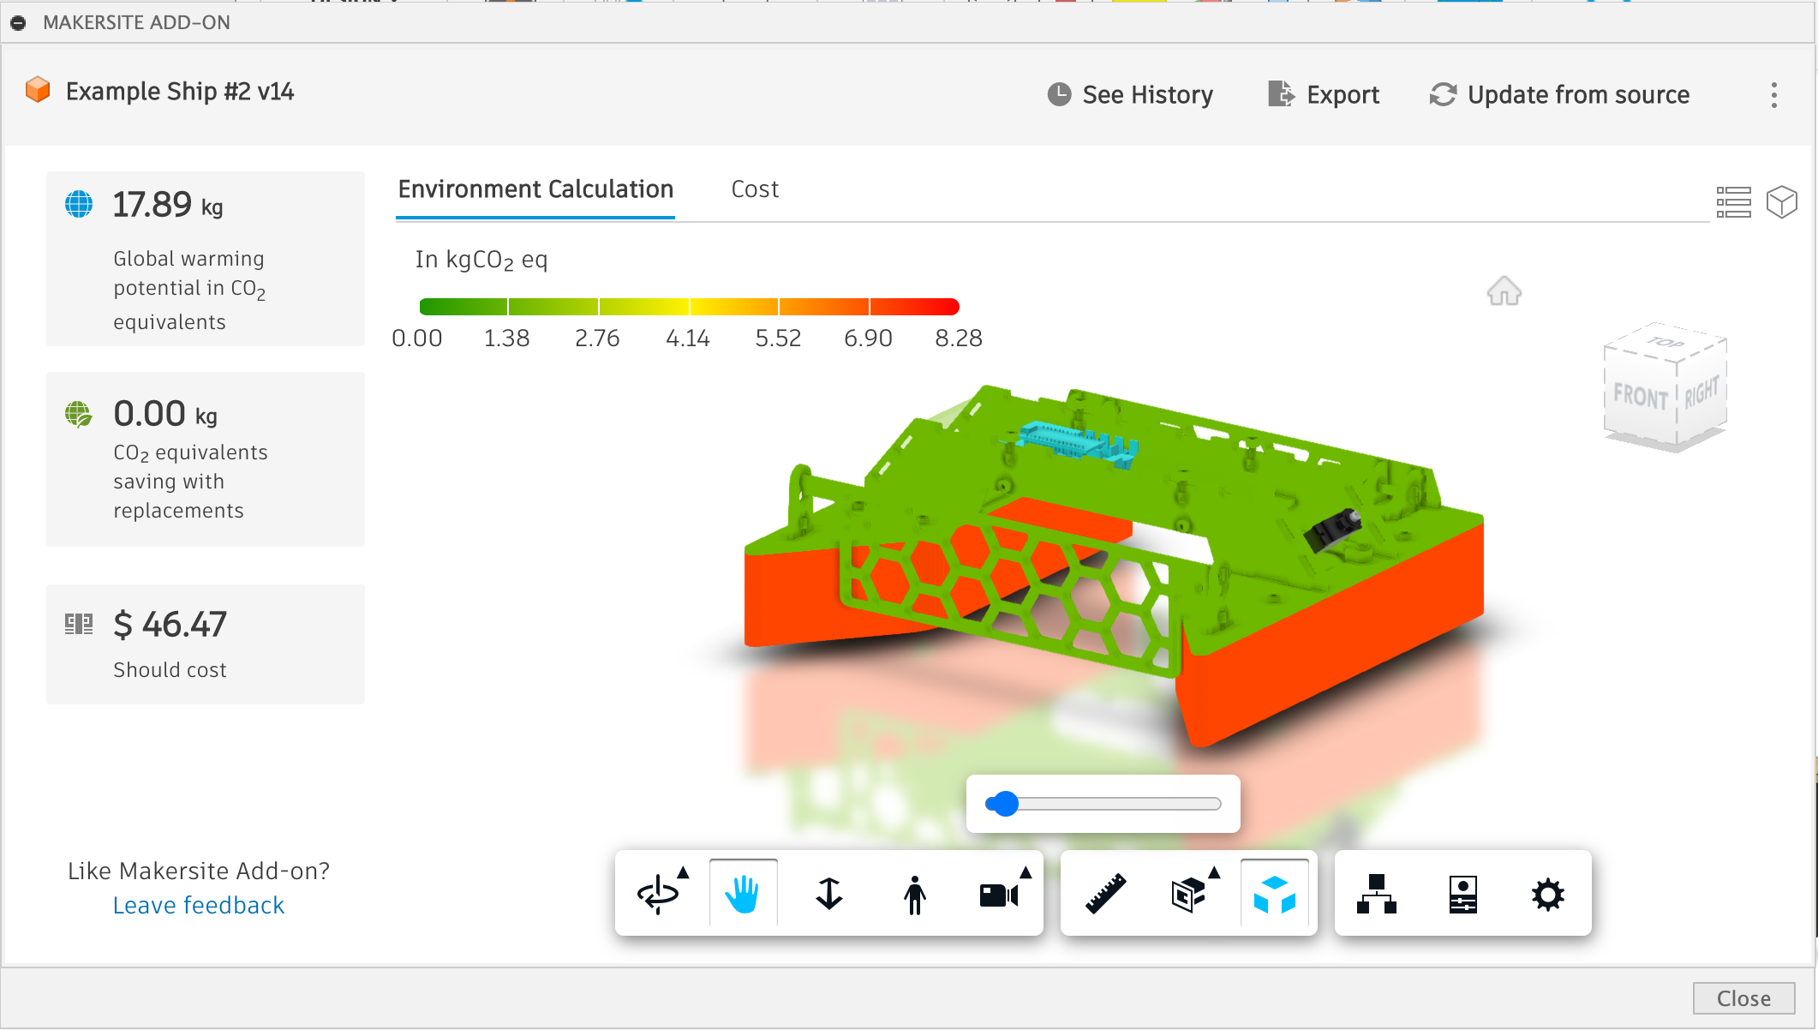
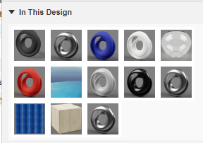
A Decision-Support System for Sustainable Design
How can we meaningfully connect sustainability assessment to design activities?
Notes:
A sample demo output of what we intend to develop

Slide 4
Principles of an Automated Feedback System
Comparative analysis
Outputs
Visualisations, Data Analytics, Severity Levels, Text Reporting, Error & Warning Messages
Inputs
Parameters, Options, Methods, Variants, Decisions
Artifact Evaluation
Assessment & Correction
Design analysis
Design query
Feedback generation
Artifact
requirements, model, simulation, test, presentation, report, discussion
Iteration support
Criteria & guidelines
Customisation based on ILOs
Multi-user interaction
Clicks, Sensors
Design implementation
Suggestions, Reflection Prompts & Feedback Rationale
Orientation
Feedback history and tracking (footprints)
Documentation & Resources

Slide 5
Our progress so far
Comparative analysis
Outputs
Visualisations & Data Analytics
Inputs
Variants
Artifact Evaluation
Extract Performance & Sustainability PIs
Assessment & Correction
Design analysis
Design query
Feedback generation
Iteration support
Artifact
CAD model
Single-user interaction
Clicks, Sensors
Design implementation

Slide 6
Agenda
Sustainable Design Pedagogy
CAD Modelling requirements
LCA Modelling requirements
Visualisation & Decision Making

Slide 7
KCL Engineering Design
Model-driven development with build & test to
motivate learning
validate experiments, data analysis and simulation
develop practical skills
Pedagogical tensions between
Exemplarity vs. Authenticity
Scaffolding vs. Ambiguity, Creativity & Judgment

Slide 8
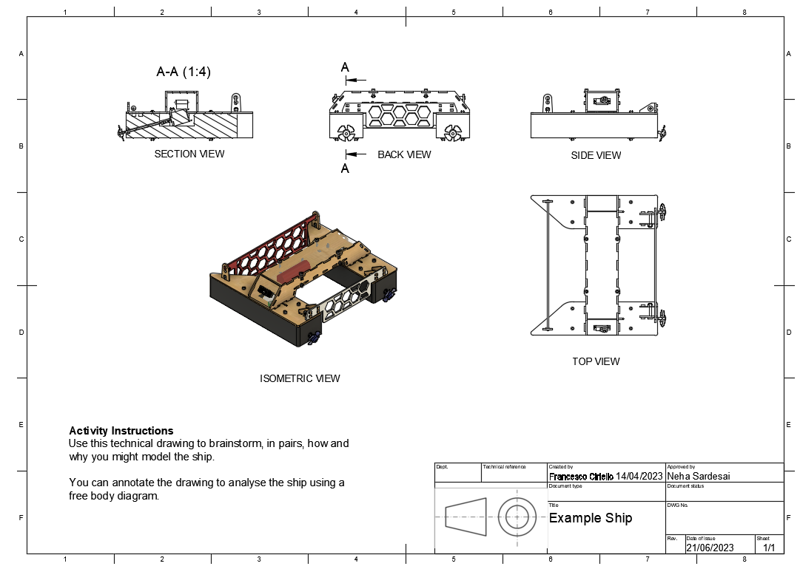
Technical communication in engineering design
Parameter | Value
mass | 1.2 kg
cost | £42.34
max speed | 0.1 m/s
min turn radius | 0.3 m
… | …
Requirements & Specifications
Bill of Materials
Parameter / Technical Specification Sheets
Analysis & Test reporting
Technical drawings
Assembly diagrams
Part diagrams
Fabrication diagrams

Slide 9
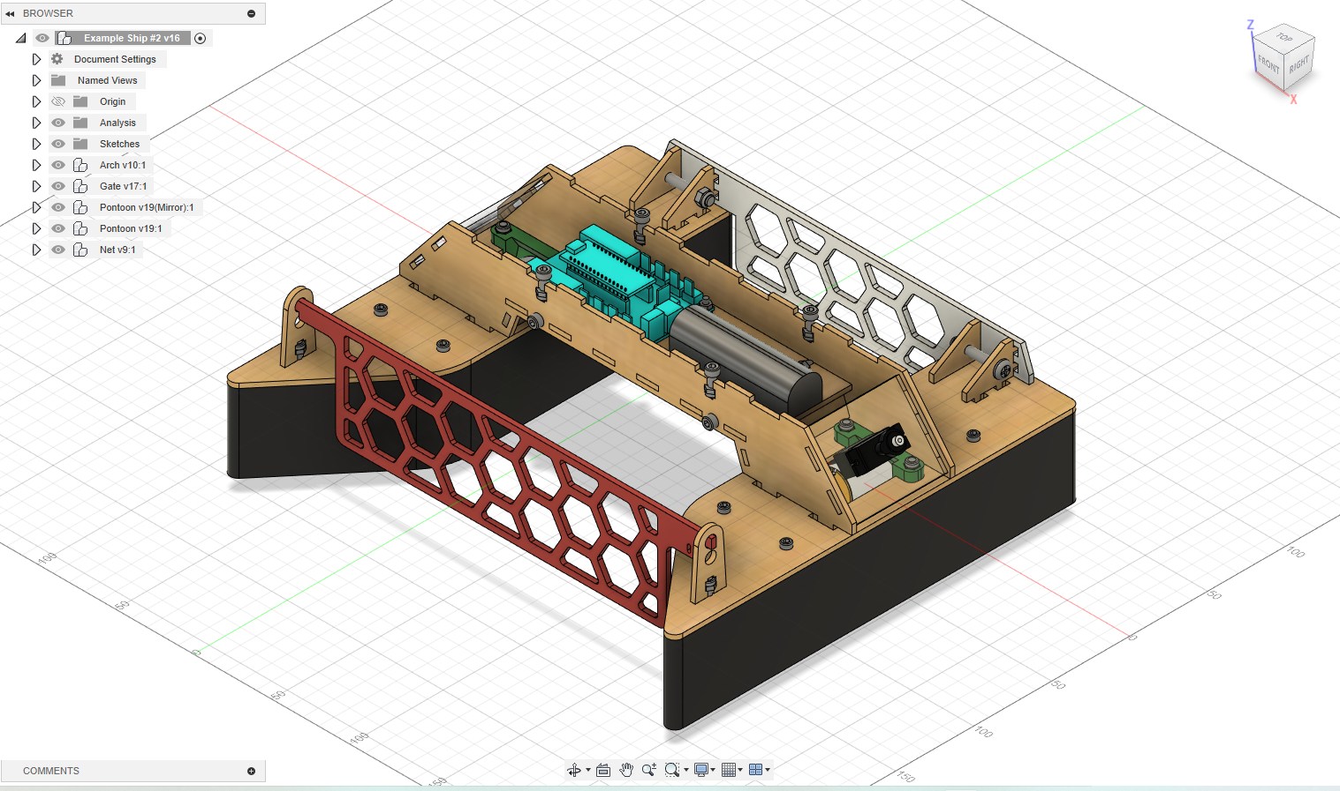
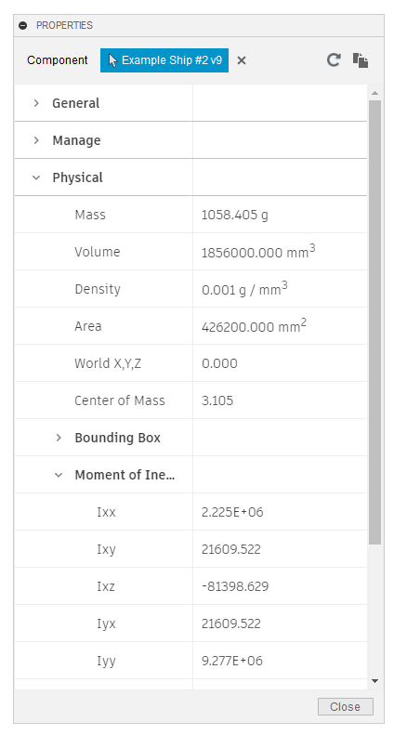
What are CAD models?
geometry & transformations
assemblies & components
materials
physical properties

Slide 10
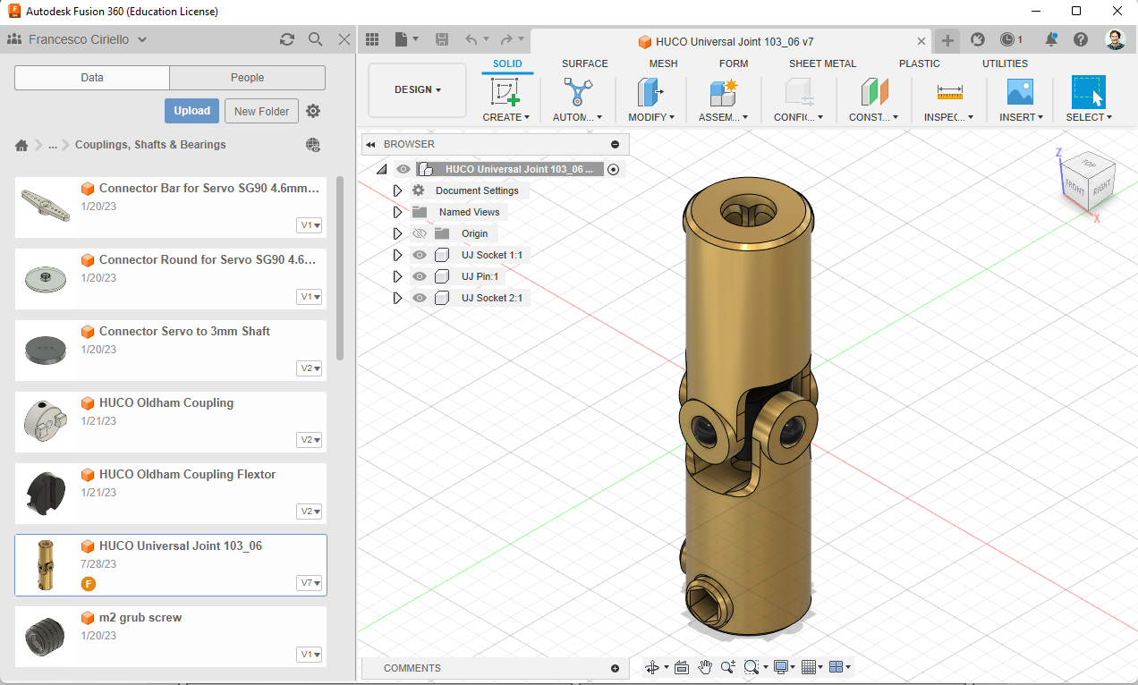
Our Virtual Component Library

Slide 11
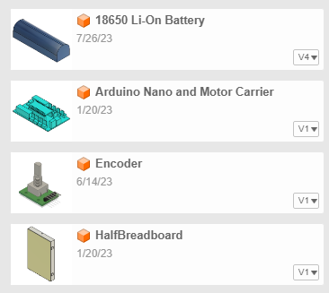
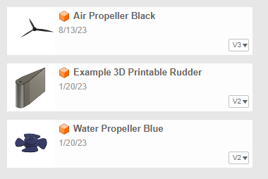
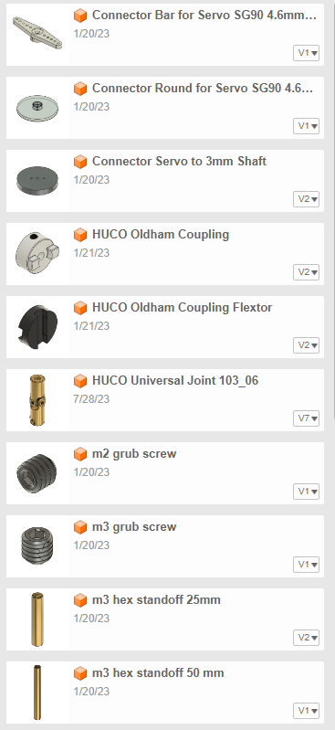
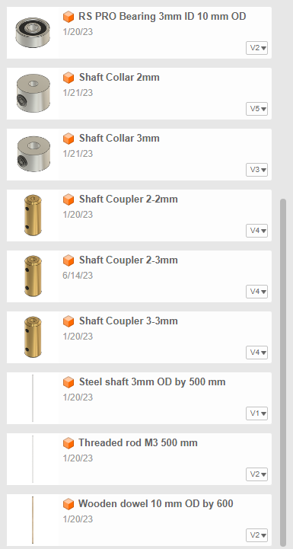
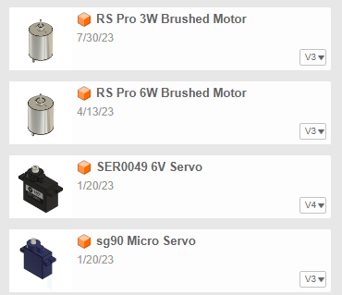
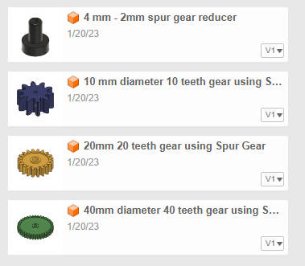
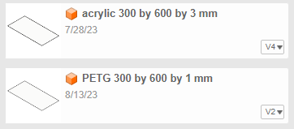
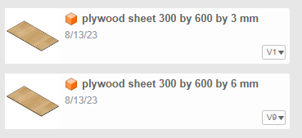
Our Virtual Component Library
electrical
propellers
couplings, shafts & sockets
gears
motors
stock materials
How can we automatically retrieve information from
our virtual library?
a new design assembled from its components?

Slide 12
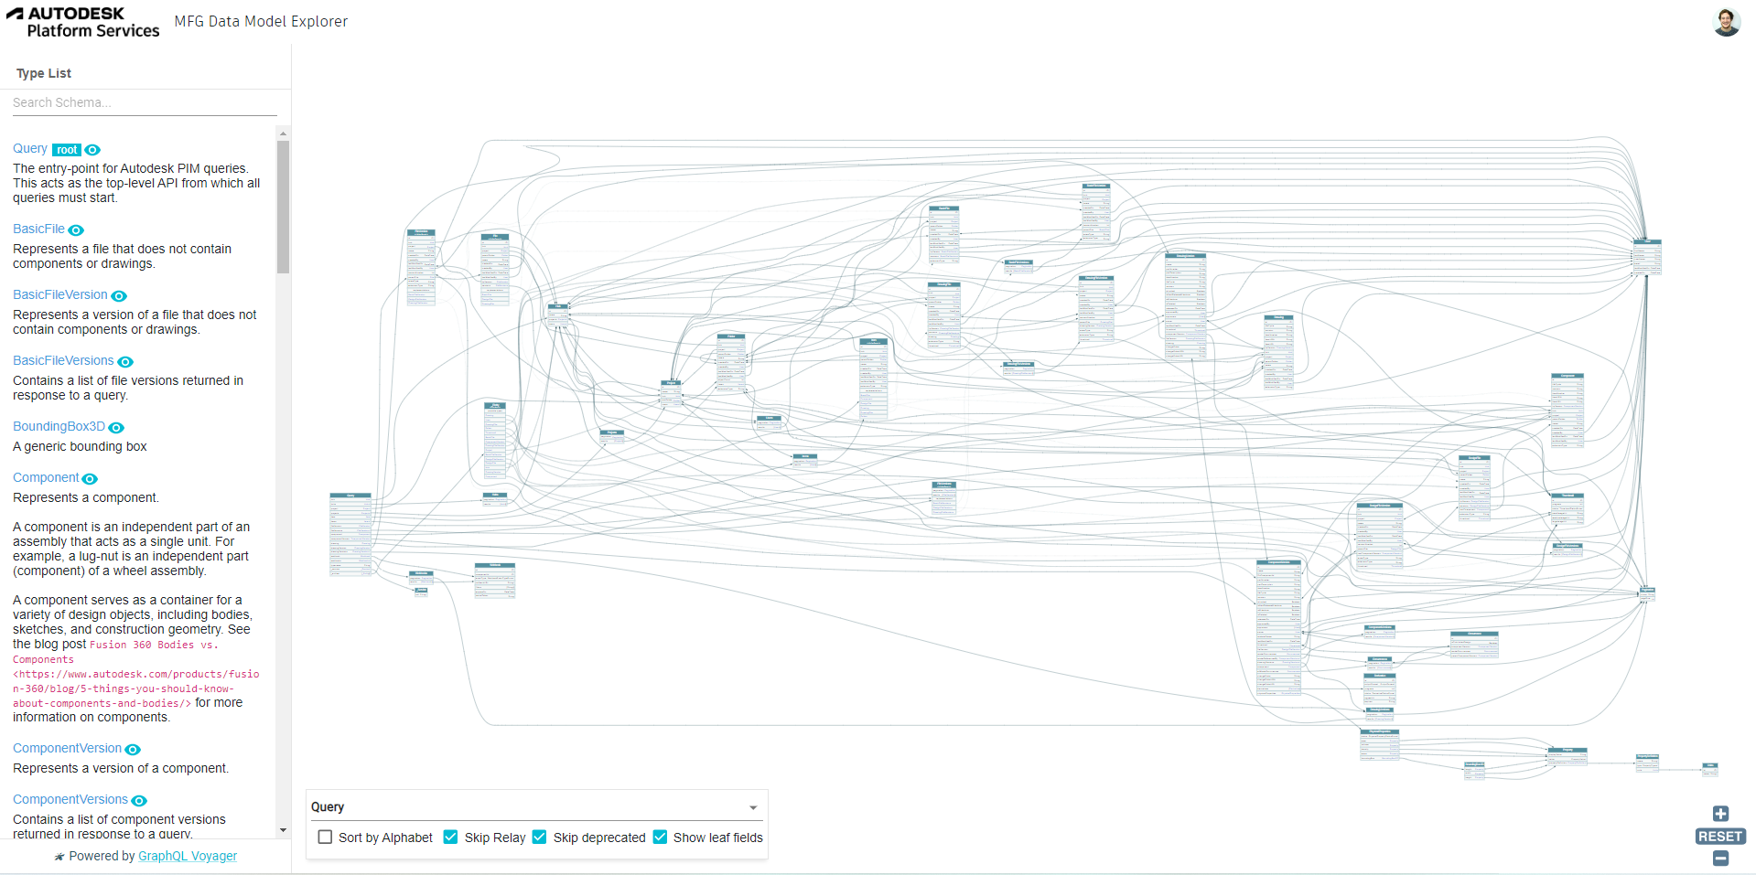
GraphQL Schema of a Fusion 360 CAD Model
https://mfgdatamodel-explorer.autodesk.io/voyager

Slide 13
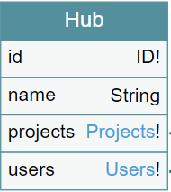
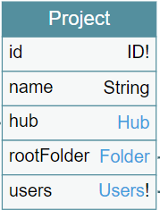
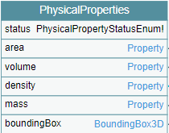
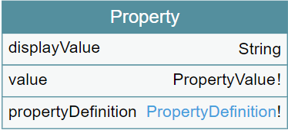
GraphQL Schema of a Fusion 360 CAD Model
https://mfgdatamodel-explorer.autodesk.io/voyager

Slide 14
GraphQL Query
.json file with material and mass data from a Fusion project / folder / assembly

Slide 15
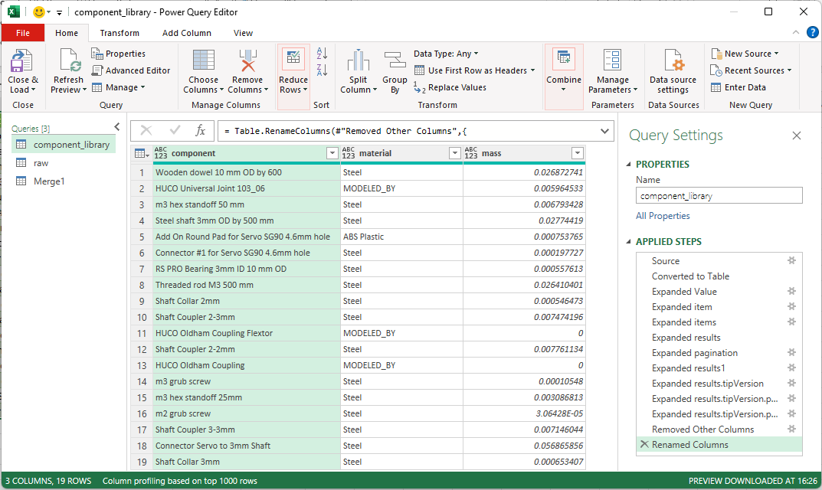
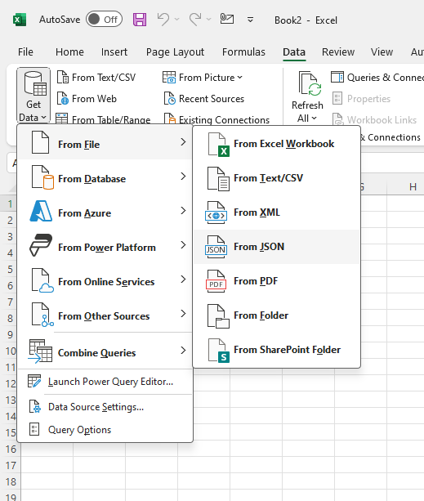
Power Query Import

Slide 16
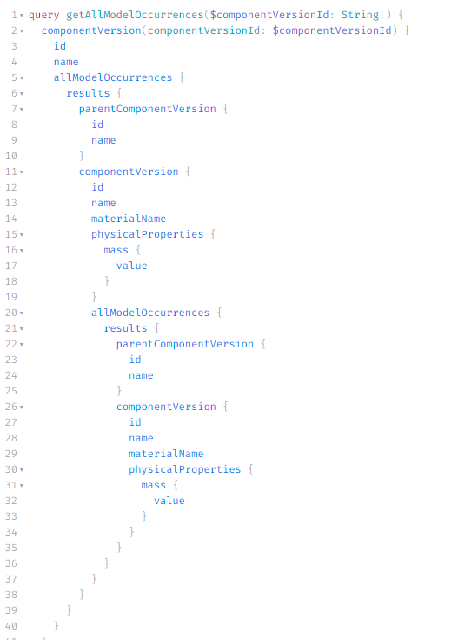
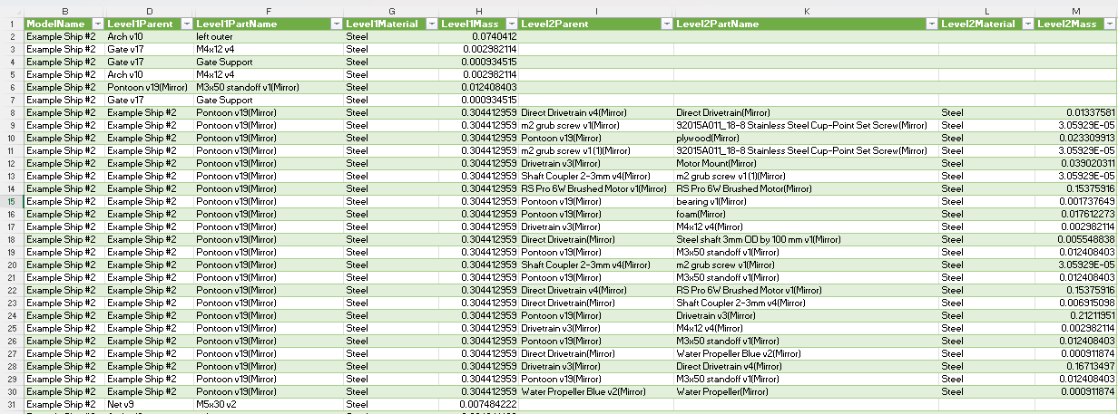
Dig into a model hierarchy
query getAllModelOccurrences($componentVersionId: String!) {
componentVersion(componentVersionId: $componentVersionId) {
id
name
allModelOccurrences {
results {
parentComponentVersion {
id
name
}
componentVersion {
id
name
materialName
physicalProperties {
mass {
value
}
}
allModelOccurrences {
results {
parentComponentVersion {
id
name
}
componentVersion {
id
name
materialName
physicalProperties {
mass {
value
}
}
}
}
}
}
}
}
}
}
Level 2 Components
Level 1 Components
Level 1 Parent
Nominal Material
Level 2 Parent
Model
Aggregate Level 1 Value
Nominal Material
Aggregate Level 2 Value

Slide 17
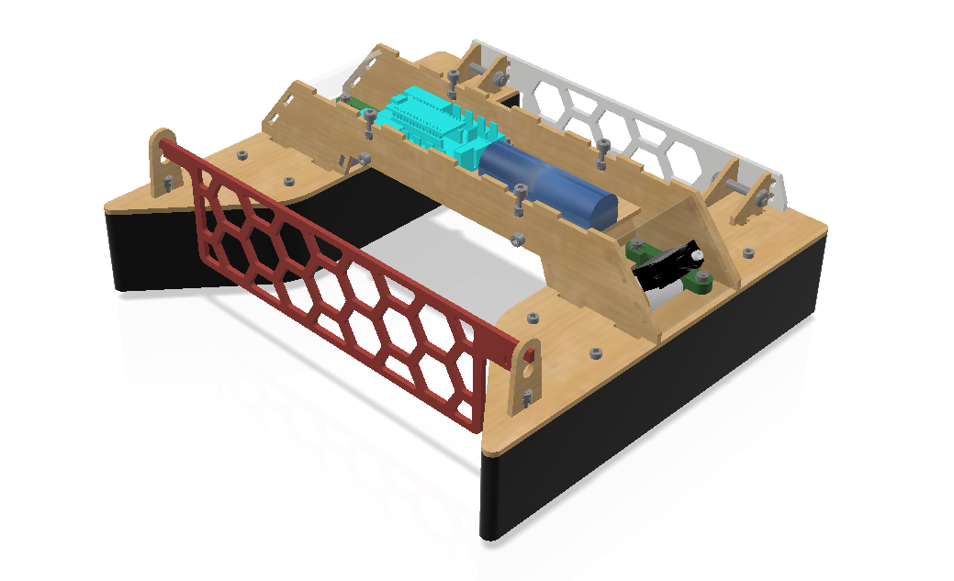
Life Cycle Assessments of Prototypes
Electromechanical
Arduino Nano 33 IoT
Li-Ion & NiMh batteries
Servomotors
Brushed DC motors
Cut & print materials
Plywood
Acrylic
PLA
PETG
Styrofoam (polystyrene)
How can we enrich this dataset to improve our decision making in design?
Mechanical
Socket Couplings
Fasteners
Universal Joints
Propellers

Slide 18
Modelling requirements for LCA from CAD
Inputs
Material properties
Name / ID
Density, g/cm³
Carbon contribution per unit / volume, g or g/cm³
Supplier properties
Manufacturer ID
Cost per volume / unit ($)
Carbon contribution per unit / volume, g or g/cm³
Component properties
Volume, cm³
Stock Volume from bounding box in cm³
Outputs
Cost per component, £
Mass, g
CO₂ potential impact per component, gCO₂eq
Alternatives
CO₂ potential savings per component, gCO₂eq
Other impacts

Slide 19
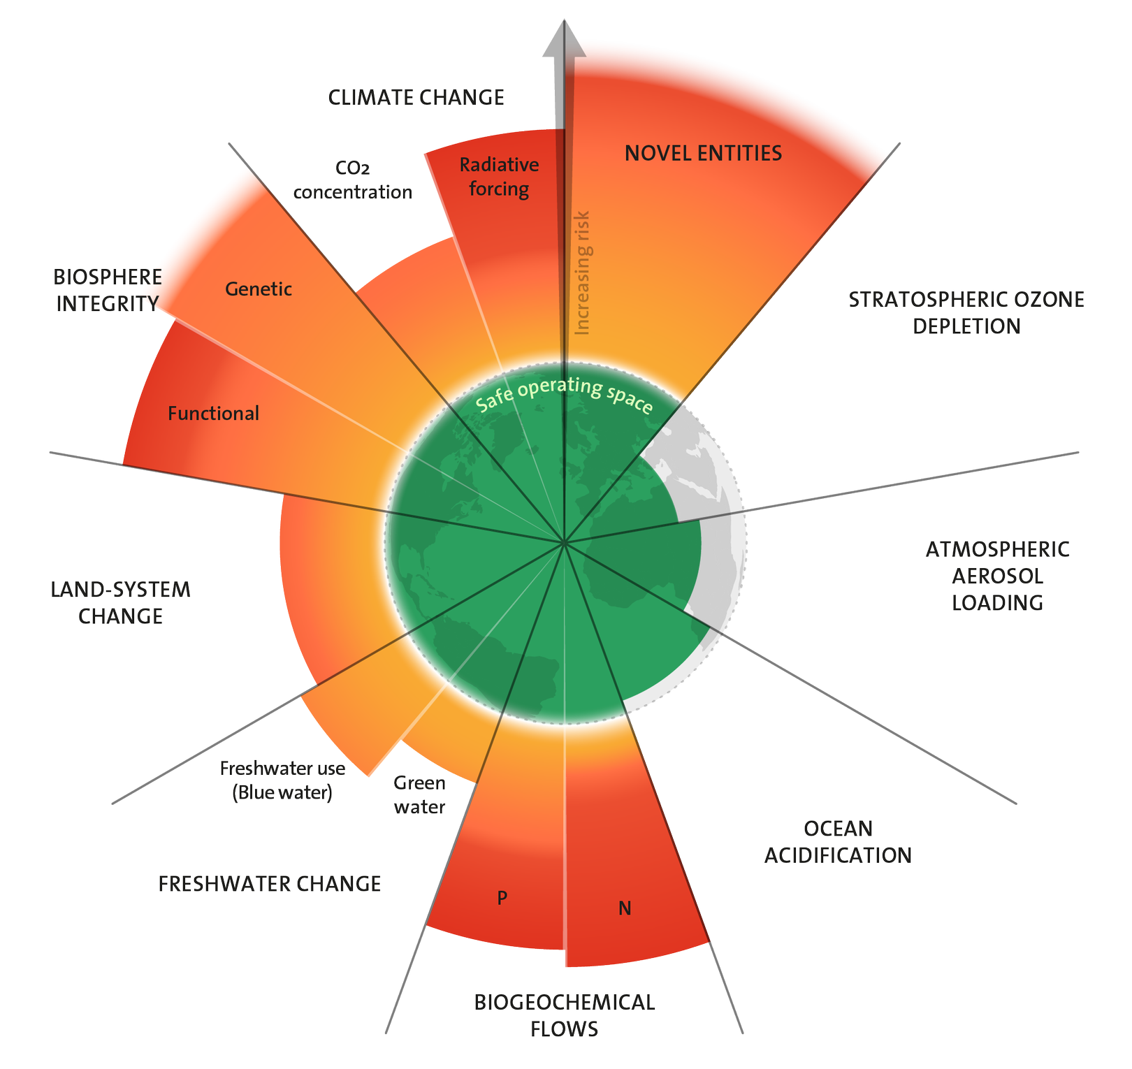
Planetary Boundaries & Sustainability KPIs
Global Warming Potential – 100 years (GWP-100a)
measured in kgCO₂eq
Acidification Potential
measured in kgSO₂eq
Ecotoxicity
measured in g1, 4DCBeq
Water use
measured in m³
Energy use
measured in MJ
Credit: Stockholm Resilience Centre (2023)

Slide 20
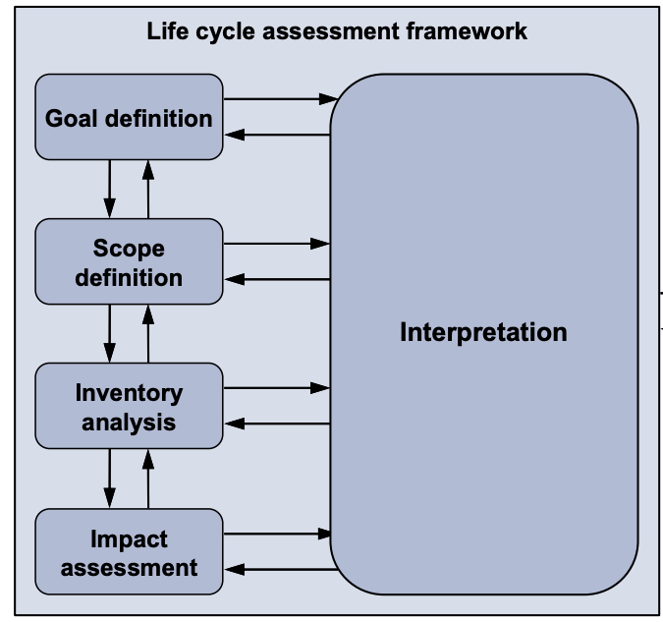
Life Cycle Impact Assessment (LCIA) Fundamentals
Life Cycle Assessments address the assessment of the environmental aspects of a product or service in its entire life cycle stages (ISO 14040)
Goal definition: What do we want to achieve?
Scope definition: What are our system boundaries?
By-Products
Emissions
to environment
Plywood Sheet
Use Phase
Manufacturing Process
End Of Life
Raw material extraction
Energy production
Cradle to gate
Transport
Cradle to grave
Credit: ILCD (2010)

Slide 21
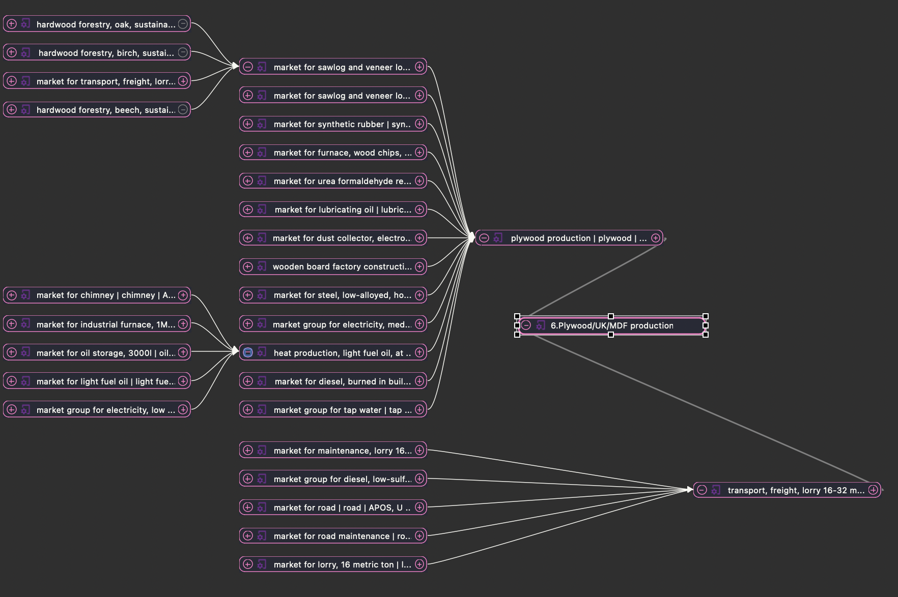
Constructing an OpenLCA-derived database for the design modules
In Eco Invent Markets are default activities with data from known suppliers/location
Process translated from our system boundaries to EcoInvent
A process diagram for plywood production in Open LCA

Slide 22
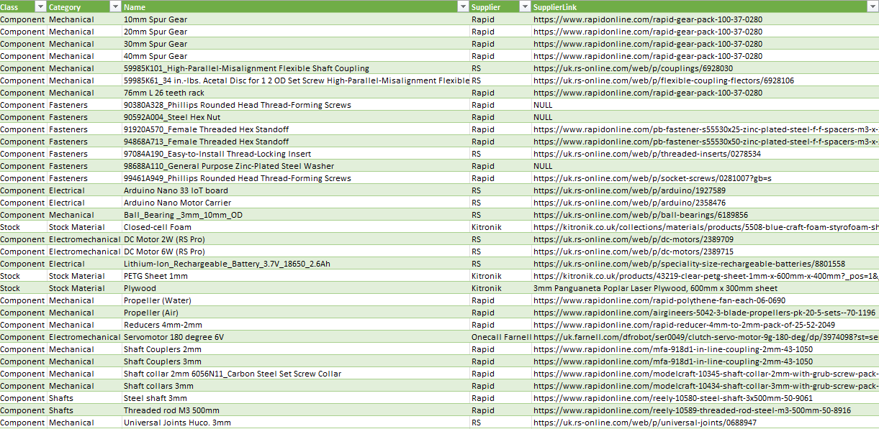
Constructing an OpenLCA-derived database for the design modules
Part
ID
Name
Supplier
Material
Mass
Cost
Impact

Slide 23
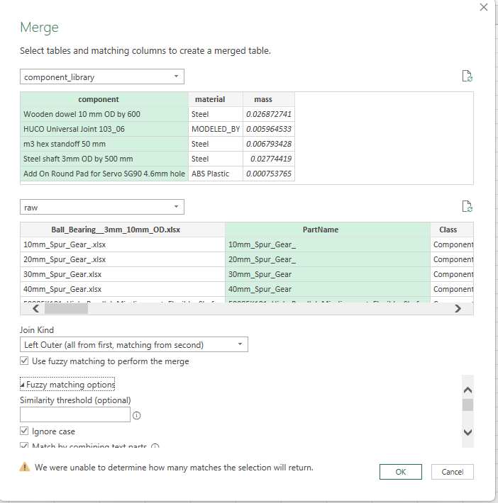
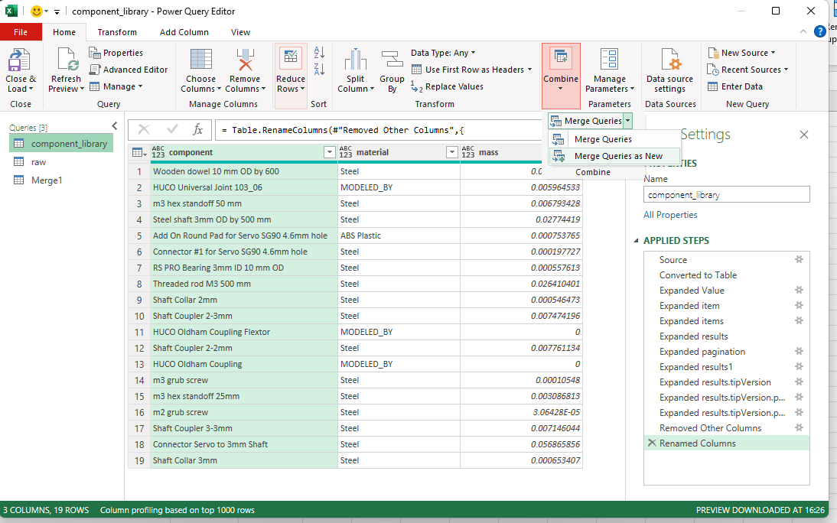
Power Query Merge

Slide 24
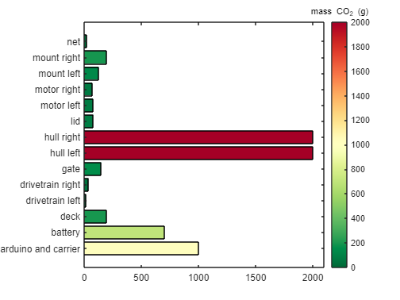
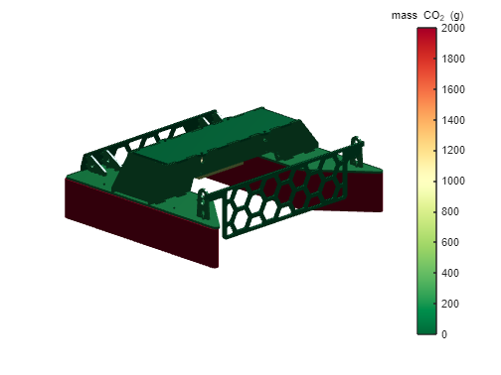
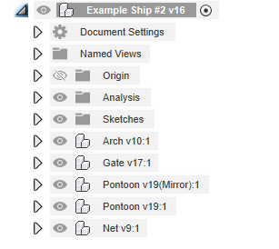
Inputs | Model | Outputs
 | Warnings: These components don’t have data. | Automated Design Feedback
-
-
Impact
Price
modelName
Level 1
Level 2
Level 3
Component Tree Diagram
GWP 100a
Water
Energy
Ecotoxicity
Aggregate
By Component
By Material
Fusion Team Files
Top impact contributors
Prompts
Opportunity savings
Improvement metrics
modelName
X
compare to:
-

Slide 25
Next Steps
Automate merging of student CAD data with our Virtual Component Library & Database
Create visualisation app for decision making
Test with learners in the design module
Create a sustainable mechanism to maintain component library and database
Dr Francesco Ciriello
Antoine El Adib
Department of Engineering
francesco.ciriello@kcl.ac.uk
Department of Engineering
antoine.el-adib@kcl.ac.uk

Slide 26
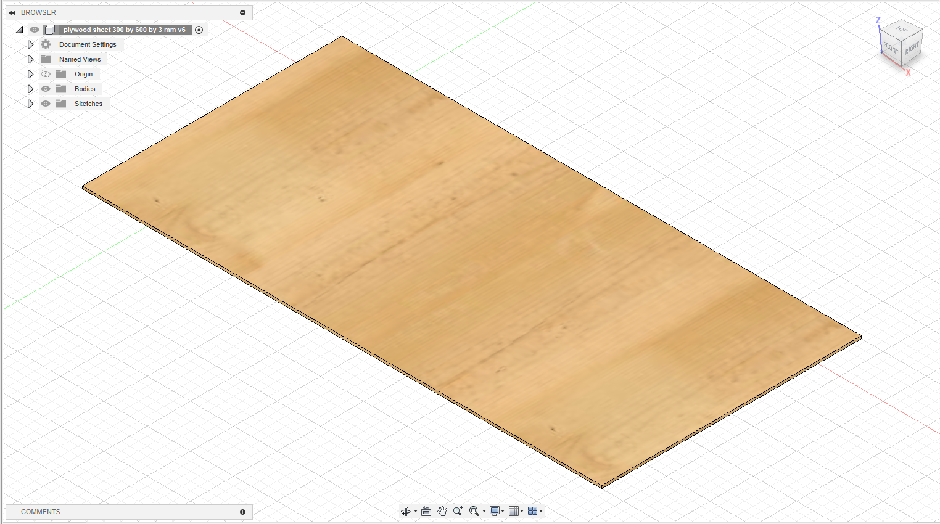
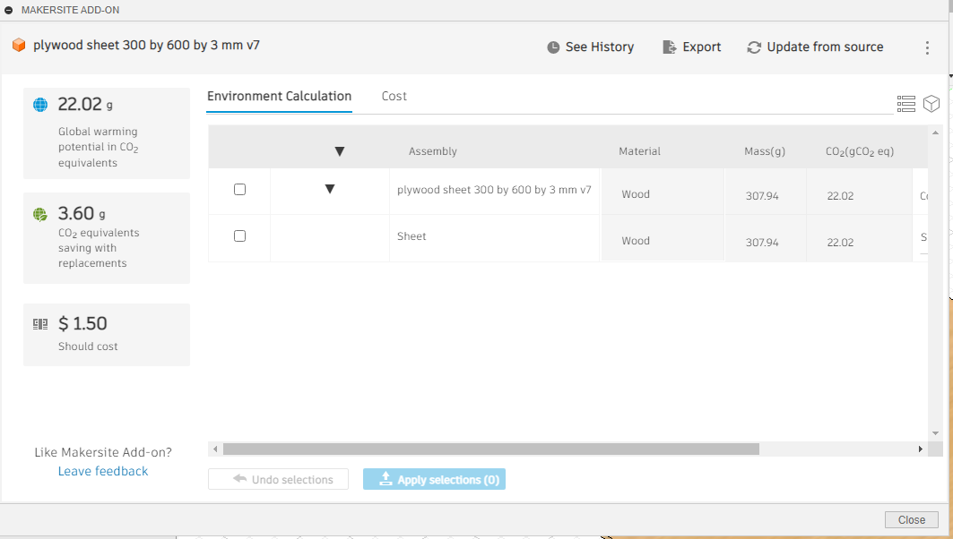
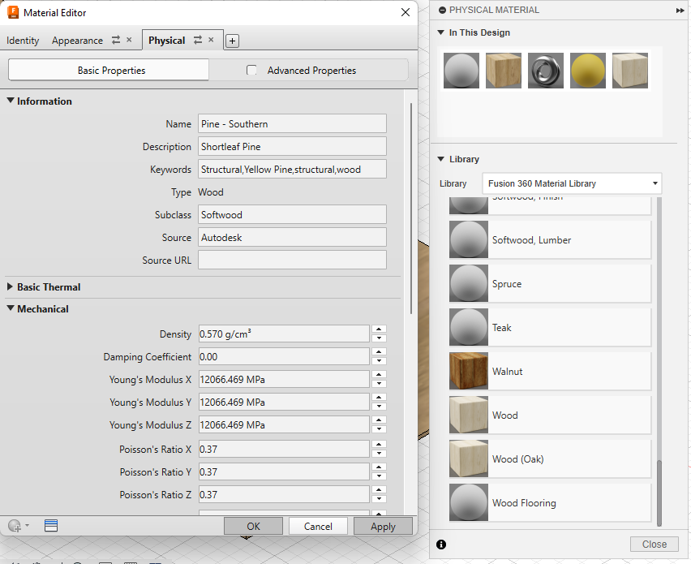
Example Case #1 : Plywood Material Sheet
Makersite plug-in works off of default Autodesk Fusion 360 material library

Slide 27
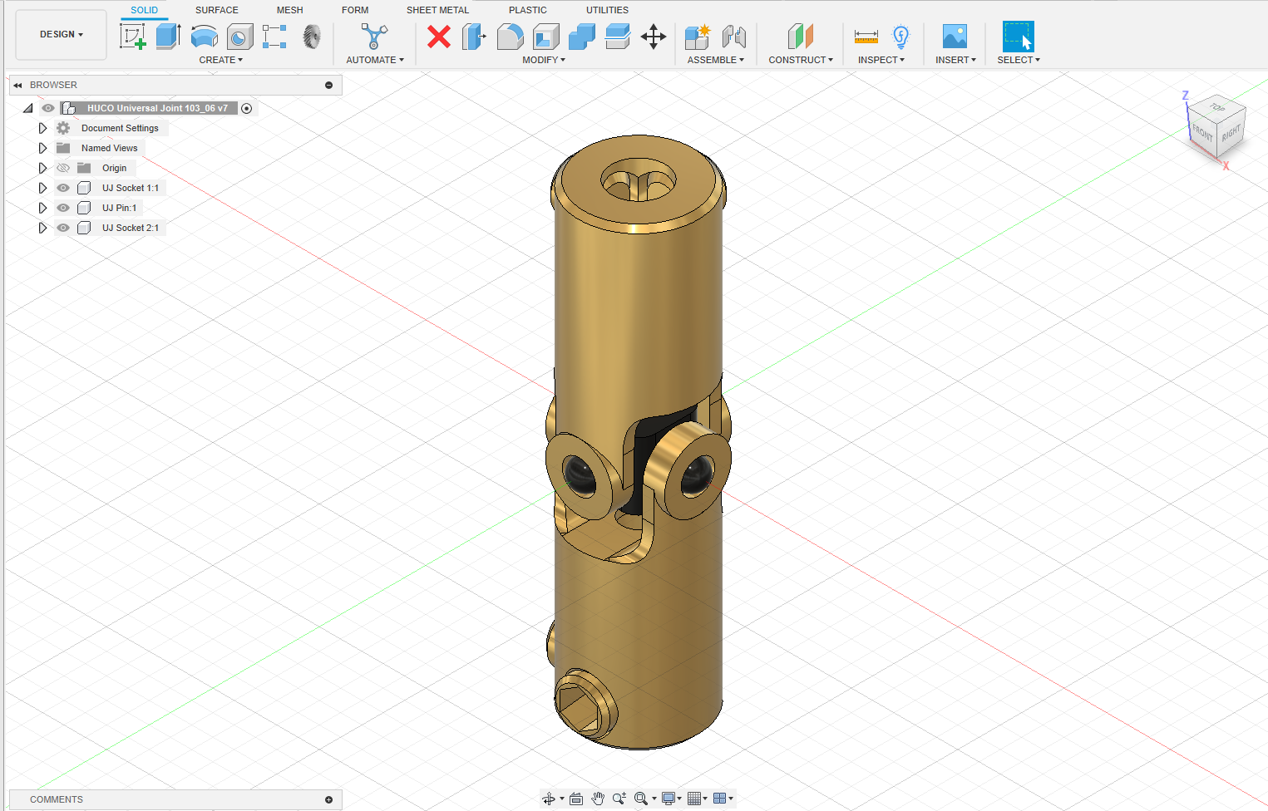
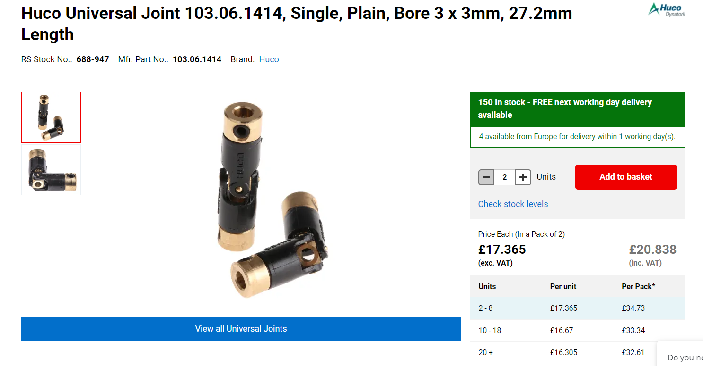
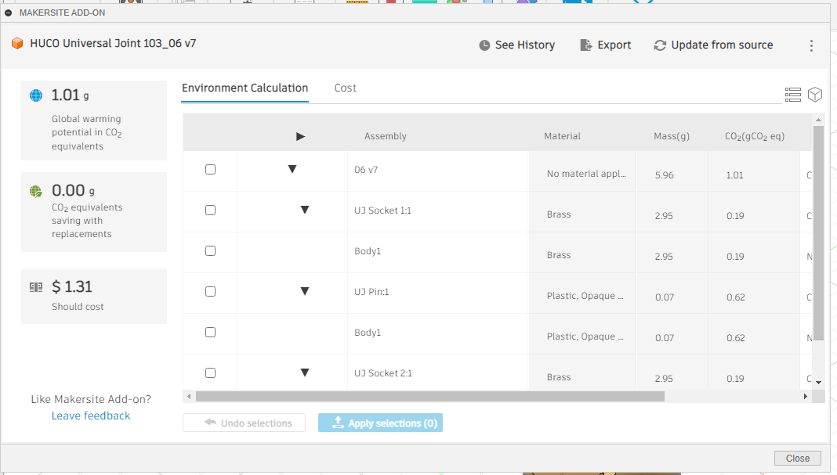
Example Case #2 : Universal Joint (Huco)
Material cost is different from unit cost

Slide 28
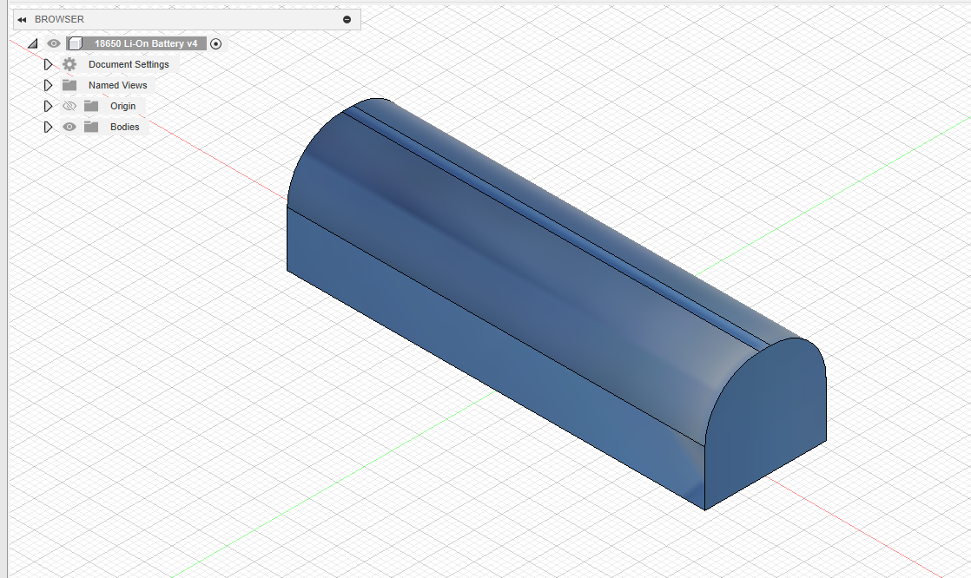
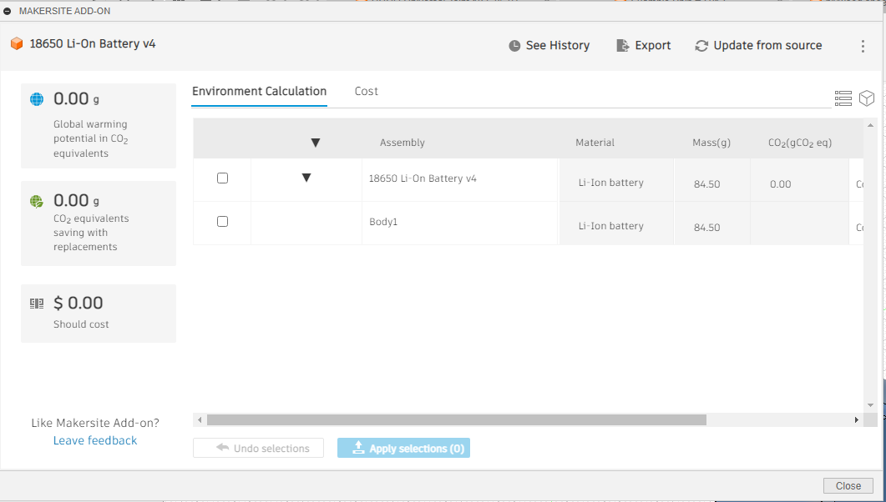
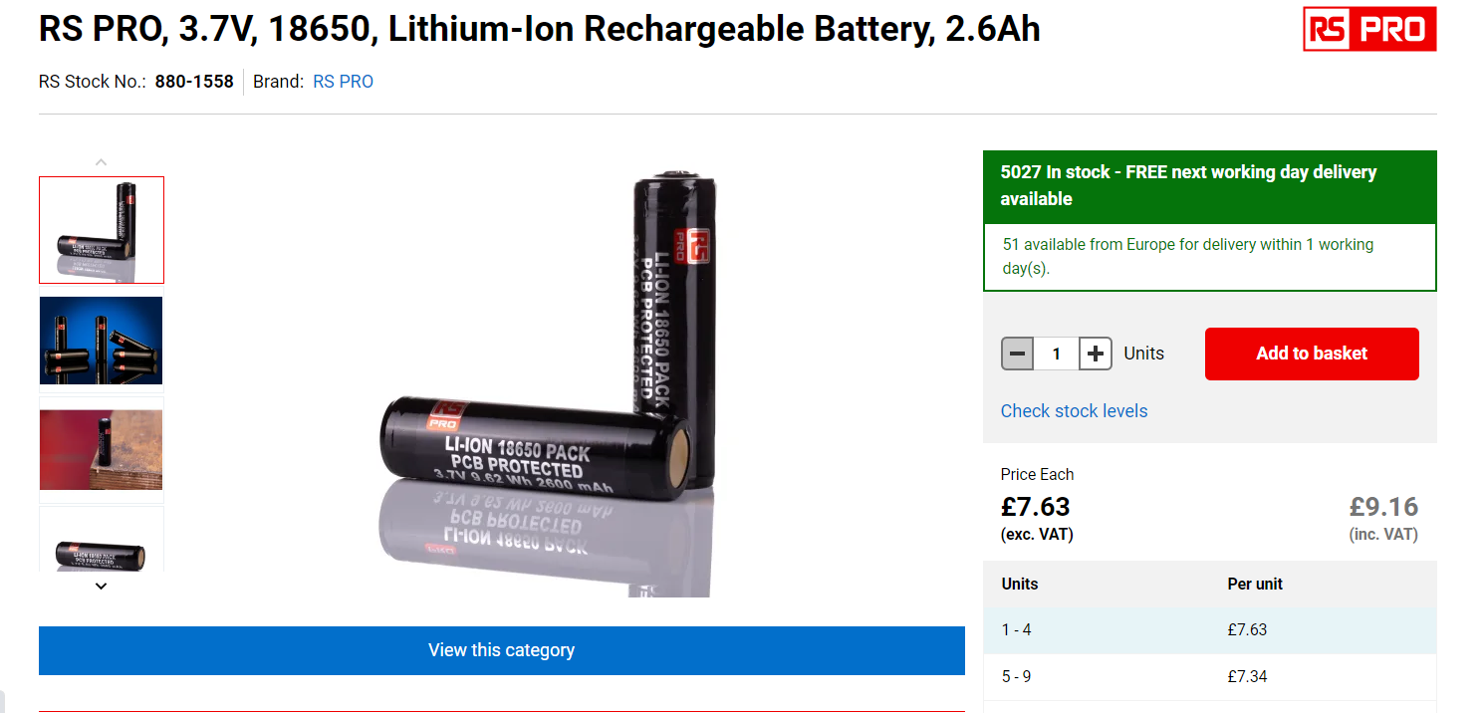
Example Case #3 : Li-Ion battery
cannot compute gCO₂eq
No default material

Slide 29
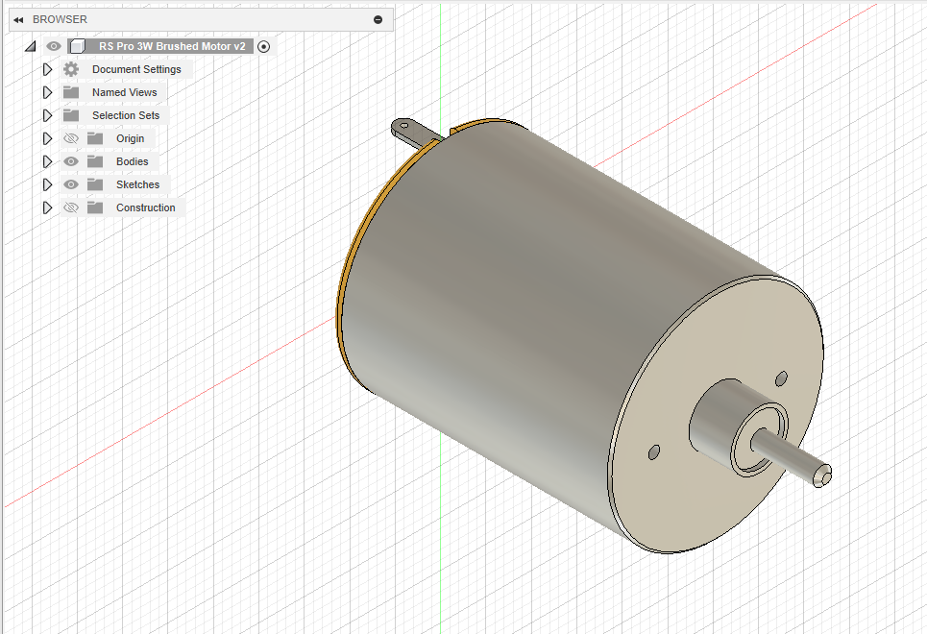
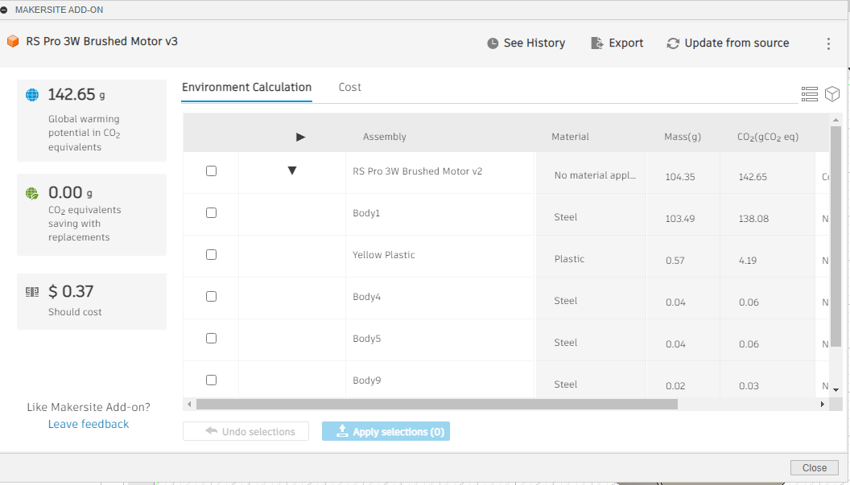
Example Case #4 : DC motor
Probably incorrectly estimating mass as not hollow
Combination of copper, steel and plastic
Missing CAD models for internal components, e.g. armature

Slide 30
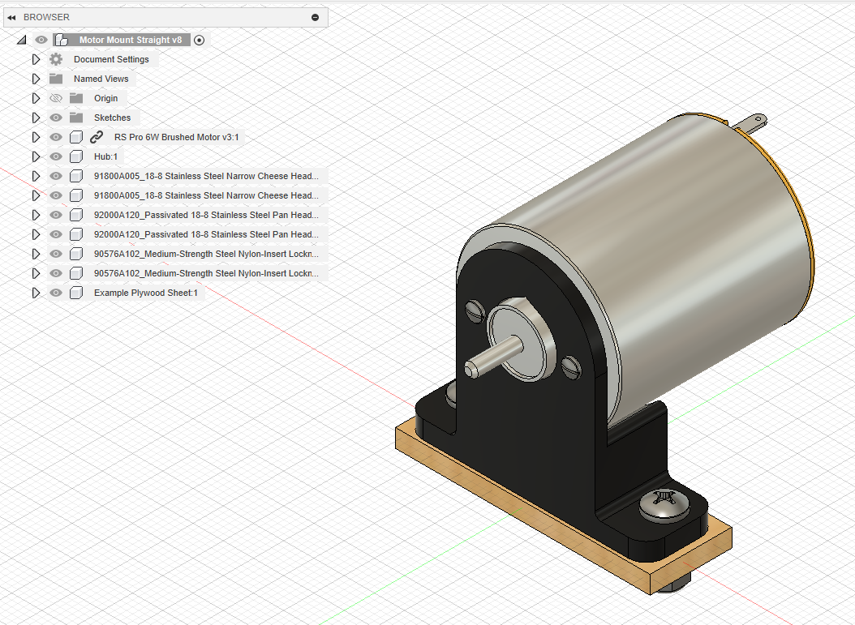
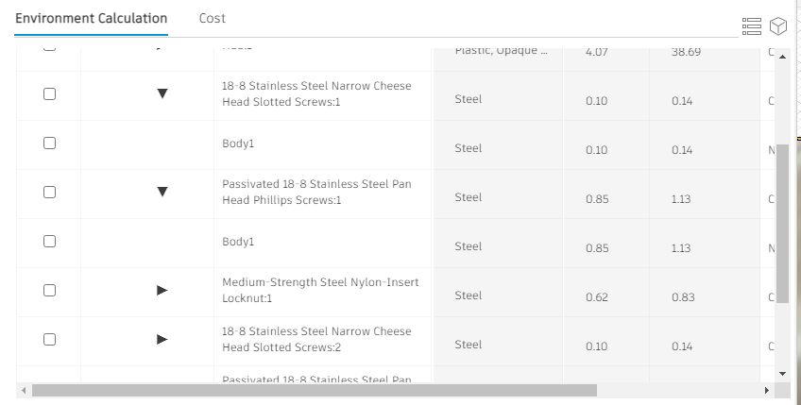
Example Case #5 : Fasteners e.g. McMaster Imports
reasonable estimates based on material

Slide 31
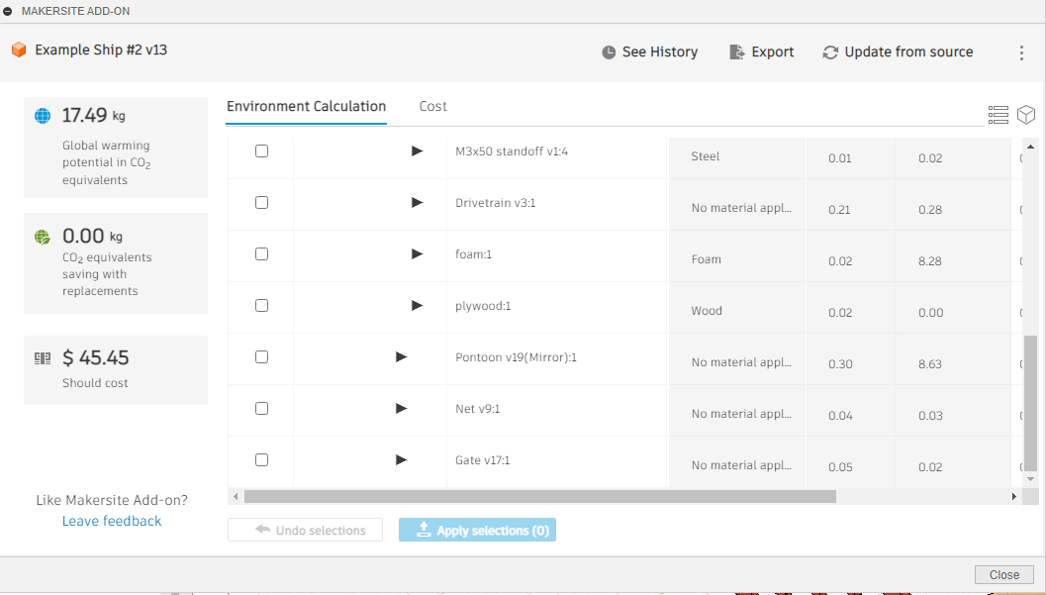
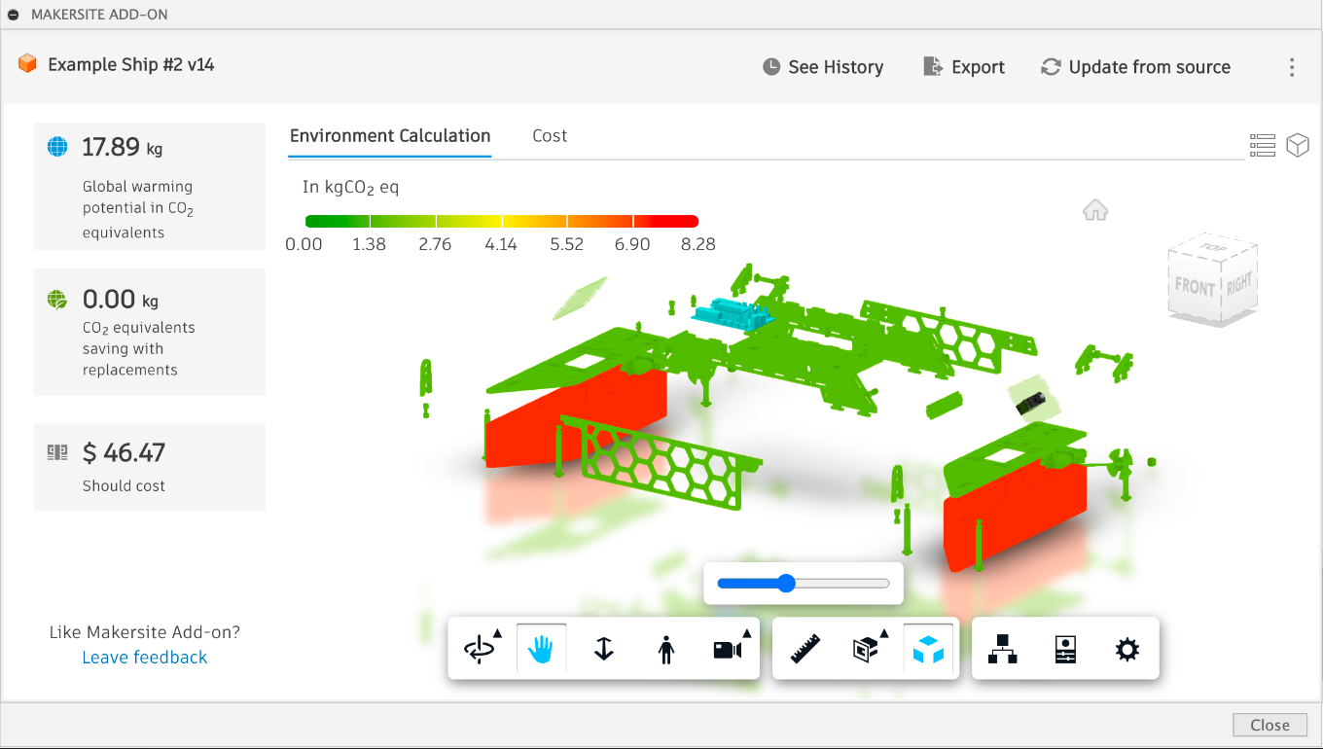
Example Case #6 : Ship Assembly
Easy to identify foam as principal contributor to gCO₂eq

Slide 32
KING'S COLLEGE LONDON
SUSTAINABILITY EVALUATION OF OUR DESIGN MODULES
USING AUTODESK'S NEW FUSION 360
MAKERSITE ADD-ON

Slide 33
What’s
New?
01
02
03
Quality control update
Chosen KPI investigation
Integrating BOM & Database
04
05
Visualisers ideation
Next steps
King’s College London | Sustainable Design Modules

Slide 34
50
40
Quality Control Results
30
20
10
0
Item 1
Item 2
Item 3
Item 4
Item 5

Slide 35
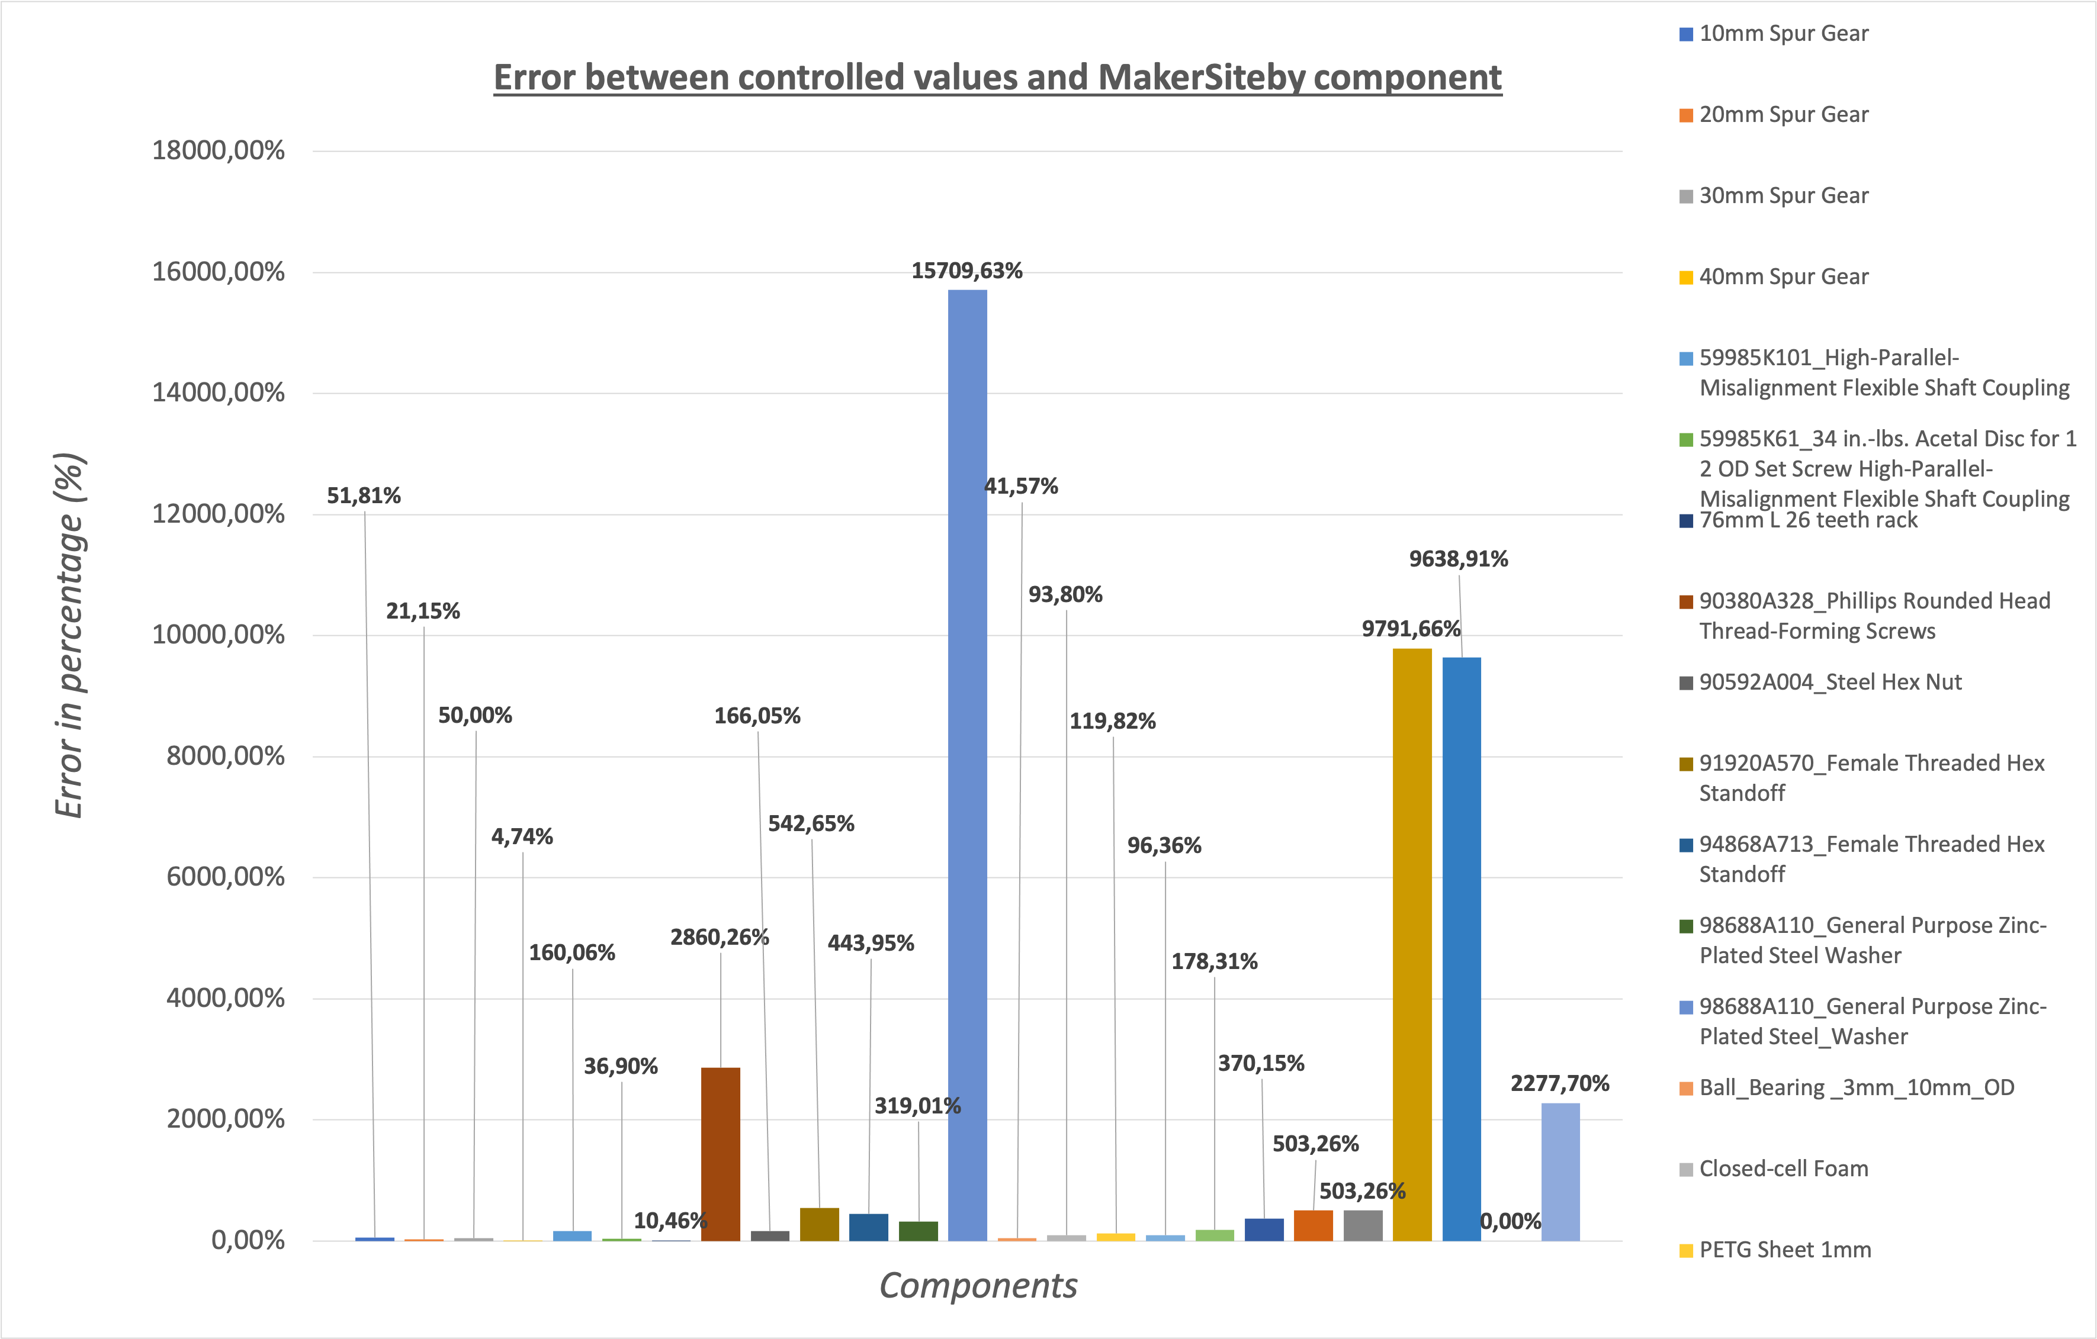

Slide 37
What do these numbers mean for us?
Quality increased however…
Makersite or Open-LCA?
We noticed a jump in average performance per material from V1/V2,however, we are still far from achieving steady qualitative results.
Difference in gCO2eq values between M-S and our database increases with the number of manufacturing processes involved. If this is especially true for components in our targeted groups, it holds for other materials.
Generally most of the errors came from uncertainties and unnecessary assumptions we could easily pinpoint and edit. However differences are still too important to be ignored.
Most of these errors might be linked to inappropriate manufacturing processes attribution in Open-LCA. It also is worth noting that we have very little information on how makersite performs calculations for us to address.
= we will perform a third round of quality control towards the end of the project

Slide 38
Additional KPIs chosen
Acidification potential - 100a (g202eq)
Acidification potential is crucial for engineers as it points directly to the product's effect on the environment's chemical balance. The release of sulfur dioxide equivalents can lead to acid rain and harm ecosystems. Understanding this metric helps us identify areas in our processes where we can minimize sulfur emissions and choose more environmentally friendly materials. It's an essential aspect of sustainable engineering design.
King’s College London | Sustainable Design Modules

Slide 39
Ecotoxicity - multiple levels (g1,4DCBeq)
This KPI assesses the potential harm a product's lifecycle may inflict on ecosystems at multiple levels (human, terrestrial, aquatic...). It quantifies the release of toxic substances, often expressed in grams of 1,4-dichlorobenzene equivalents (g1,4DCBeq). High values of this KPI indicate a greater risk of contaminating ecosystems with harmful chemicals.
Water input (m3)
This KPI is important because it quantifies how much water our product consumes throughout its life cycle. By understanding our water consumption, engineers can develop strategies to minimize waste, recycle water, and choose production methods that are less water-intensive. This not only conserves resources but also reduces costs.
King’s College London | Sustainable Design Modules

Slide 40
Energy input (MJ)
This KPI represents the total energy required to produce and operate the product. It's fascinating because it reflects our product's energy efficiency and, consequently, its economic viability and environmental impact. By analyzing this data, engineers can optimize production processes, adopt energy-efficient technologies, and reduce our reliance on non-renewable energy sources.
Oil and gas input (m3)
This KPI is intriguing because it highlights our product's reliance on these non-renewable resources. By closely examining this metric, engineers can explore alternative materials and energy sources, such as renewables and biofuels, to reduce our dependence on oil and gas. This shift not only makes our processes more sustainable but also helps us prepare for a future with dwindling fossil fuel reserves. NB: Oil amounts for total oil used throughout the product’s lifecycle.
King’s College London | Sustainable Design Modules

Slide 41
Connecting BOM to our database
Now that we have spent a considerable part of the project understanding LCA scopes and assessment methods and processes, we have collected significant data on our components and a range of KPIs.
But how we collect, store and communicate that data to students is crucial to completing their projects.
This is why before even thinking of sharing the data through visualisers we wanted to prototype through Python an early-stage product allowing our students to confront a BOM to our internal database automatically
King’s College London | Sustainable Design Modules

Slide 42
Extract relevant data
BOM Database
KPI Database
Name | Material | Mass
Comp1 | A | 5
Comp2 | B | 2
Comp3 | C | 3
Code runs through each row/component of the Makersite BOM
Name | Material | Class | KPIs
Comp4 | C | Comp | x
Comp5 | B | Comp | x
Comp1 | A | Stock | x
And checks for a match in our internal KPI Database

Slide 43
2.Matchmaking: name and/or material
Name | Material
Comp1 | A
1st row
Name | Material
Comp4 | C
Comp5 | B
Comp1 | A
Name | Material
Comp4 | B
2nd row

Slide 44
3.Preliminary storage in an empty dataframe
Comp 1 | A | KPI_1 | KPI_2 | ...

Slide 45
4.Conditional calculation
If the component is not a consumable (i.e acrylic, plywood…)
Name | Material | Mass
Comp1 | A | 5
Comp 1 | A | KPI_1 | KPI_2 | ...
*
if no match
Comp 4 | 0 | 0 | 0 | 0
+
else: leave intact in preliminary storage

Slide 46
3
Item 5
20%
Item 1
20%
2
1
VISUALISERS
0
10
12
14
16
Item 4
20%
Item 2
20%
Using Plotly
Item 3
20%

Slide 47
monitors KPI values for each part of the assembly
confronts it to a scale (either set by academics or industry standard)
at a glance information and data (ecoivent documentation)
same visualiser can be used for either:
all KPI confrontation per part
input chart per part
output chart per part

Slide 48
gradual colour increase makes it clear which components are most expensive
can be sorted per type (i.e stock material first) and compared to total stock material allowance
cost overrun graphically shown and indicated in at a glance panel

Slide 49
RESEARCH
Our next steps
Research and investigate how to extrcat and use hierarchy
Research in further depth the visualisers offered by plotly
Research how we can include and use meshes as visualisers
Test our prototype through a range of BOMs and databases
Pinpoint the weaknesses of the program and harvest the structure of the BOM
DESIGN&TEST
Design 5+ visualisers to prototype the following weeks
King's College London | Sustainable design modules

