Slide 1
iDecide: Quantifying Uncertainty in Models using Artificial Intelligence for Personalised and Shared Decision-Making in Digital Health.¹ ERiMA: Envisioning Risk Models for Assessment of AI-based applications.²
Dr Huma Samin ¹
Post Doctoral Research Associate Computer Science
Durham University, UK
huma.samin@durham.ac.uk
Dr Nelly Bencomo ^{1,2}
Associate Professor in Computer Science
Durham University, UK
nelly.bencomo@durham.ac.uk
Prof Dorothy Monekosso ^{1,2}
Chief Technology Officer
More Life UK, Ltd
dorothy.monekosso@more-life.co.uk
Dylan J Walton ¹
Research Assistant
Durham University, UK
dylan.walton@durham.ac.uk
Prof Peter Sawyer ²
Professor Emeritus
Aston University, UK
p.sawyer@aston.ac.uk
Dr Andrew Darby ²
Research Associate
Durham University, UK
andrew.g.darby@durham.ac.uk

Slide 2
Personalized and Shared Decision-Making
To achieve: Patient’s Target Health Goals
Consultation
Preferences
Values
Beliefs
Past Health Records
Doctor Shares Information
Patient considers Options
Together they make
Decisions
Notes:
It is a collaborative process through which a clinician supports a patient in deciding about their treatment and achieve the patient’s target health goals in correspondence with the patient’s preferences, values, beliefs and past health records.
Moreover, the treatment plan can be adjusted over time by the clinician based on the patient’s response to the specific treatment and satisfaction with the target goals.
Explicit treatment of uncertainty is essential as there is uncertainty in how the patient will respond to the treatment.

Slide 3
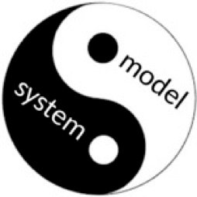
Research Background
Decision-Making under Uncertainty
Self-Adaptive Systems
Models @Runtime
Abstract representations that should be:
causally connected to the system being modelled
offers reflective capabilities.
The system changes The runtime model changes
Notes:
I will briefly discuss about our research background. We have been working in the area of decision-making under uncertainty. Specifically in the domain of Self-Adaptive Systems. The idea is to have a Model@Runtime that supports the decision-making process. i.e. to have a runtime model as an abstract representation of the system that is causally connected to the system and offers reflective capabilities. When there is a change in the state of the system, the runtime model also changes and other way around.

Slide 4
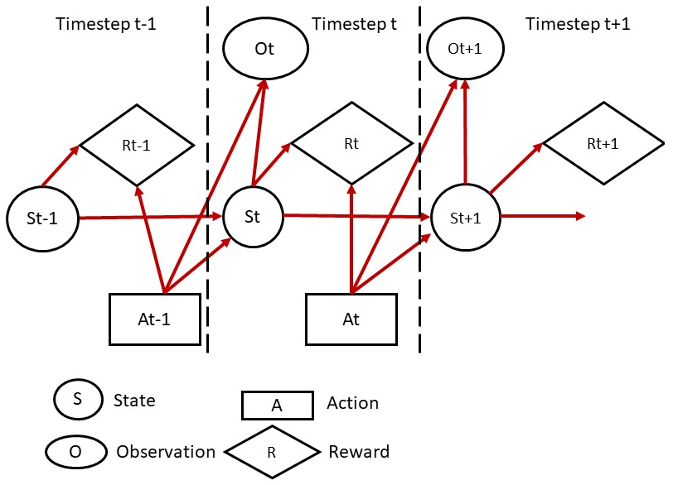
Research Background
Partially Observable Markov Decision Process
Model@Runtime for multi-objective decision-making for Self-Adaptation.
* Samin, Huma, Nelly Bencomo, and Peter Sawyer. "Decision-making under uncertainty: be aware of your priorities." Software and Systems Modeling (2022): 1-30.
Notes:
In our research, we have been working with Partially Observable Markov Decision process as a Model@Runtime for multi-objective decision-making for self-adaptation. POMDPs consider the system working in a partially observable environment where the states of the system are not directly observable known as hidden states. Instead, a belief over the hidden state is maintained.

Slide 5
Aims of the Projects
Map the experience with decision-making under uncertainty from the domain of Self-adaptive systems to cases of personalized and shared decision-making for digital health. ¹
Risk and Value Analysis based on the decisions: To perform exploratory analysis to study the relationship of decisions for the treatments/interventions over time and the goals achieved while identifying risk levels and utility value of the decisions made. ^{1,2}
To design and develop AI Risk Model-driven Analysis Framework.²
Notes:
Map the experience with decision-making under uncertainty from the domain of SAS to cases of personalised and shared decision-making for digital health. The cases will be provided by More Life UK Ltd (https://www.more-life.co.uk/) for adjusting diet plans and exercise routines for weight management for NHS patients.
Risk and Value Analysis based on the decision: To perform exploratory analysis to study the relationship of decisions for the treatment over time and the goals achieved while identifying risk levels and utility value of the decisions made.

Slide 6
Case Study: Weight Management
Goal: Maximizing Benefits and Minimizing Risks
Type 2 Diabetes, Hypertension, and Sleep Apnea
Decisions: Bariatric Surgery or Adjust Diet Plan and Exercise Plan
Observations: Symptoms and Past Health Records
BMI> 40
BMI between 35 and 40 + Obesity related Conditions: Type 2 Diabetes, High Blood Pressure
BMI between 30 and 40
BMI less than 30
Notes:
Bariatric or metabolic surgery is used as a treatment for people who are very obese.
It can lead to significant weight loss and help improve many obesity-related conditions, such as type 2 diabetes or high blood pressure.

Slide 7
POMDPs
Time t-1
Time t
Time t+n
A
A
…
A
NFR
NFR
NFR
NFR
NFR
NFR
State
State
State
O
R
O
R
R
O
Action Node
State node
Observation node
Reward node

Slide 8
POMDPs
Time t-1
Time t
Time t+n
Treatment
Treatment
…
Treatment
NFR
NFR
NFR
NFR
NFR
NFR
Benefits/Risks
Benefits/Risks
Benefits/Risks
Symptoms
EU
Symptoms
EU
Symptoms
EU
Action node
State node
Observation node
Reward node

Slide 9
Risk Analysis using Surprise
Surprise is a measure of unexpectedness.
Different probabilistic measures:
Bayesian Surprise
Confidence Corrected Surprise
Bounding Surprise using Sigmoid Function
F(x) = 1 / (1 + e^{-x})
Notes:
An important part of this analysis will be the use of surprise to assess the situations of failure where some requirement is unsatisfied. The way surprise and failure are linked is that a surprising event will be determined to be where failure occurs, more specifically where a previously satisfied NFR switches to being unsatisfied.

Slide 10
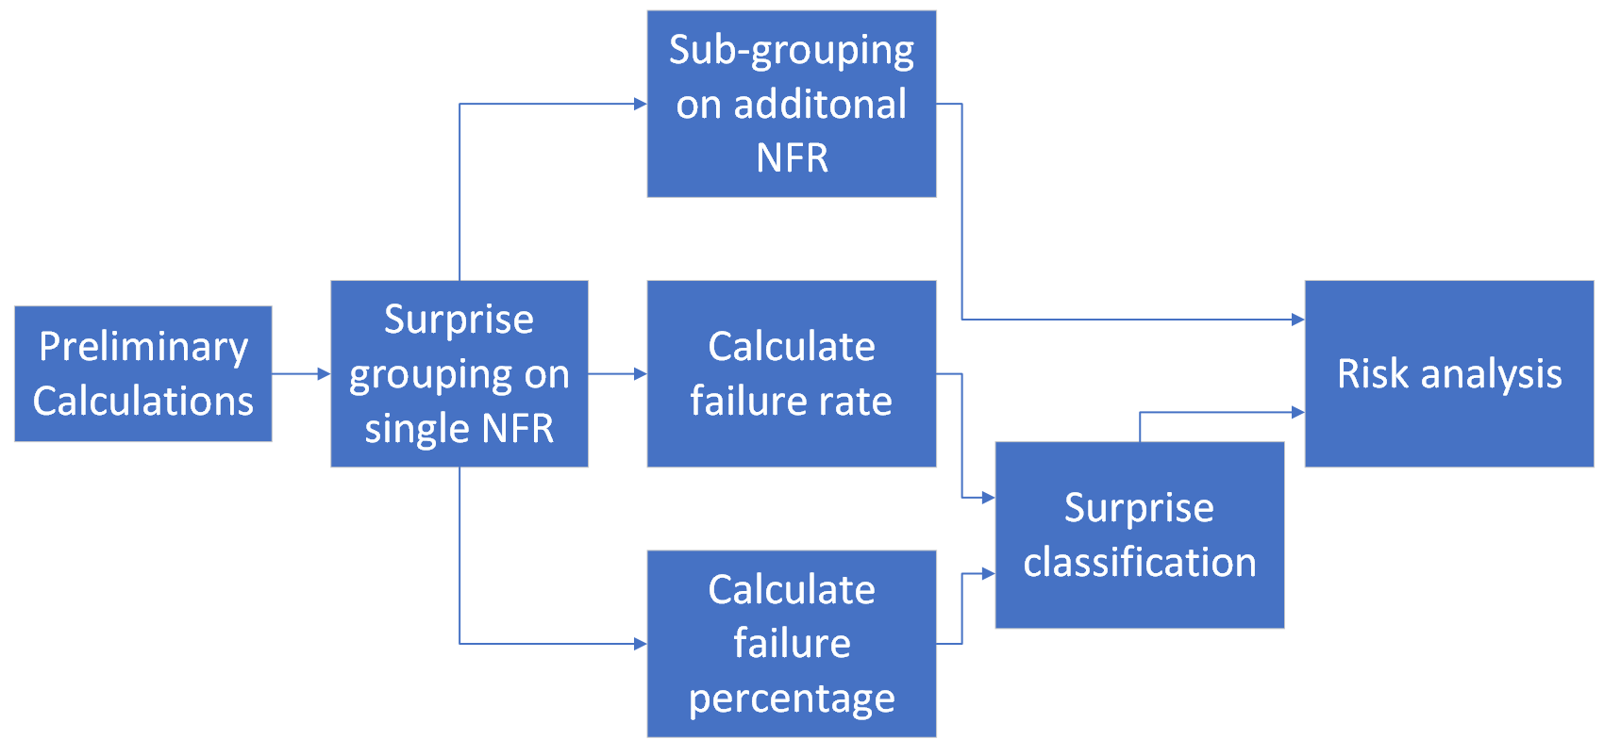
Risk Analysis Framework
Notes:
Here, the surprise values are grouped in some intervals according to the size of surprise, and as surprise value is between 0 and 1 so are the interval bins.
This technique allows us to further focus on the separate bins allowing a more thorough analysis of the contents. We can also ”bin” the results of the subset of surprises where failure occurs in the same way, and using these two values we can calculate the failure rate of a given group.
Failure Rate for NFR: dividing the number of surprising elements in a group by the number of all elements in the group.
Failure Percentage: dividing the number of surprising elements in a group by the number of surprising elements in all groups.
The next method for identifying high risk groups for classification is by breaking down what is happening in the other NFR when failure occurs. What is done here is that for one of the groups produced in the binning, we can break down this group further using the exact same technique. However, now we will be looking at the surprise values of the other NFR to see if there are any links that might help us identify risk

Slide 11
Case Study
Remote Data Mirroring (RDM)
Copies of important data are stored at one or more secondary locations
Goal: Protect data against loss and unavailability
Can be configured (adapted) in terms of two Remote mirroring protocols (Topologies)
Adaptation actions/interventions
Minimum spanning tree (MST)
Redundant topology (RT)
++ MC but --MR
-- MC but ++MR
Trade-off and Optimization of Quality Properties; aka non-functional requirements (NFR)
Minimization of Costs (MC)
Maximization of Performance (MP)
Maximization of Reliability (MR)
under environmental uncertainty of link failures and varying ranges of bandwidth consumption
*Samin, Huma, et al. "RDMSim: an exemplar for evaluation and comparison of decision-making techniques for self-adaptation." 2021 International Symposium on Software Engineering for Adaptive and Self-Managing Systems (SEAMS). IEEE, 2021.
Notes:
RDM is a data protection technique that stores copies of data at physically isolated locations to protect data against loss, unavailability, or corruption.
It can be an application for Microservices as well! Any autonomous system in fact.

Slide 12
Risk Analysis

Slide 13
Risk Analysis
Bayes MC Classifications
Low | 0.3
Low-mid | 0.7
Middle | 0.4
High-mid | -
High | 0.5, 0.6
CCS MC Classifications
Low | 0.4
Low-mid | 0.7
Middle | 0.2
High-mid | -
High | 0.5
Risk Levels based on Failure Rate

Slide 14
Research Outputs
Workshop Paper:
Walton, Dylan J., Huma Samin, and Nelly Bencomo. "Modelling Uncertainty for Requirements: The Case of Surprises." 2023 IEEE 31st International Requirements Engineering Conference Workshops (REW). IEEE, 2023.
Tutorial:
Andrew Darby, Peter Sawyer, Nelly Bencomo. “Speculative Design and Requirements Engineering.”, IEEE 31st International Requirements Engineering Conference Tutorials, 2023.

Slide 15
Next Steps
Explore further the case of PSDM by exploring different patient profile cases in consultation with MoreLife, UK.
Applying decision-making offered by POMDPs for PSDM, and evaluate the decision-making offered.
Research Funding:
In collaboration with NHS:
EPSRC IAA : WeDecide: Clinical Tool For Shared Decision-Making For Treatment Of Menopause Symptoms

Slide 16
Thank You

