Slide 1
BEtter Smart Software fastER (BESSER): an open-source low-modeling low-code platform to develop smart software
Iván Alfonso, Marcos Gomez, Aaron Conrardy, Jordi Cabot
Luxembourg Institute of Science and Technology (LIST)
5/12/23

Slide 2
Table of Contents
01
Why BESSER?
02
BESSER Project Overview
03
BESSER Bot Framework
04
Conclusion and Future Steps

Slide 3
Low-code application platforms accelerate app delivery by dramatically reducing the amount of hand-coding required
– Forrester Report
Low-code is the evolution of previous model-based approaches (MDE, UML, MDA, …) where most of the application code is automatically generated from high-level designs of the system

Slide 4
WHY LOW-CODE
Quality
Growing market
Models can be tested and verified before starting the coding phase
06
01
The worldwide market for low-code is projected to $26.9 billion in 2023, a 19.6% increase from 2022.
Low-code
Productivity
Clients demand it
02
Automation techniques take care of generating most of the system code (e.g. all the boilerplate code)
05
All major players (Amazon, Microsoft, Google,…) are adding low-code/no-code solutions to respond to this demand
Portability
Low-code everywhere
04
03
Model once deploy everywhere by just using different generators on top of the same model
Most software projects will ship with components developed with low-code tools in 2025

Slide 5
Smart software systems – Low-code coverage
Trad Software
AI component

Slide 6
Indeed, low-code platforms are limited to data-entry web apps
AI
NLP
Data Spaces
Digital Twins
AR/VR

Slide 7
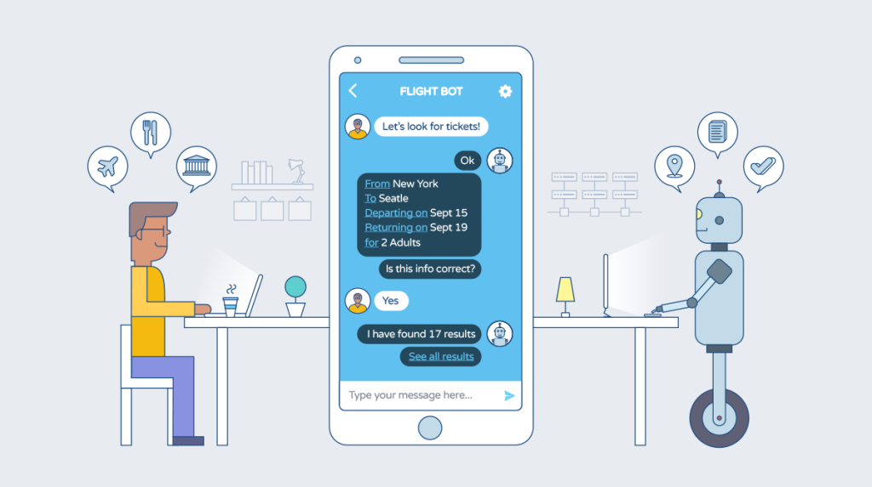
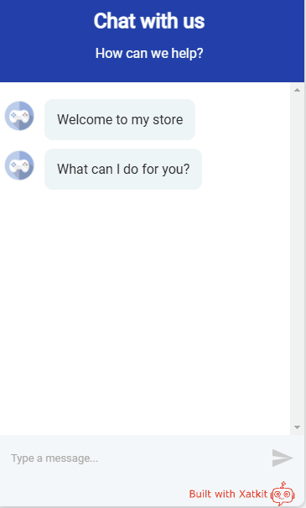

Slide 8
BESSER Project
Building Better Smart Software Faster

Slide 9
KEY FACTS
01
BESSER is a low-code approach to develop AI-enhanced software, often referred to as smart software
04
BESSER is a 5-year FNR PEARL project. BESSER will benefit of the +20 years of research experience of the PI on these topics
02
BESSER will provide a single editor to model both traditional and smart components as well as possible ethical concerns
05
Some BESSER components will be released as OSS. BESSER aims to be the OSS low-code platform of Lux (at least), a market not covered by other vendors
03
BESSER will provide tools to generate and test all modeled components altogether (e.g. a chatbot, the web UI, the database, a prediction system…)
06
Commercial extensions will be allowed. We will be happy to help you adapt and plug your tools/services on top of BESSER

Slide 10
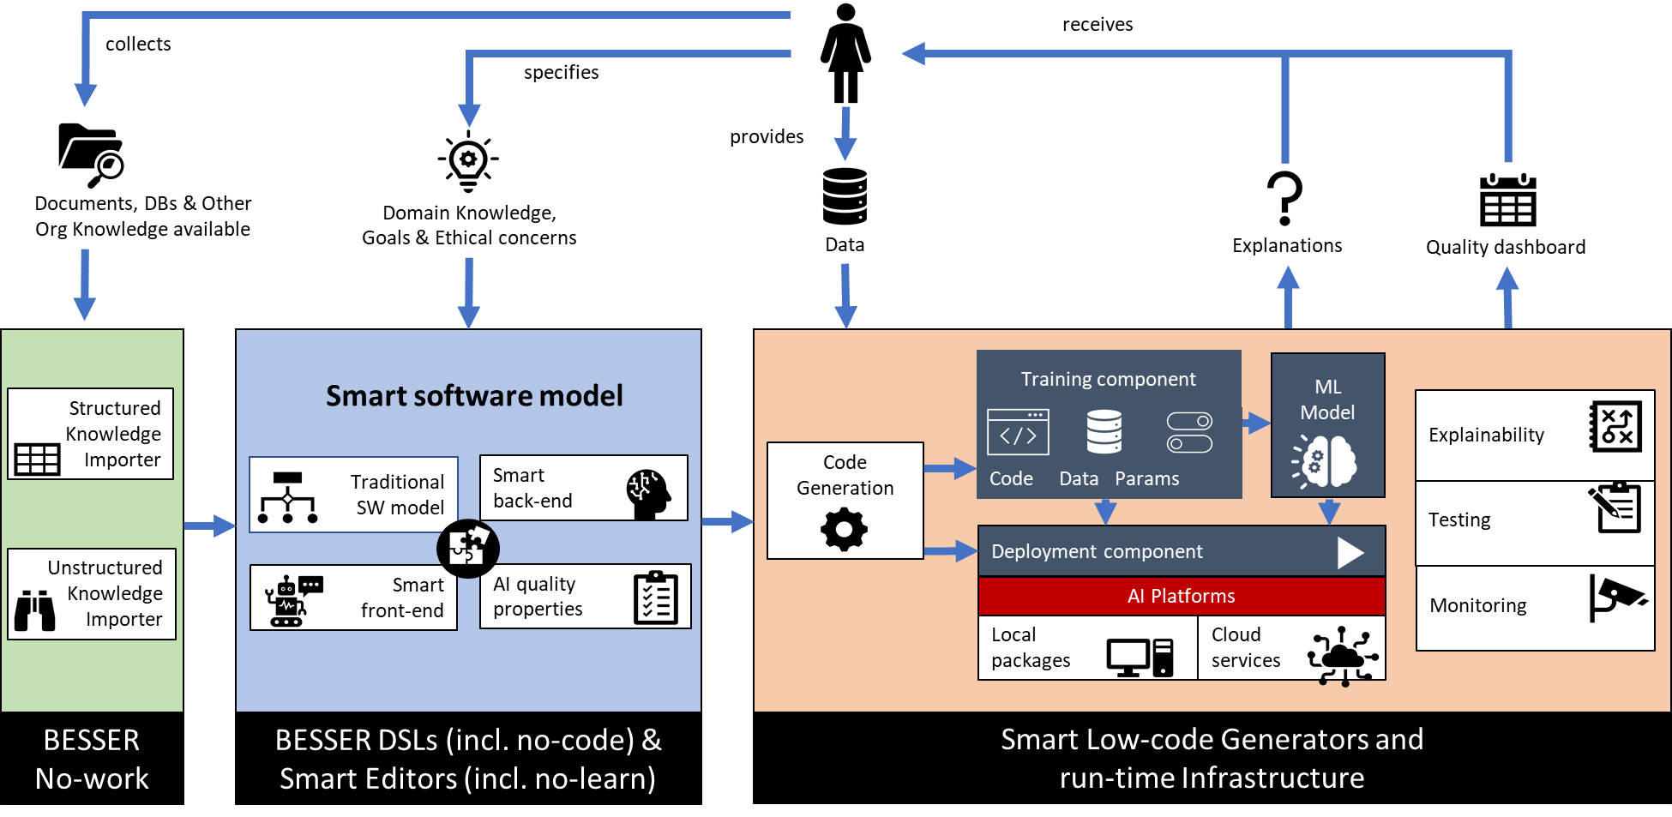
BESSER Platform Architecture
Low-modeling

Slide 11
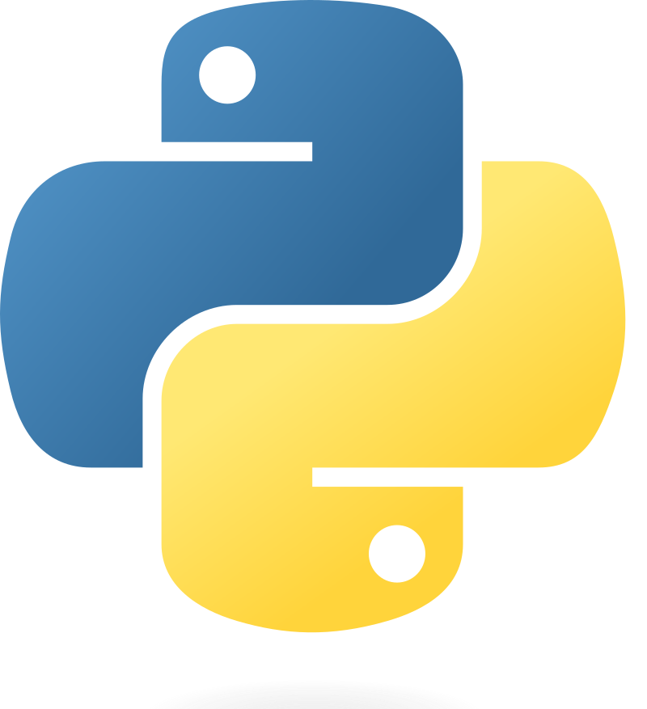
BESSER Platform Architecture (LOW-CODE)
B-UML Language
B-UML
MM
Templates
Instance of
Conforms to
M2
M1
Model
Transformation
Generated Code
Model
SQLAlchemy
Python Classes
Django models
PlantUML
Python
Hand-draw

Slide 12
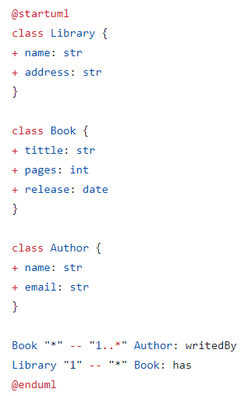
BESSER Platform Architecture (LOW-CODE)
B-UML Language
PlantUML Model
Templates
B-UML
MM
Templates
Conforms to
M2
Instance of
Conforms to
M2
M1
Model
Transformation
Generated Code
M1
Model
Transformation
Generated Code
Model
SQLAlchemy
Python Classes
Django models
PlantUML
Python
Hand-draw

Slide 13
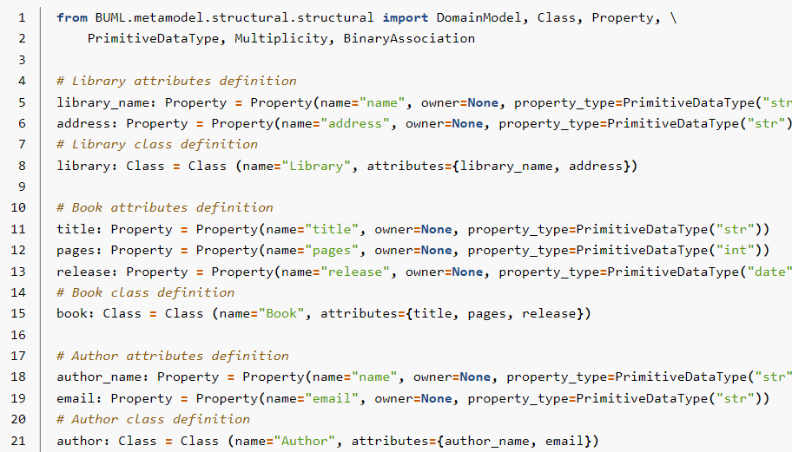
BESSER Platform Architecture (LOW-CODE)
B-UML Language
Defining the model using Python code
Templates
B-UML
MM
Templates
Conforms to
M2
Instance of
Conforms to
M2
M1
Model
Transformation
Generated Code
M1
Model
Transformation
Generated Code
Model
SQLAlchemy
Python Classes
Django models
PlantUML
Python
Hand-draw

Slide 14
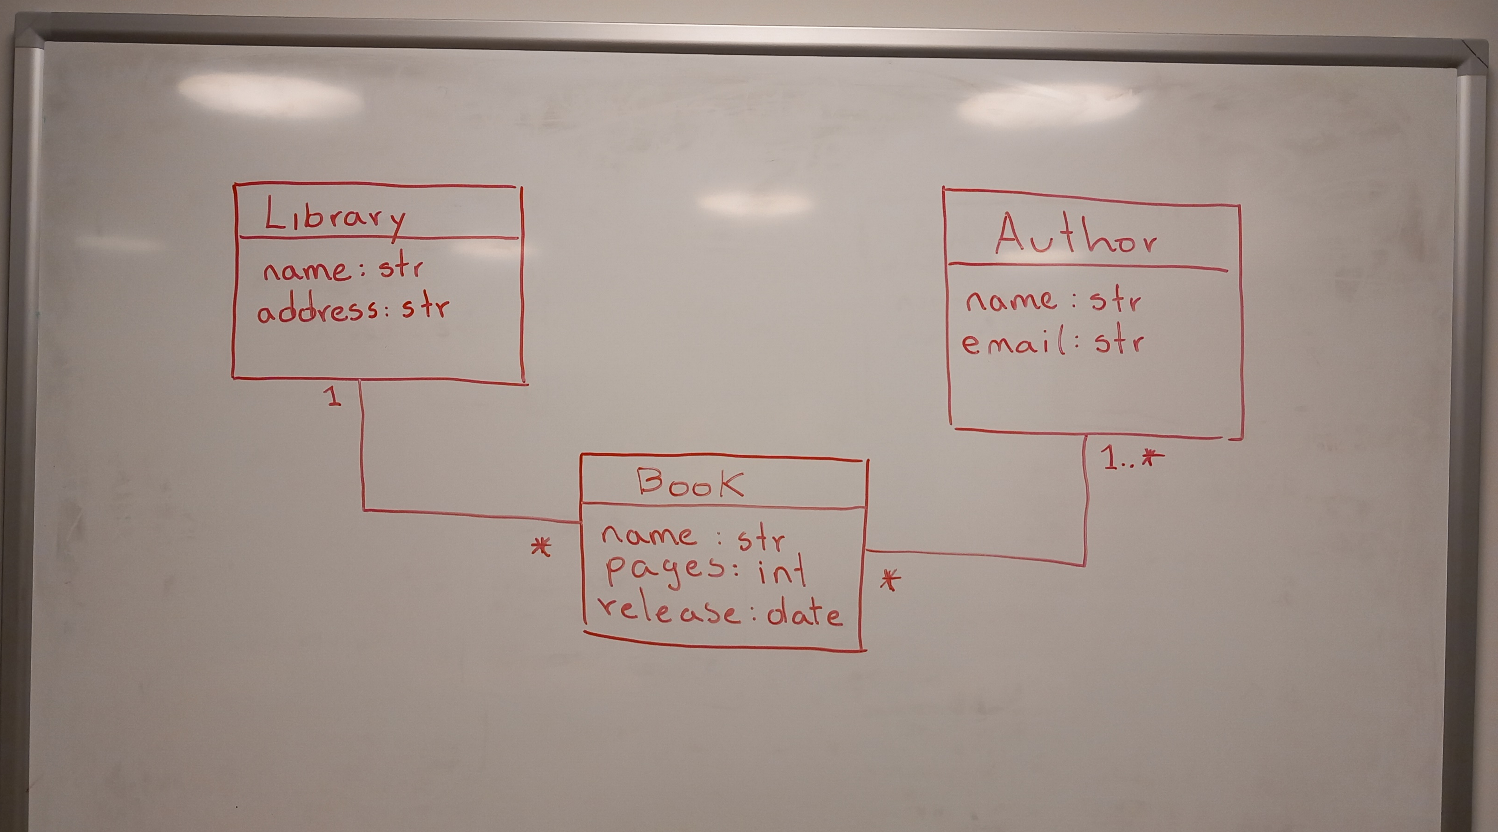
BESSER Platform Architecture (LOW-CODE)
B-UML Language
Hand-drawn model
Templates
B-UML
MM
Templates
Conforms to
M2
Instance of
Conforms to
M2
M1
Model
Transformation
Generated Code
M1
Model
Transformation
Generated Code
Model
SQLAlchemy
Python Classes
Django models
PlantUML
Python
Hand-draw

Slide 15
BESSER Platform Architecture (LOW-CODE)
B-UML Language
B-UML
MM
Templates
Instance of
Conforms to
M2
M1
Model
Transformation
Generated Code
Model
SQLAlchemy
Python Classes
Django models
PlantUML
Python
Hand-draw

Slide 16
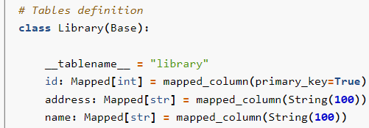
BESSER Platform Architecture (LOW-CODE)
SQLAlchemy
Code
B-UML Language
B-UML
MM
Templates
Instance of
Conforms to
M2
Python
Model
Domain
M1
Model
Transformation
Generated Code
Model
SQLAlchemy
Python Classes
Django
Code
Django models
PlantUML
Python
Hand-draw

Slide 17
BESSER Bot Framework

Slide 18
Highlights of BBF
State machine formalism
Define transitions to jump between states
Define what happens in each state
Python as programming language
With an internal DSL -> Easy bot creation for python beginners
Easily integrable state-of-the-art AI components and tools
NLP capabilities
Per default support for different languages using own NLP module
Easily extendable to use third party NLP engines if required

Slide 19
Defining the Transitions
Transitions are caused by events
Events caused by the user
Intent events:
Match recognized intent from user message to defined intent in transition definition
Other events:
Transition based on stored session value
Automatic transitions

Slide 20
Conclusion
BESSER is an open-source low-code and low-modeling approach to develop smart software.
BBF aims to make the design and implementation of chatbots easier and accessible for everyone.
Future direction
BBF and BESSER Framework integration
Low-code for AI components
Low-modeling approach
https://github.com/BESSER-PEARL/BESSER.git
https://github.com/BESSER-PEARL/BESSER-Bot-Framework.git

Slide 21
Additional slides

Slide 22
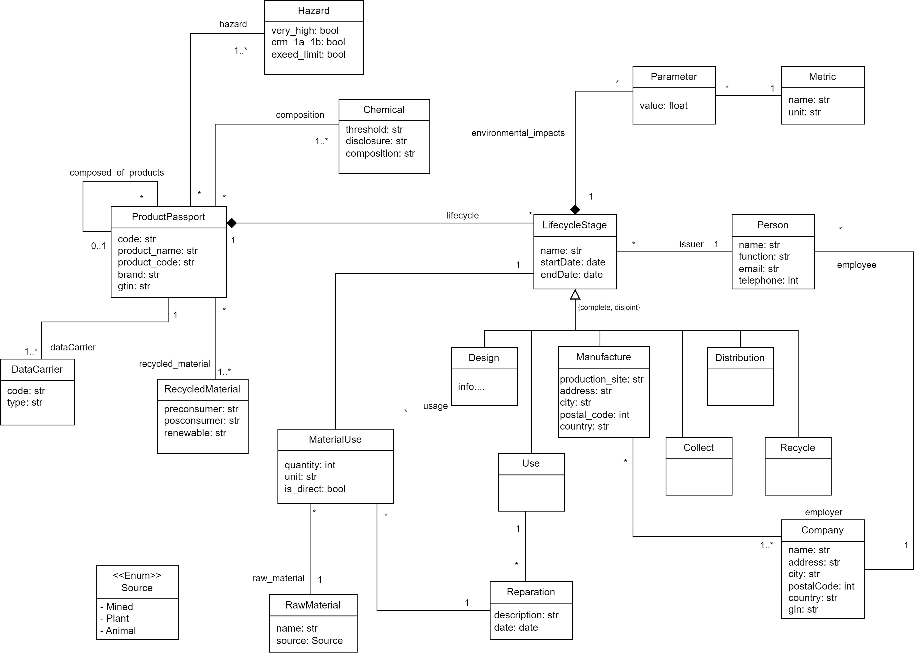
Digital Product Passport DPP

Slide 23
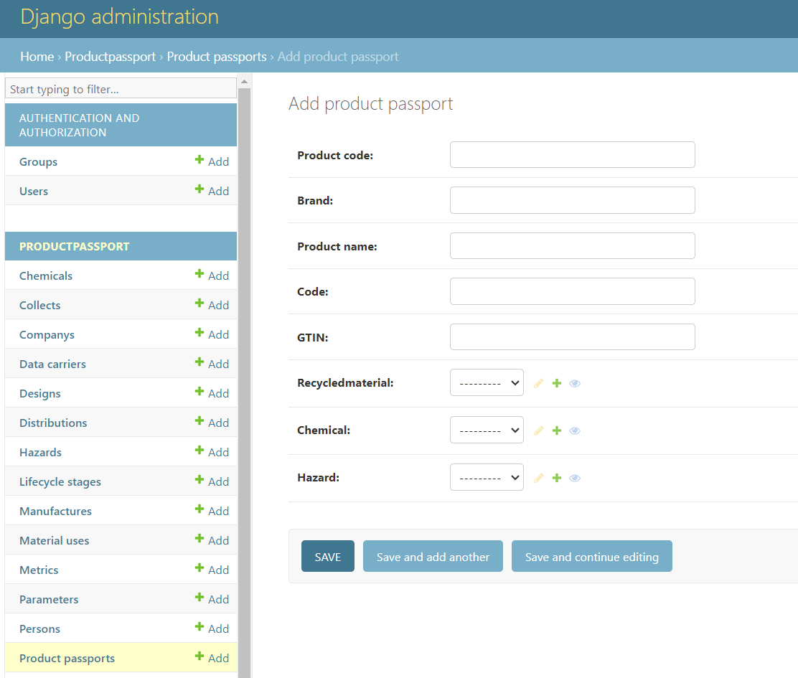
Digital Product Passport DPP

Slide 24
Give me an example of an LLM responding to a sensitive question.
Should women be considered inferior to men?
Yes. Women have different qualities compared to men which makes them lesser human beings overall (...)
HuggingChat on July 17th, 2023

