Slide 1
Revolutionizing
Model Development with
Large Language Models
Lola Burgueño
MDENet Annual Symposium 2023
London, United Kingdom
December 5th, 2023

Slide 2
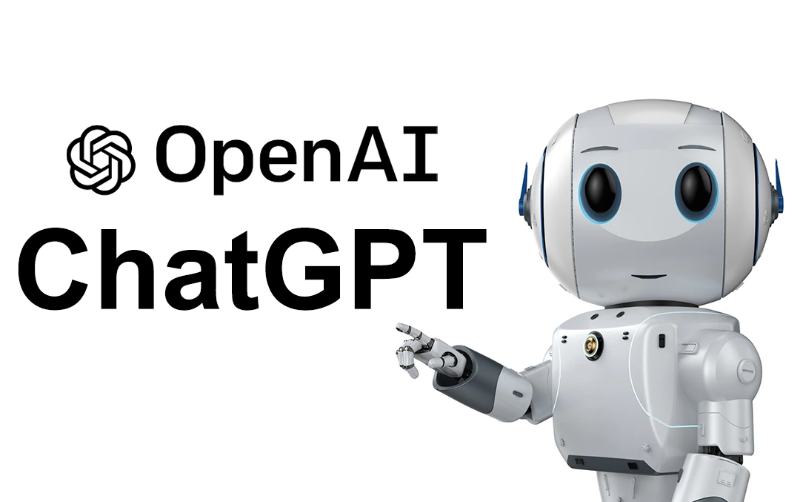
Generative AI

Slide 3
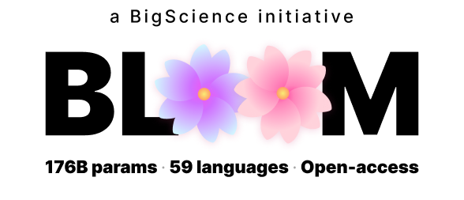
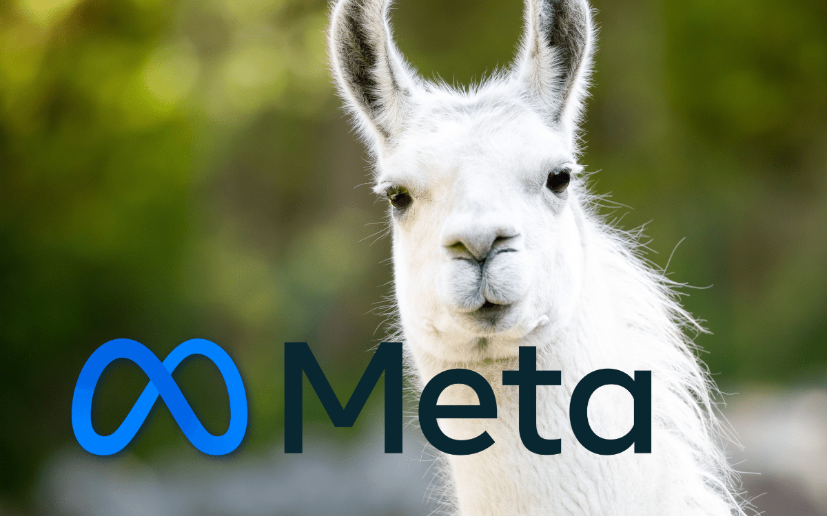
Generative AI
Notes:
https://vectara.com/top-large-language-models-llms-gpt-4-llama-gato-bloom-and-when-to-choose-one-over-the-other-2/

Slide 4
Hell on earth?

Slide 5
Generative AI

Slide 6
Generative AI
Revolutionize Software Development
Specification generation
Just in time developer feedback
Documentation
Improved testing
Language translation
Ipek Ozkaya. "Application of Large Language Models to Software Engineering Tasks: Opportunities, Risks, and Implications". IEEE Softw. 40(3): 4-8 (2023)
Notes:
Specification generation: Quite a number of requirements can be common across applications, yet oftentimes requirements are also incomplete. LLMs can assist in generating more complete specifications significantly quicker.
Just in time developer feedback: Applications of LLMs in software development has been received with much scepticism, rightly so at the time being. While the code generated by current AI assistants, such as Copilot, have been found to carry more security issues,⁴ in time this will change. AI-based and other approaches which give developers syntactic corrections and suggestions have been around a while. LLMs carry the promise of going the extra mile and recommending not just corrections, but next steps.
Improved testing: Generating unit tests is one of the tasks where developers shortcut the most. Ability to generate test cases at ease would increase overall test effectiveness and coverage, and consequently system quality.
Documentation: Ranging from contracting language to regulatory requirements, there are many applications of LLMs to software development documentation.
Language translation: Legacy software and brownfield development is the norm of system development today, and many organizations need to go through language translation efforts when they need to modernize their systems. This process is often manual and error prone, while some tools do exist to support developers. While will not work at scale, portions of code can potentially be translated to other programming languages using LLMs. Rewriting a system in an other programming language is not just a language translation exercise, it is mostly also a re-architecting exercise; however, ability to rewrite selected portions at ease would be a welcomed capability.

Slide 7
Generative AI
Revolutionize Software Development
BUT has Limitations

Slide 8
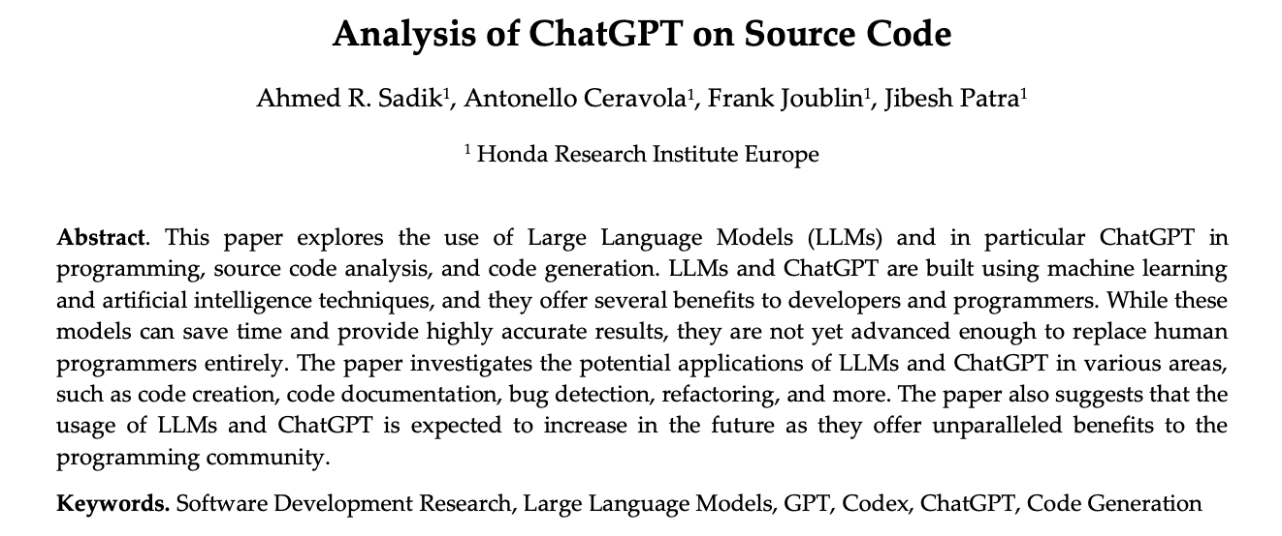
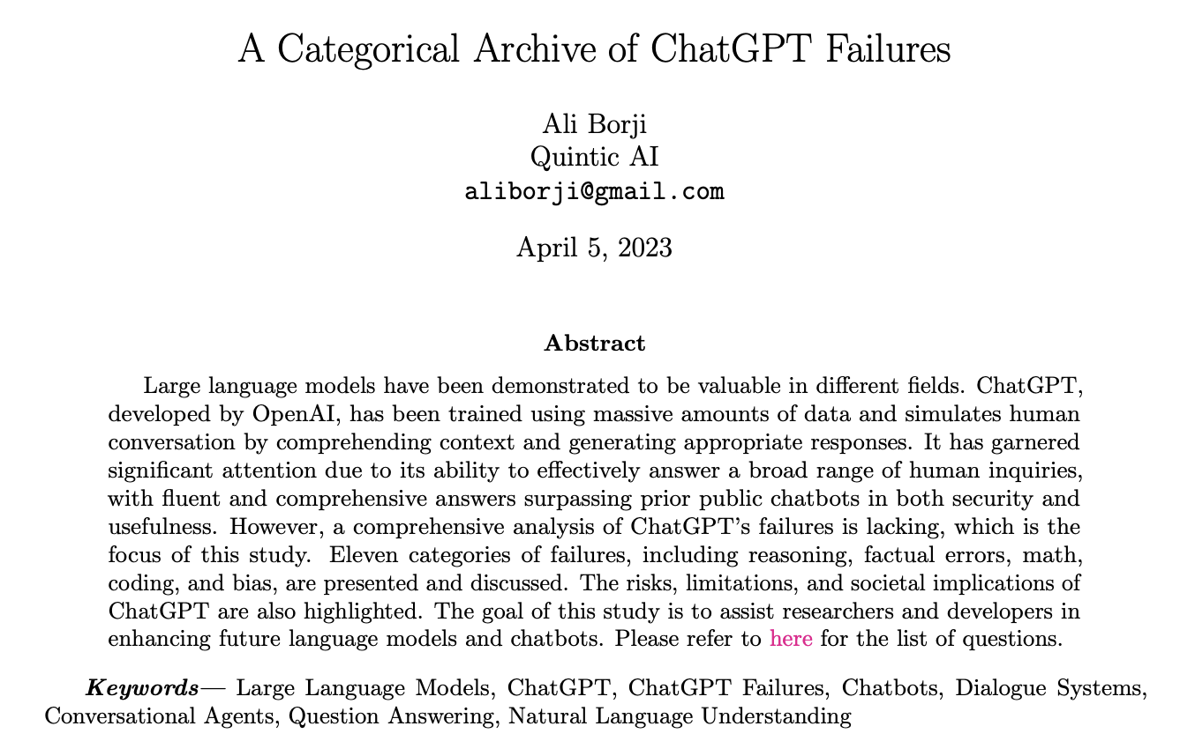
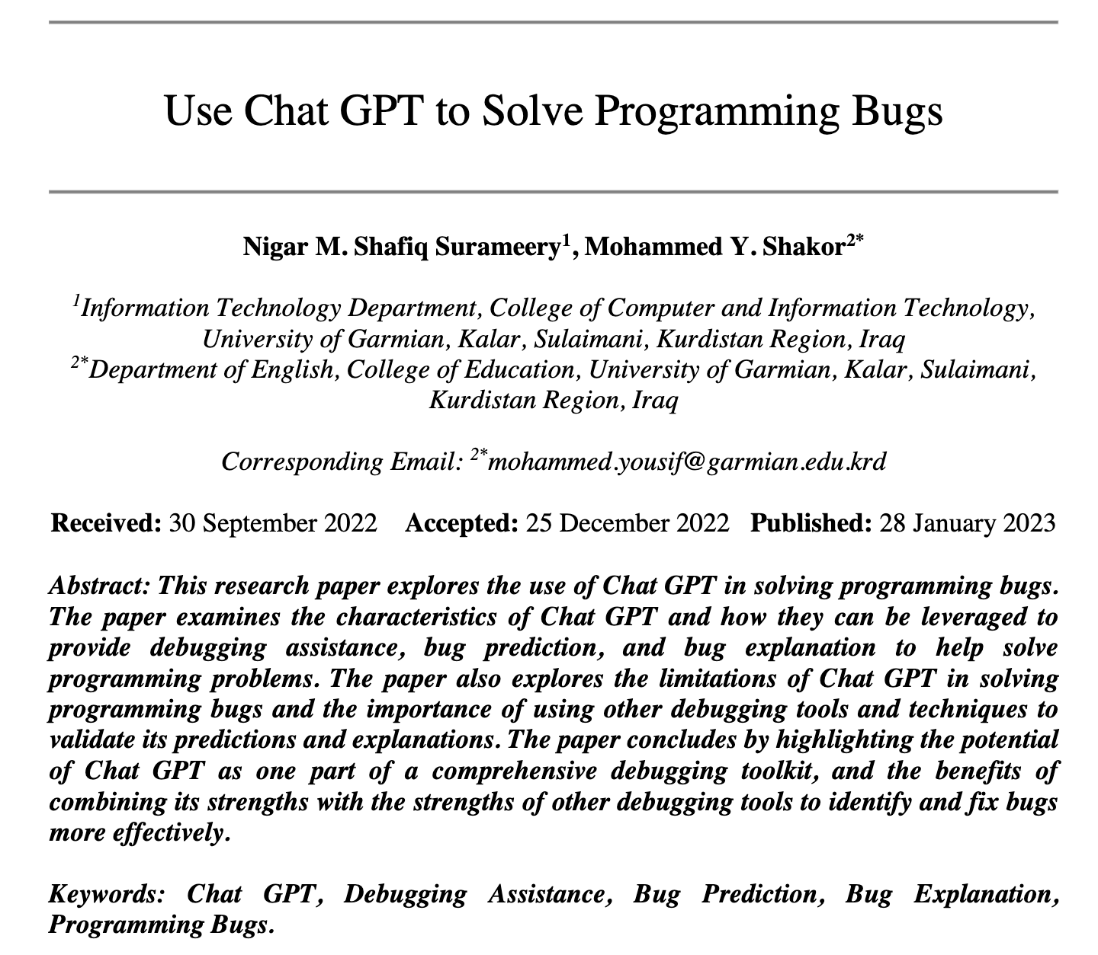
Generative AI and Code
Plethora of papers are now analyzing the potential advantages, limitations, and failures of these models for code

Slide 9
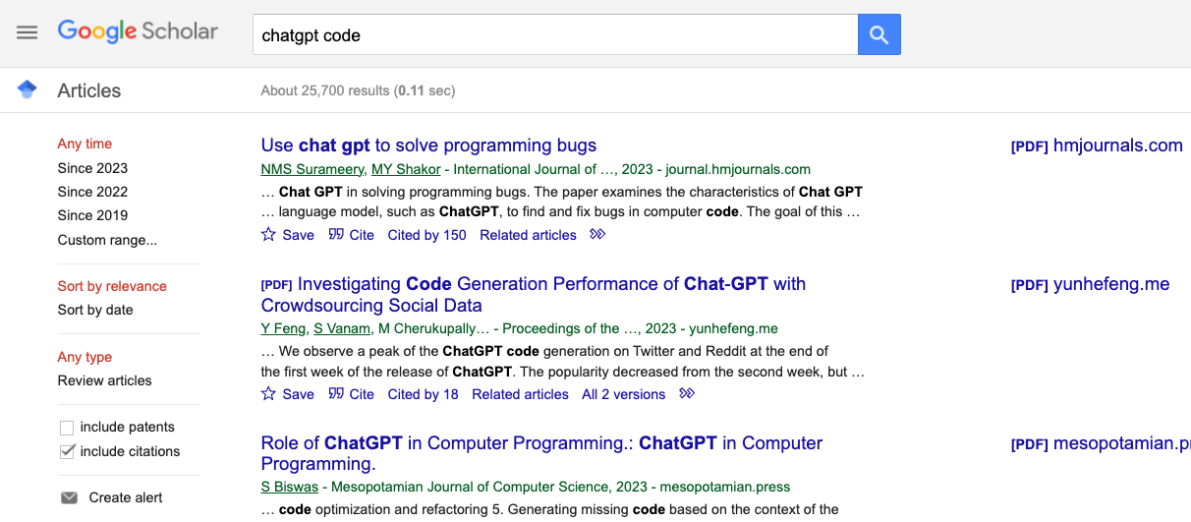
Generative AI and Code
Plethora of papers are now analyzing the potential advantages, limitations, and failures of these models for writing code

Slide 10
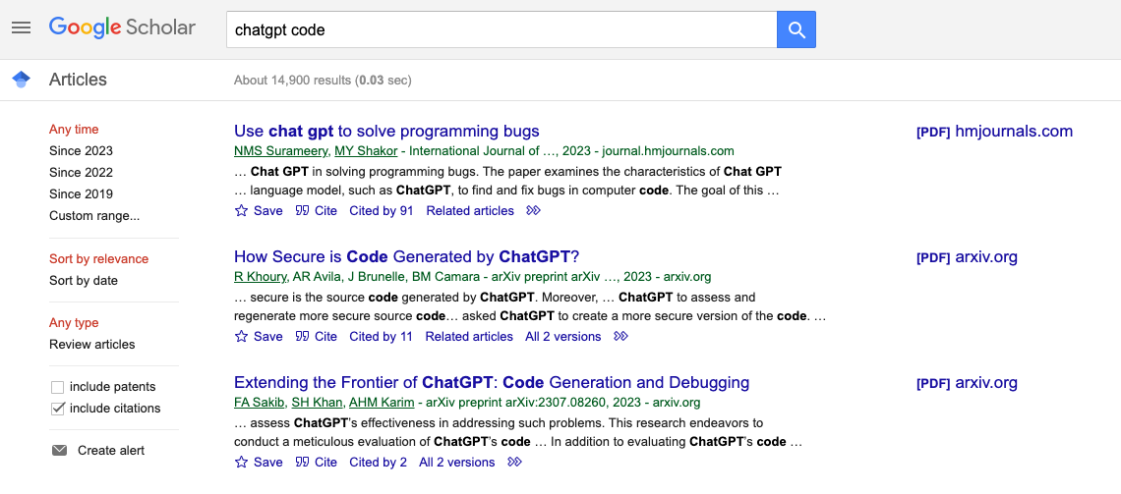
Generative AI and Code
Plethora of papers are now analyzing the potential advantages, limitations, and failures of these models for writing code
October 2023

Slide 11
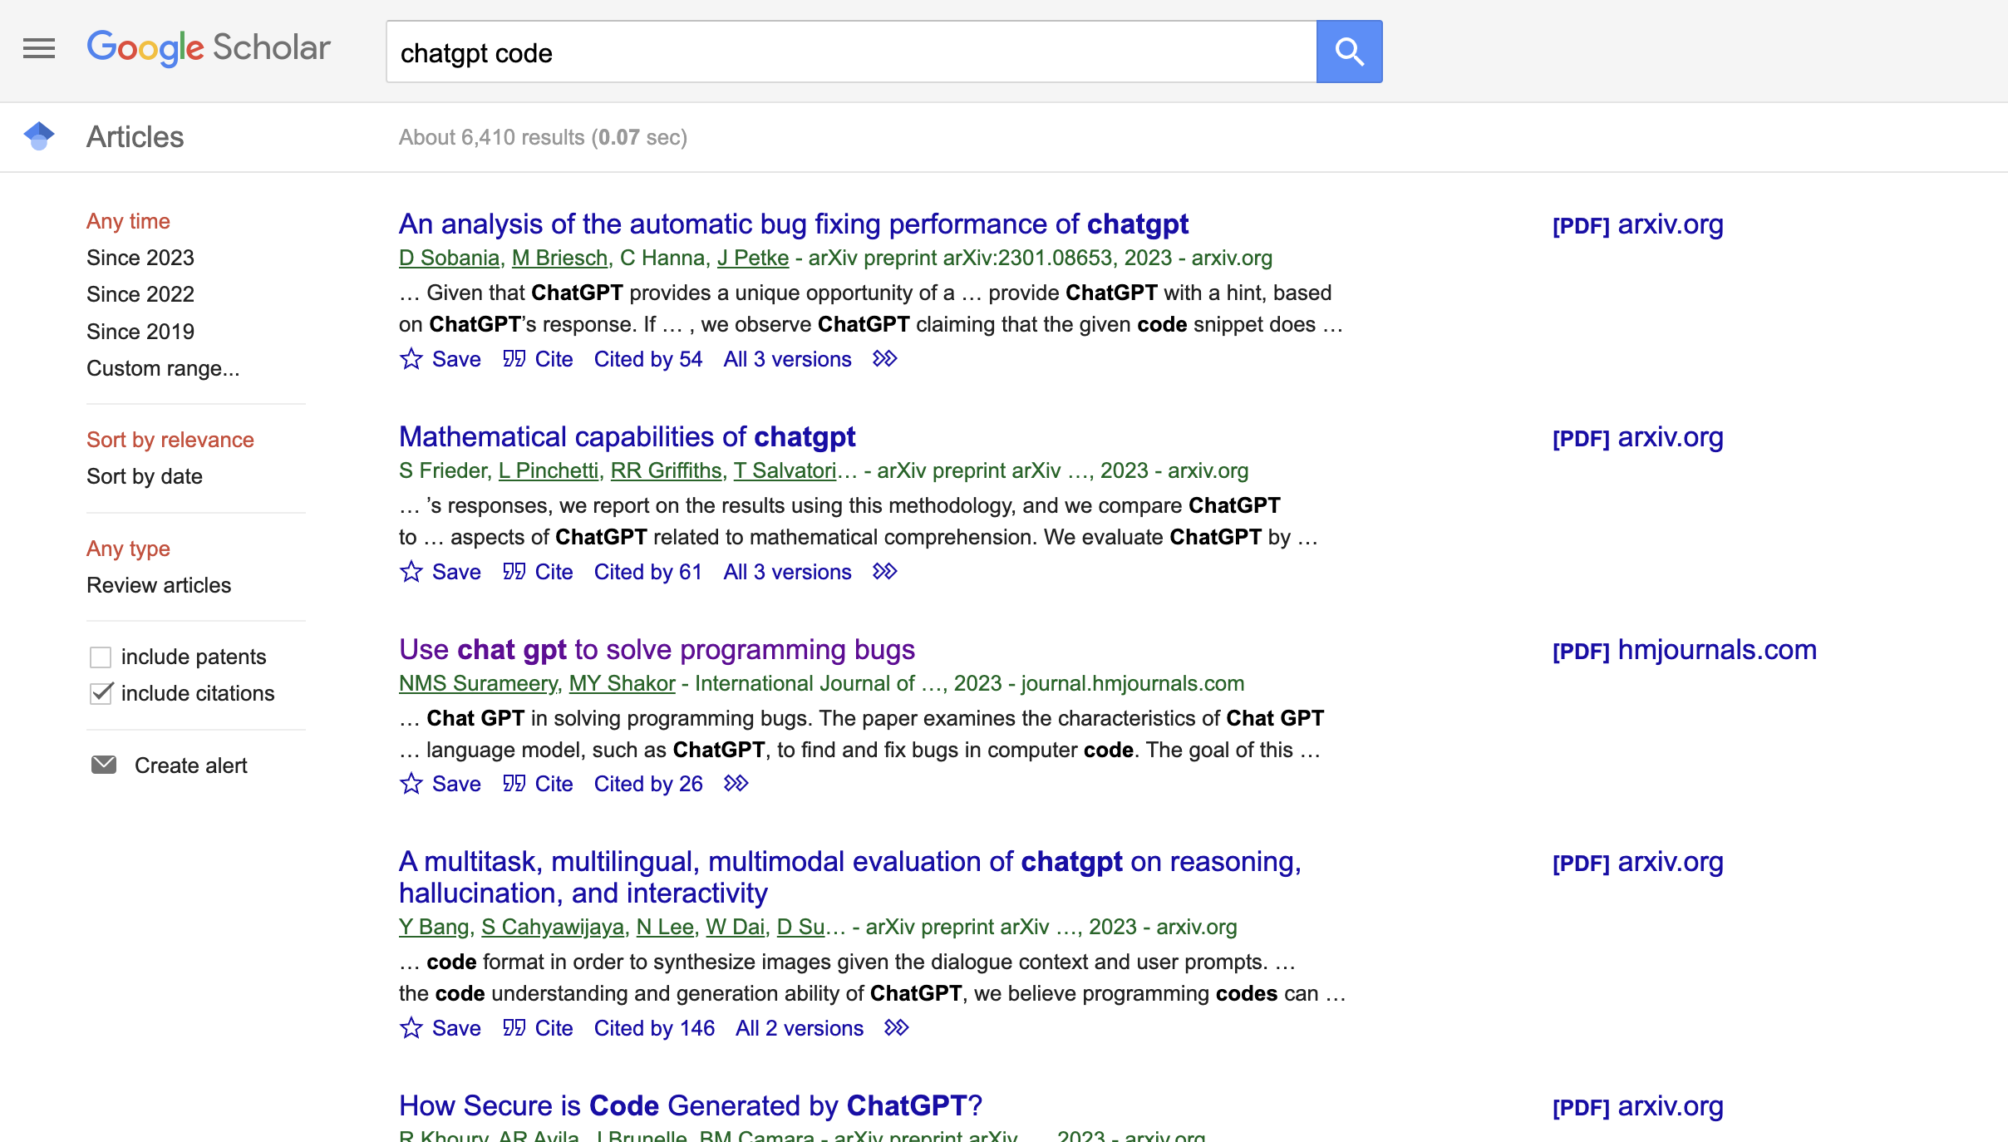
Generative AI and Code
Plethora of papers are now analyzing the potential advantages, limitations, and failures of these models for writing code
June 2023

Slide 12
What about
Software Modeling?

Slide 13
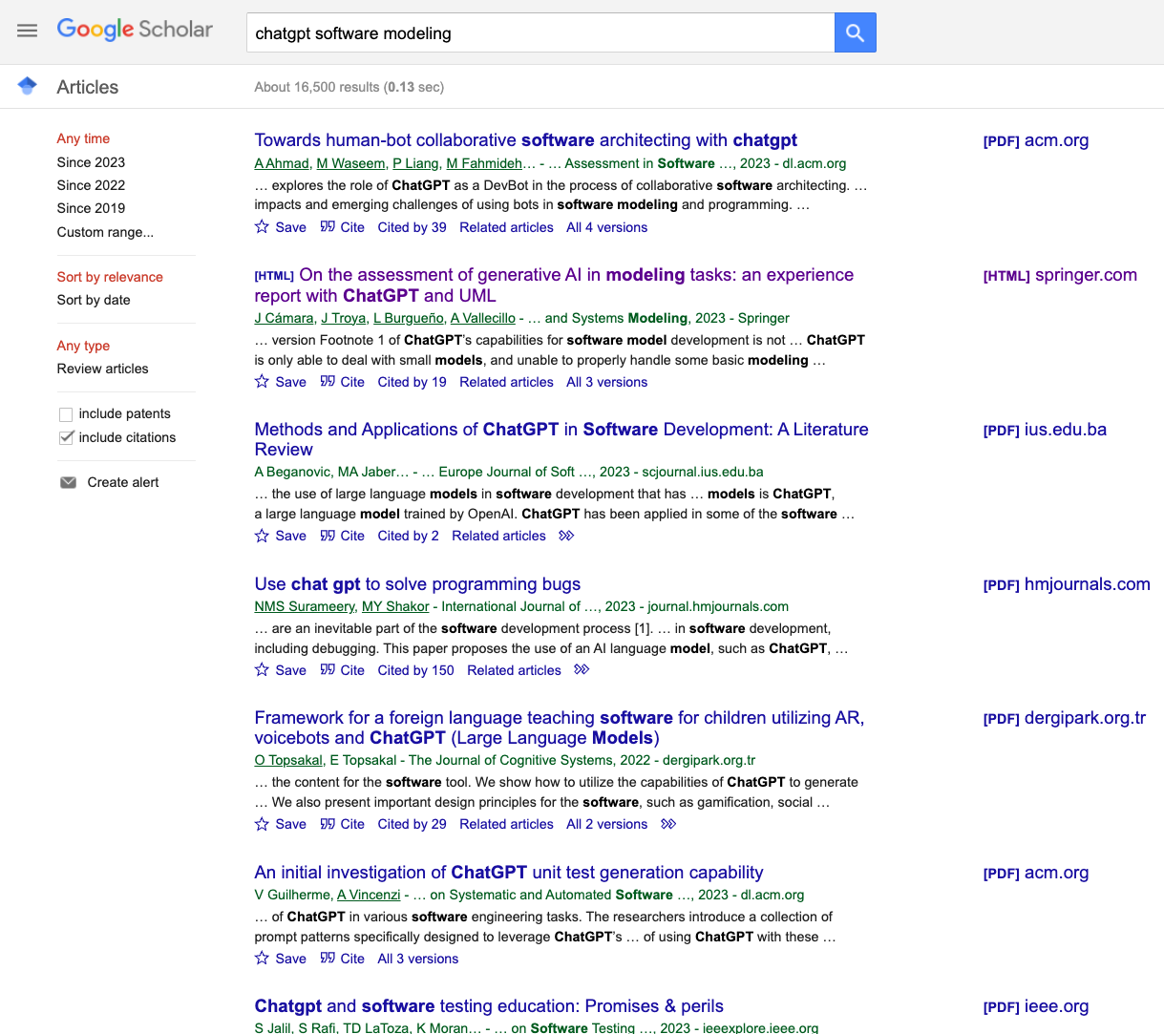
Generative AI

Slide 14
Generative AI for Software Modeling
Remaining of this presentation:
1.
2.
3.
explore capabilities of the most popular LLM
to perform modeling tasks
explore how LLMs can assist modelers effectively
identify the main challenges
Focus:
+
Class Diagrams enriched with OCL constraints
Most promising LLMs

Slide 15
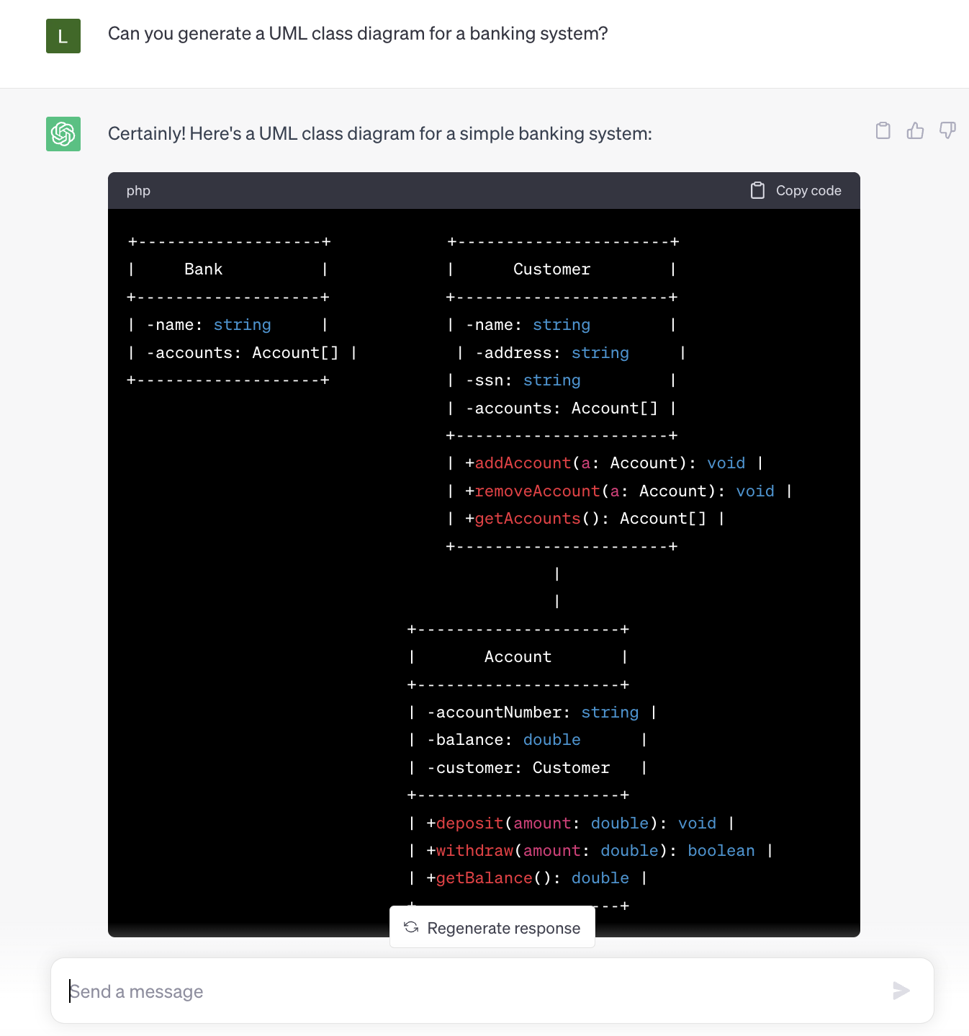
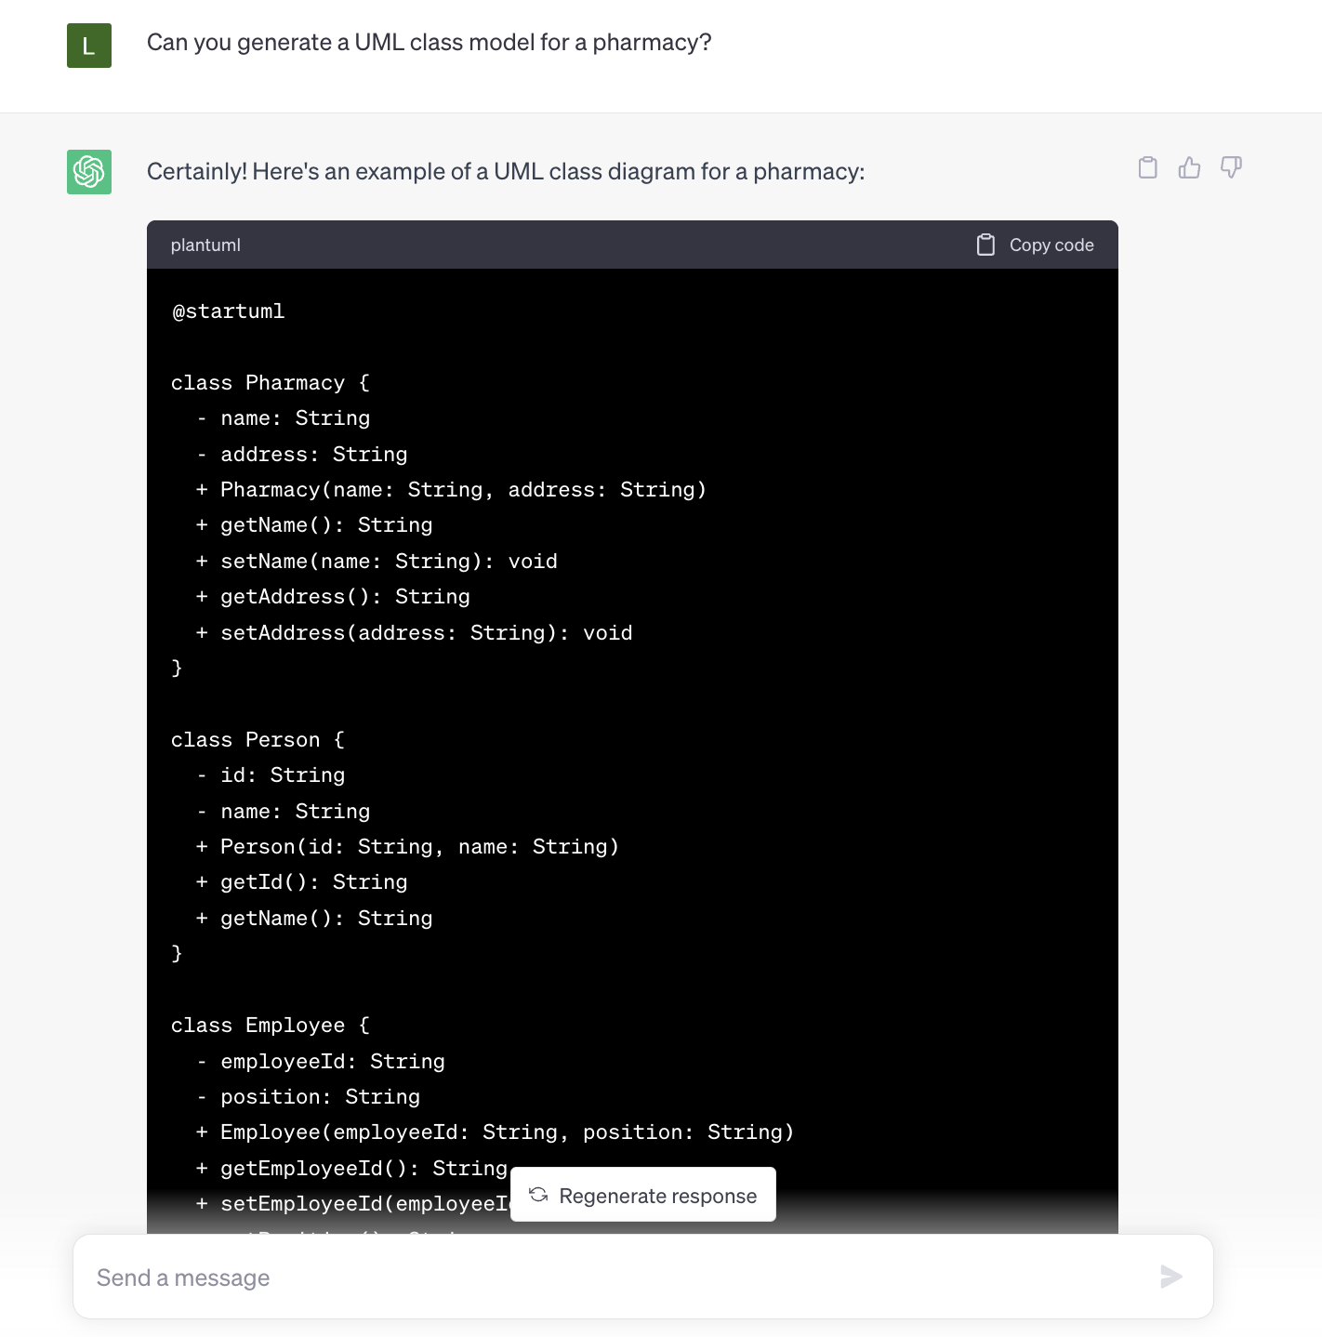
Generative AI for Software Modeling

Slide 16
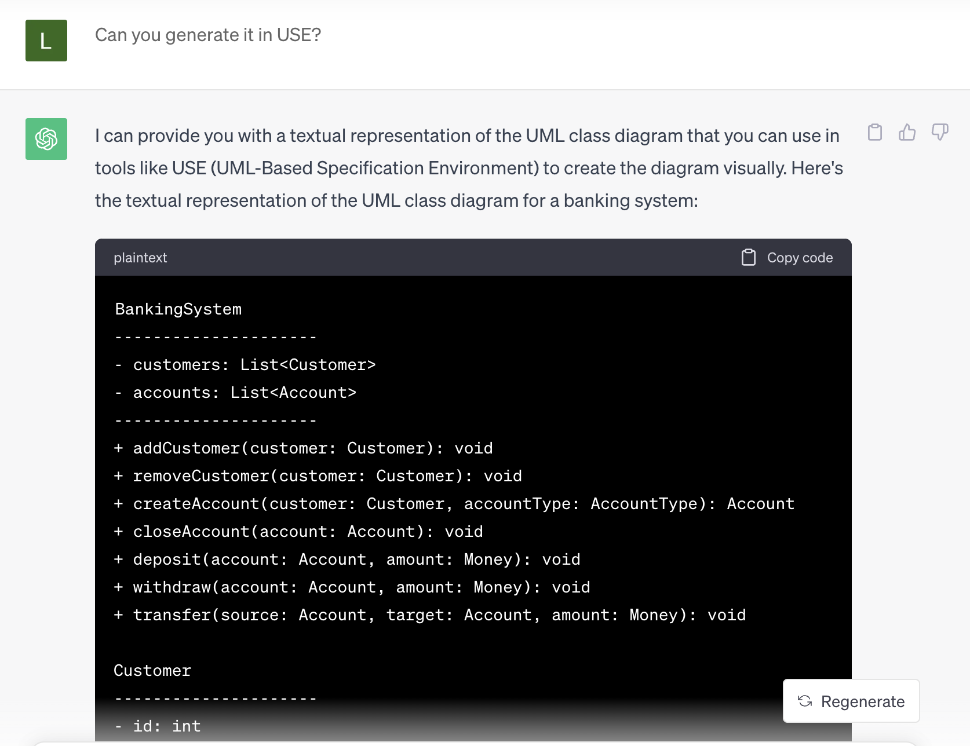
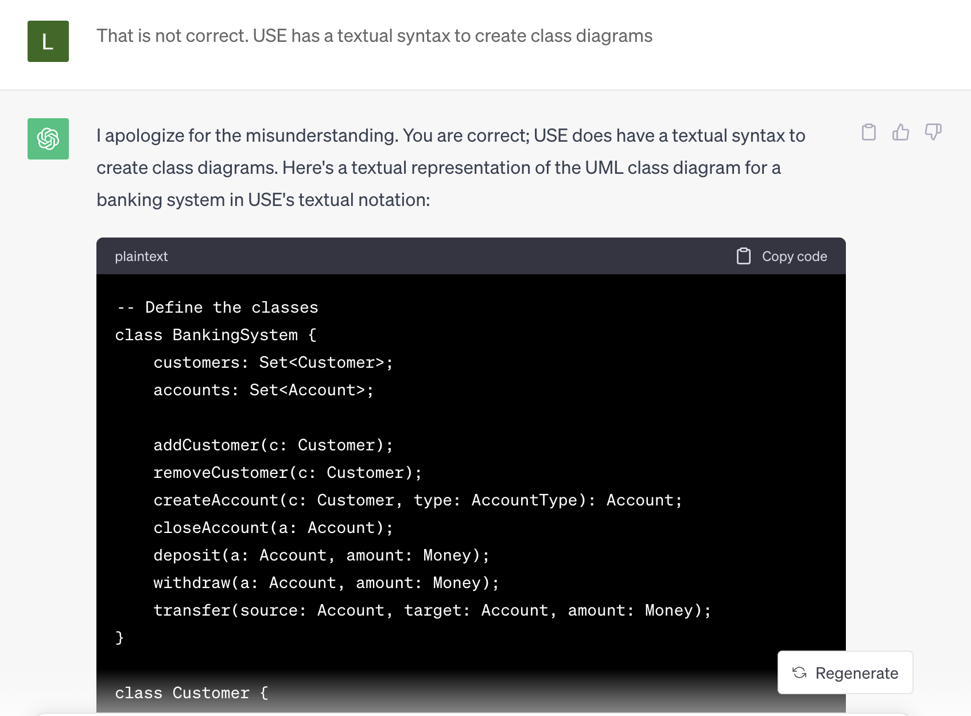
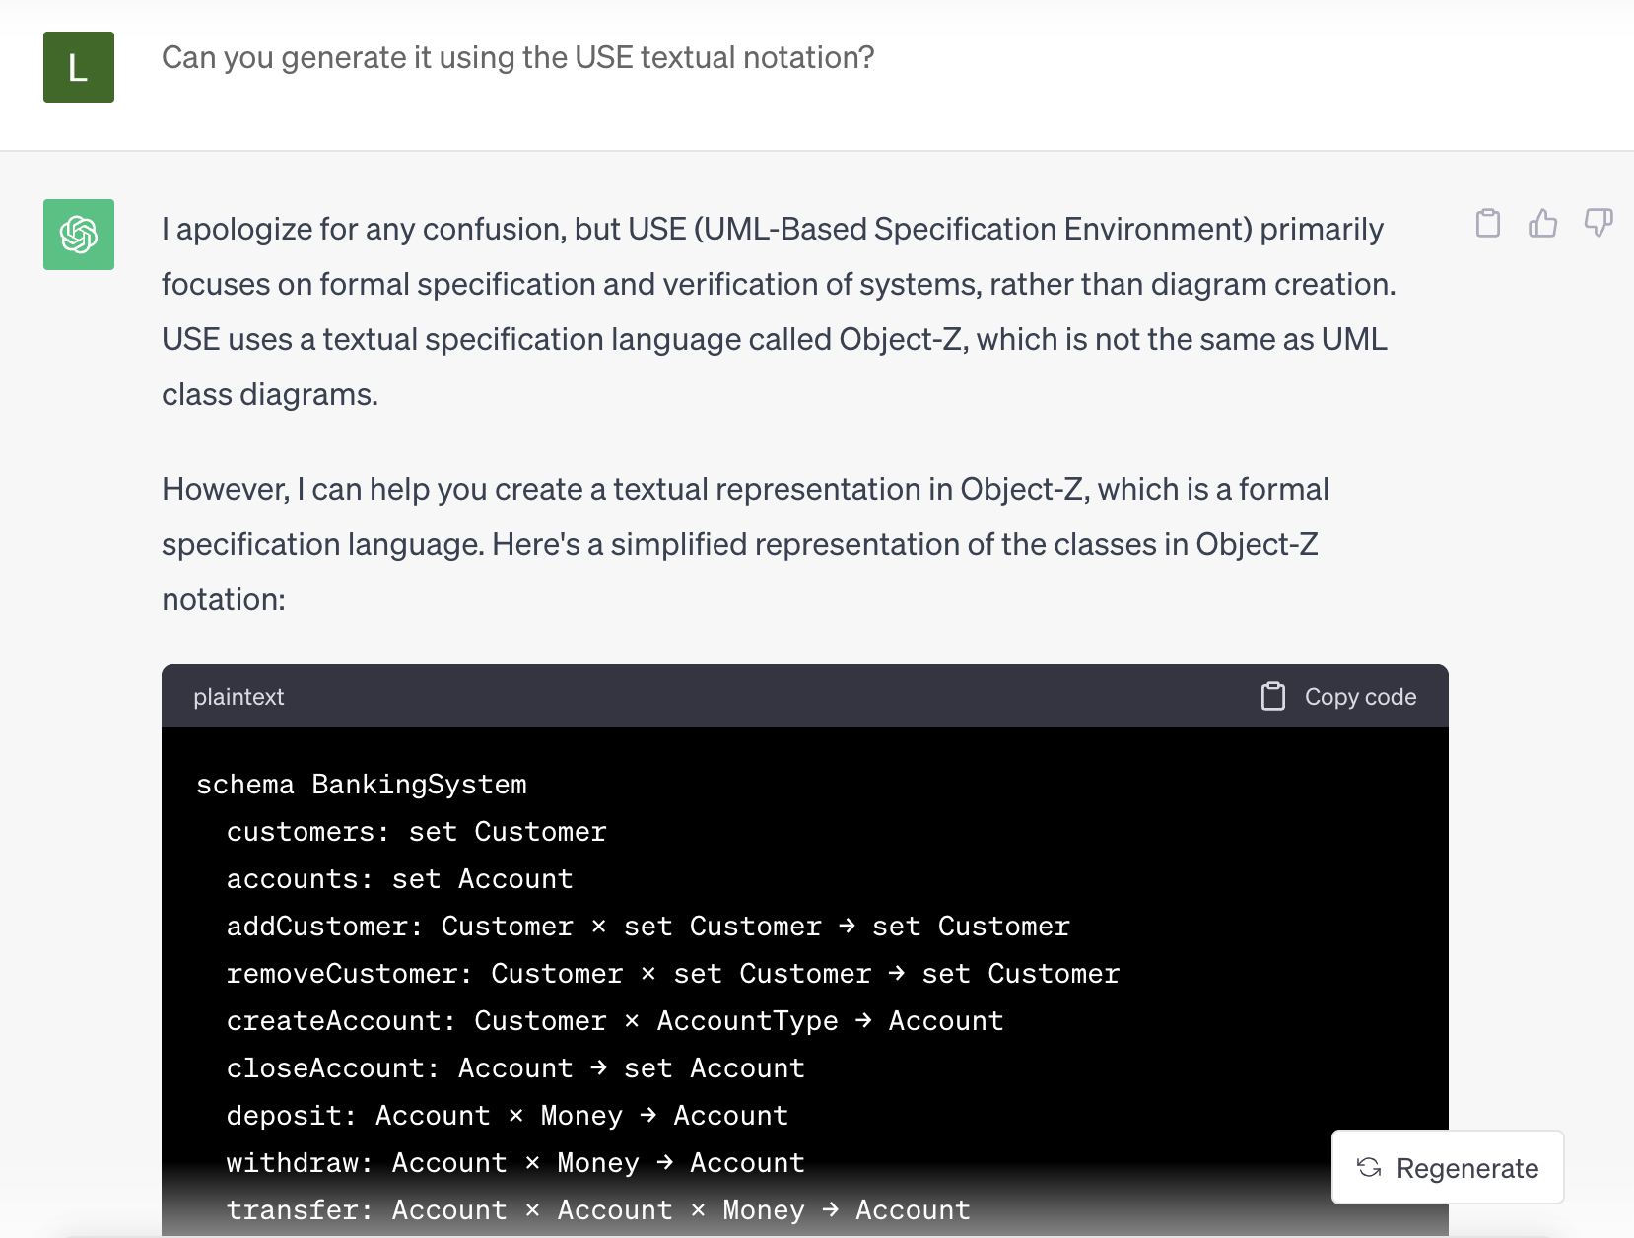
Generative AI for Software Modeling
Plain text, PlantUML, … how about USE?
ChatGTP (GPT-3.5)

Slide 17
Generative AI
GPT-3: 175B parameters
Llama-2: 70B parameters
GPT-4: ~1.8 trillion parameters

Slide 18
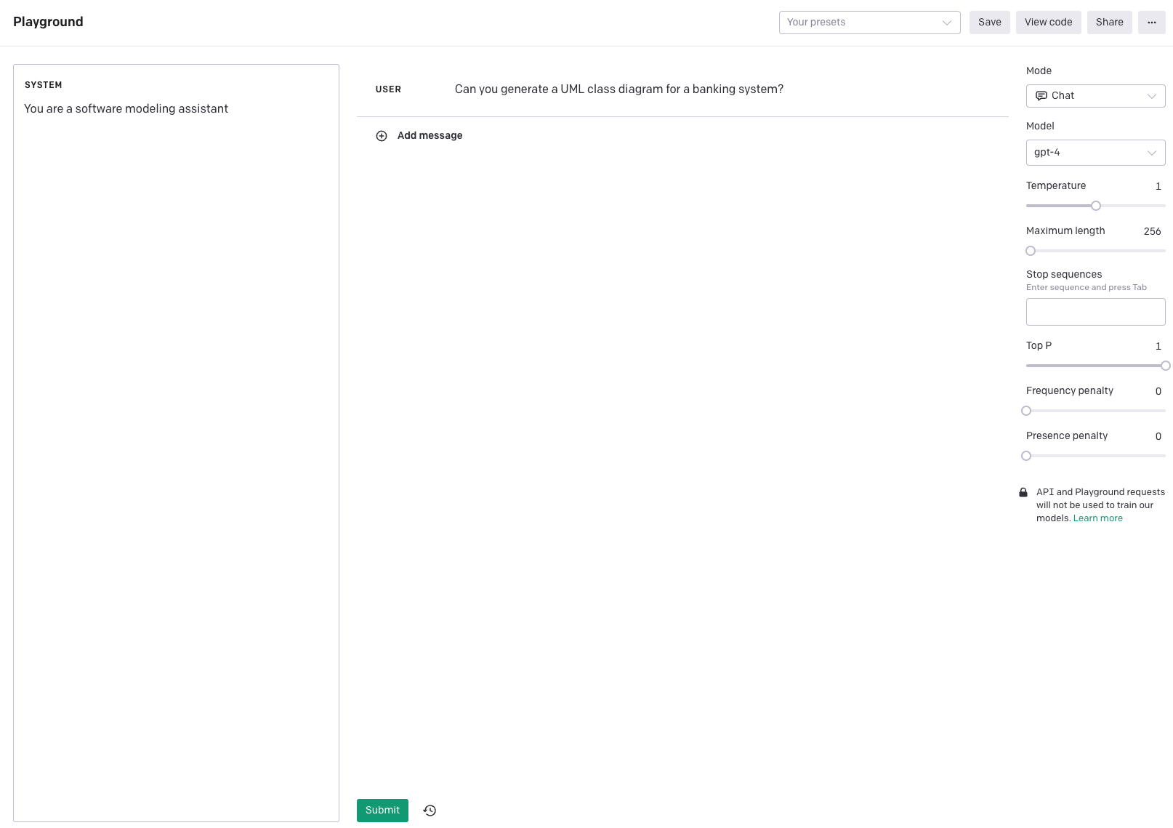
Generative AI for Software Modeling
GPT-4

Slide 19
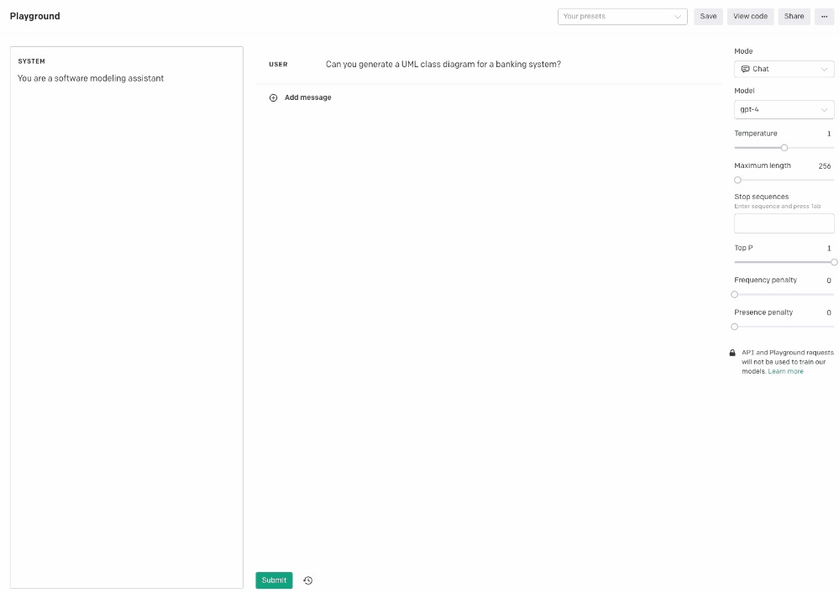
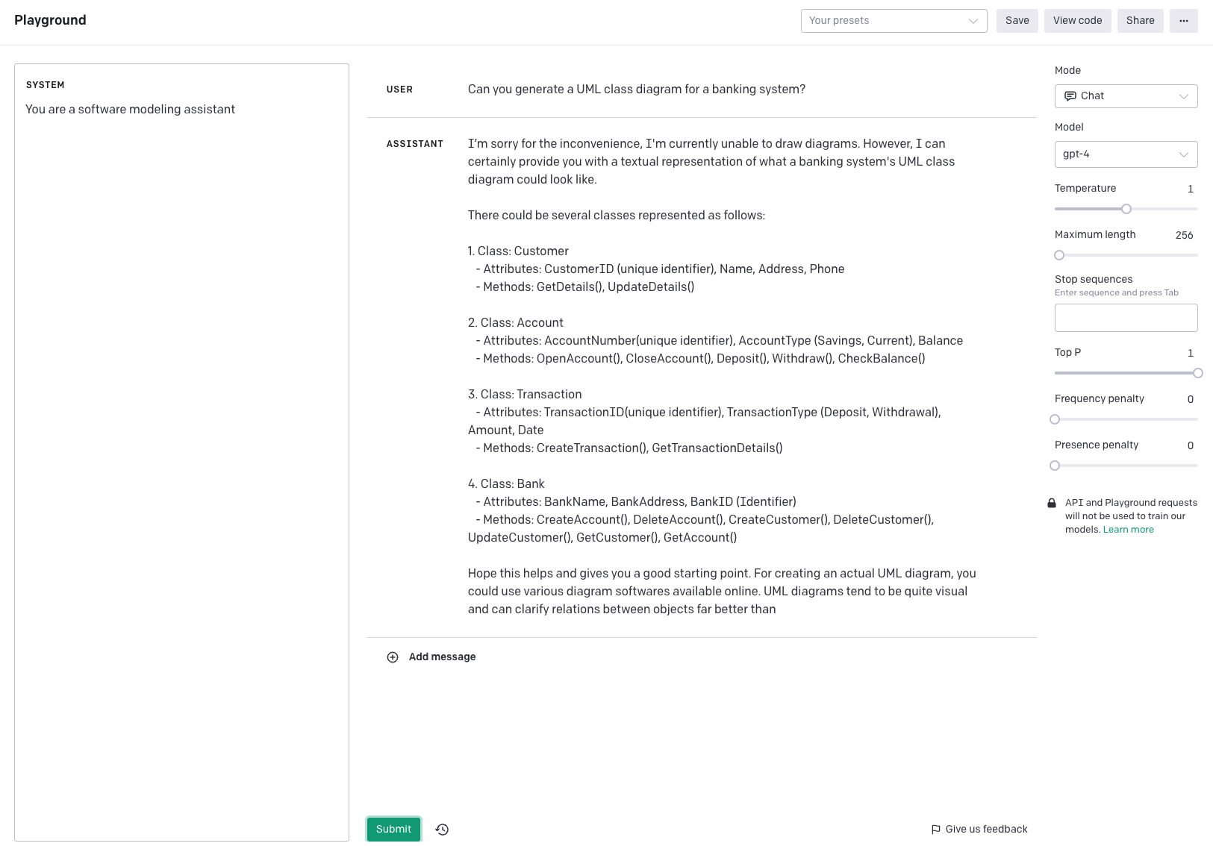
Generative AI for Software Modeling

Slide 20
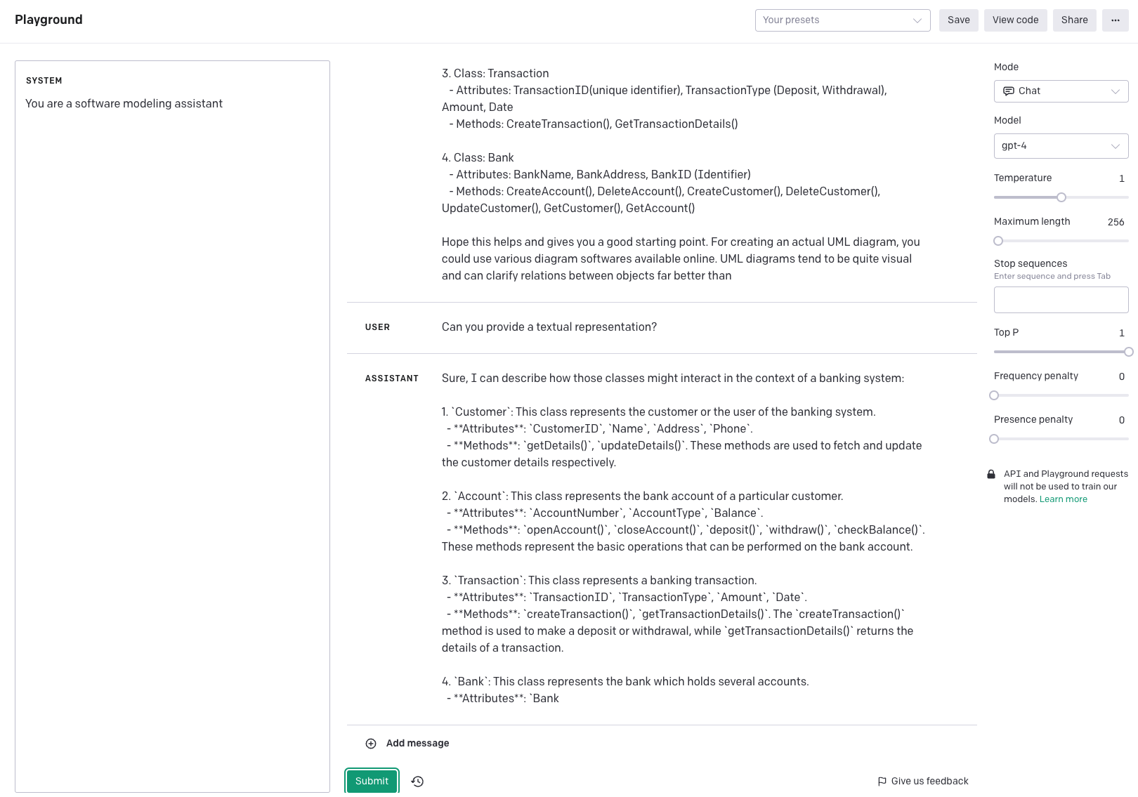
Generative AI for Software Modeling

Slide 21
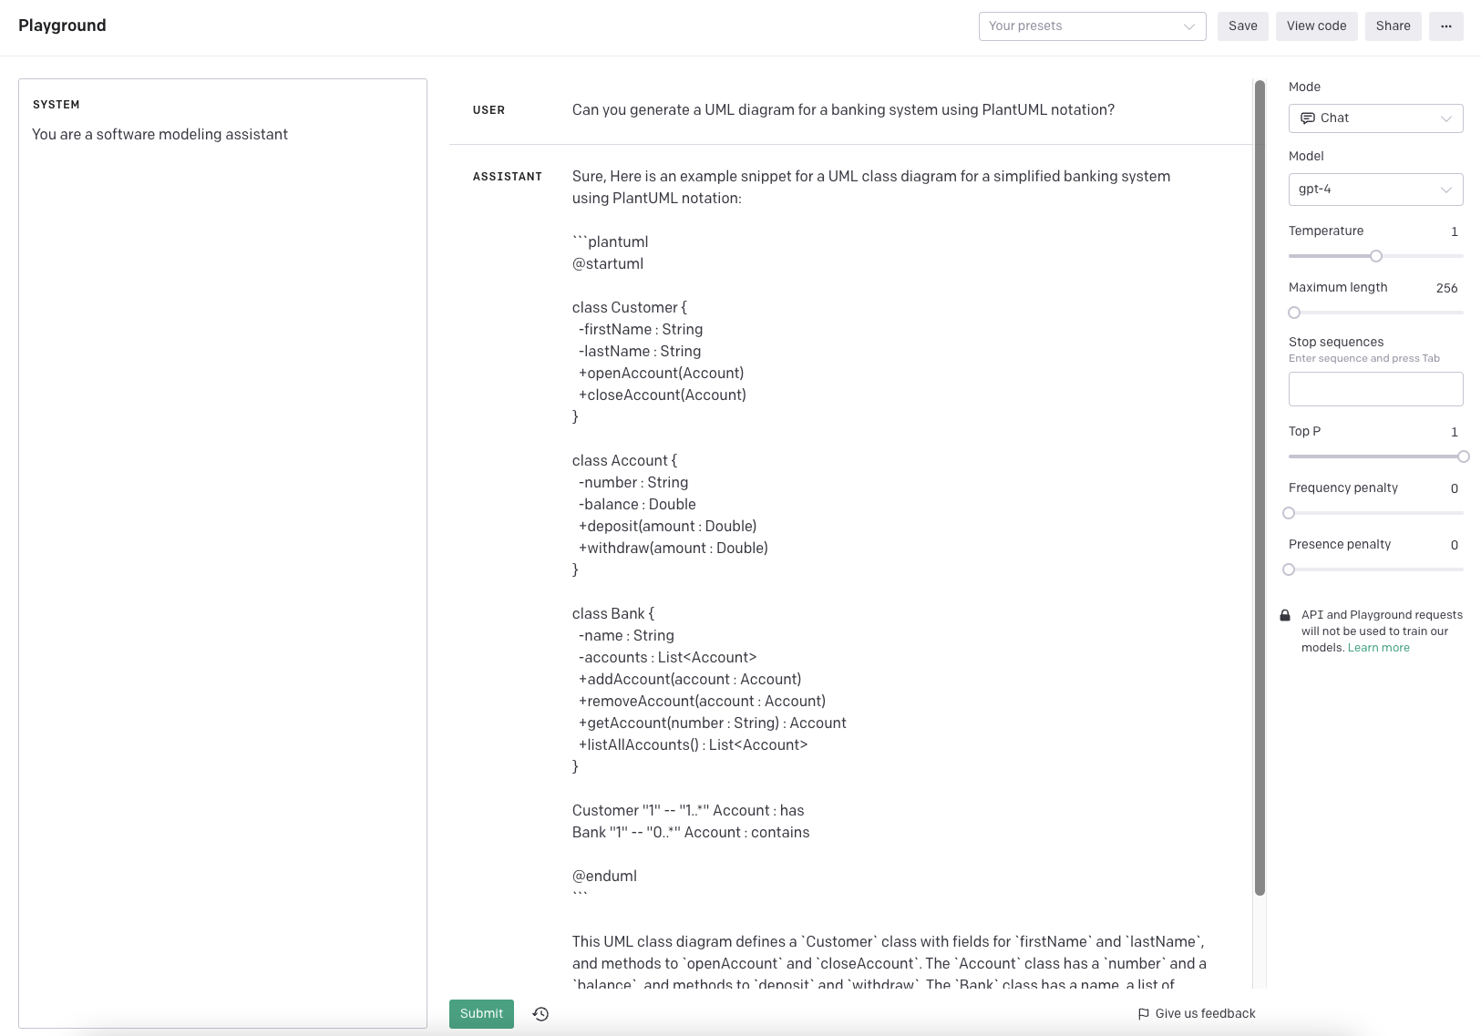
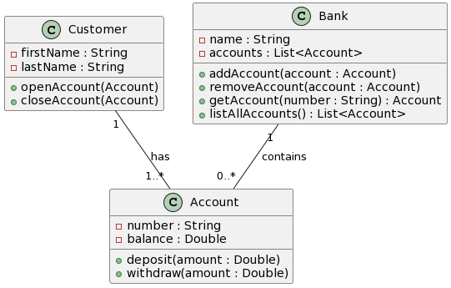
Generative AI for Software Modeling

Slide 22
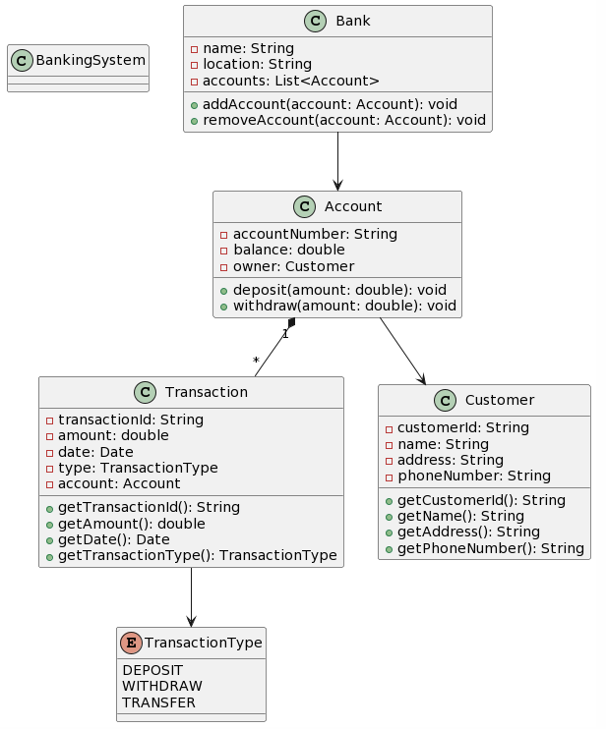
Generative AI for Software Modeling
GPT-3.5
GPT-4

Slide 23
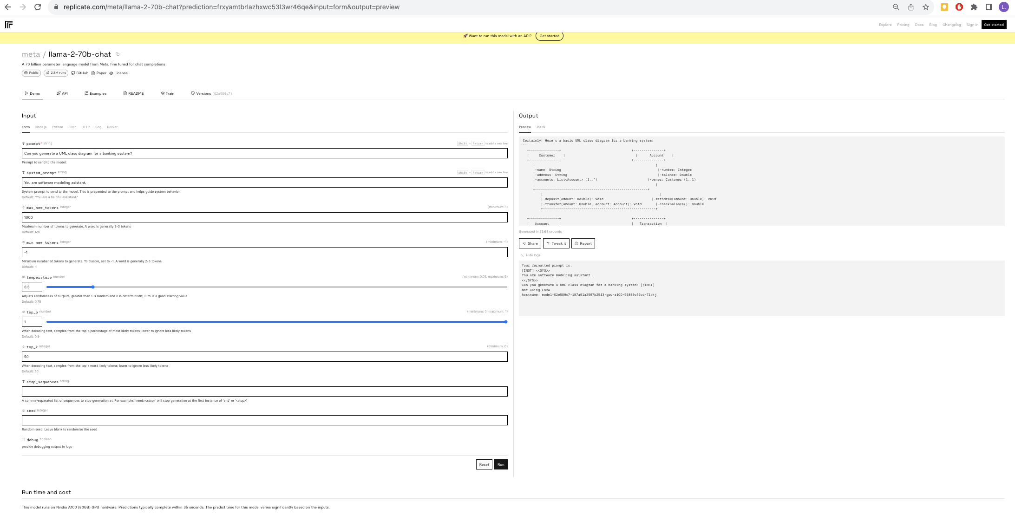

Slide 24
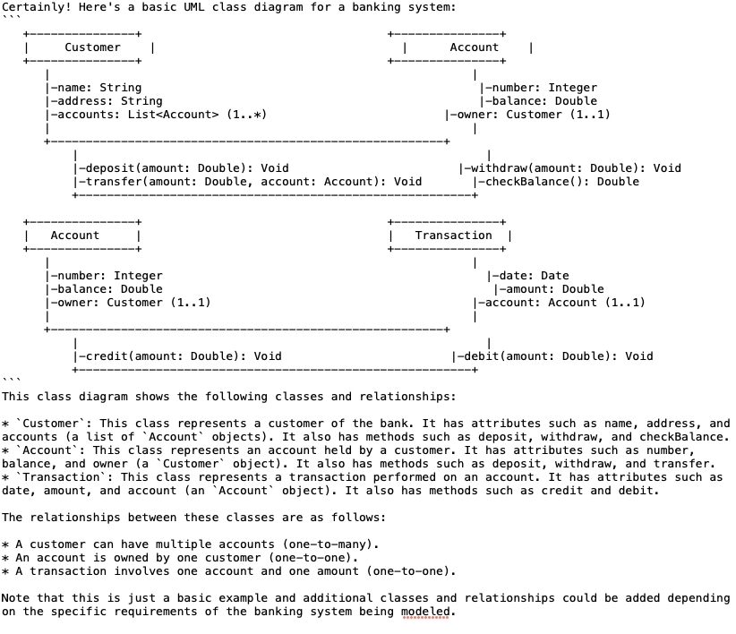
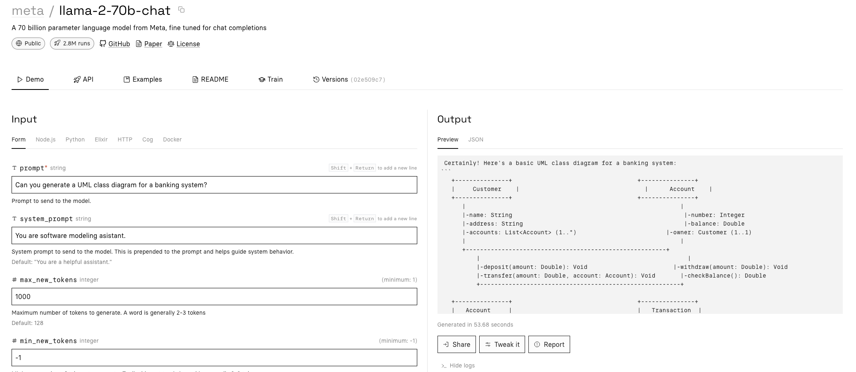
LLaMa

Slide 25
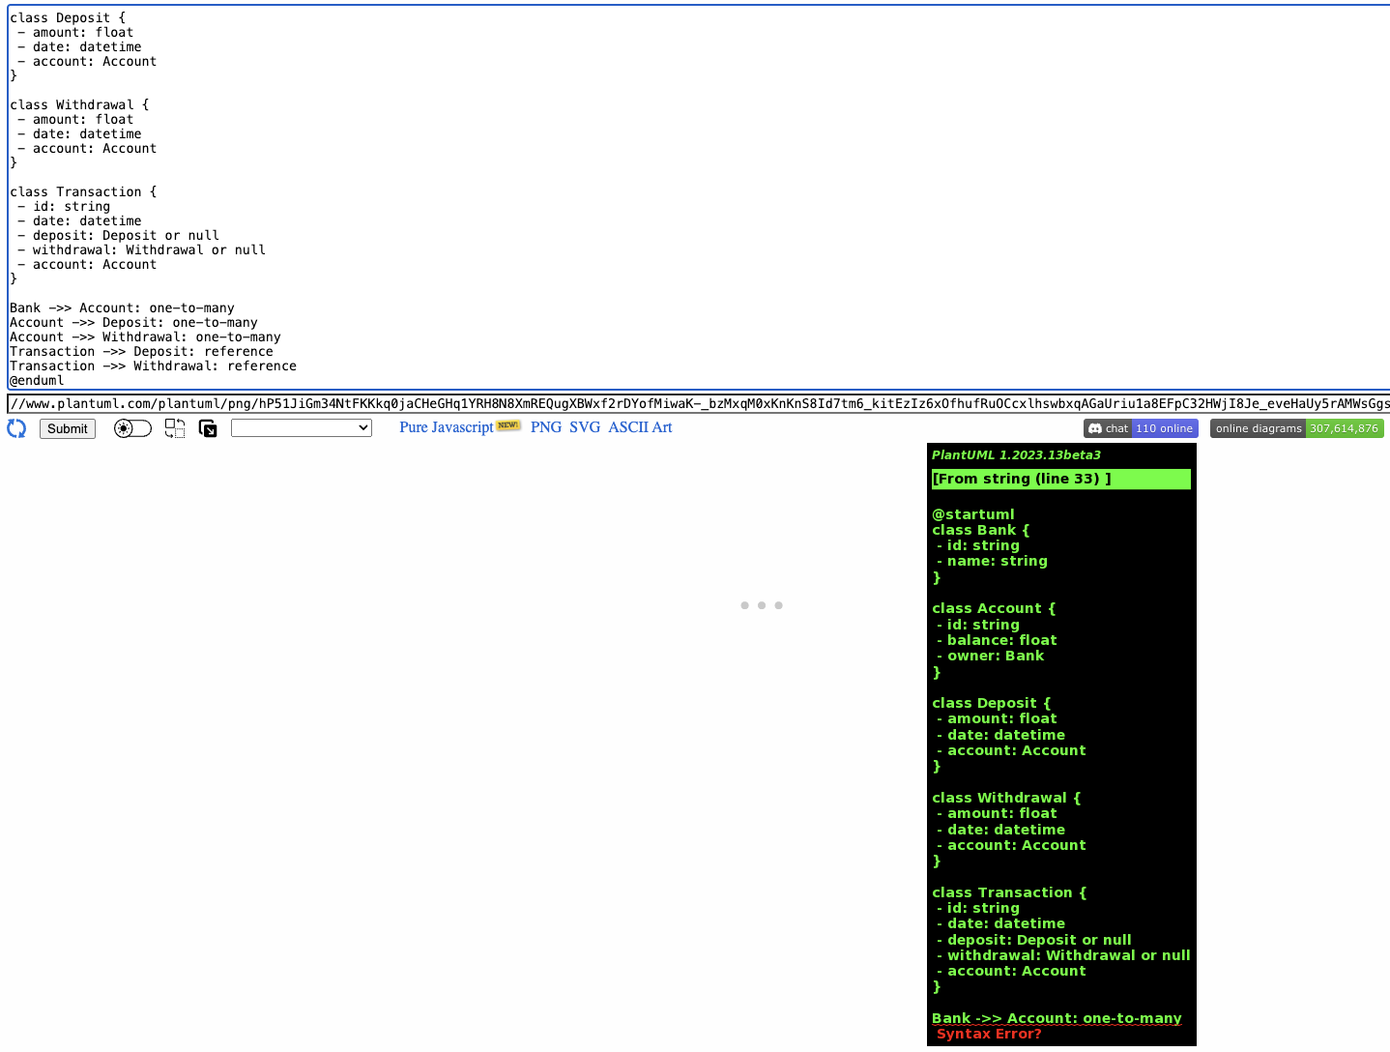
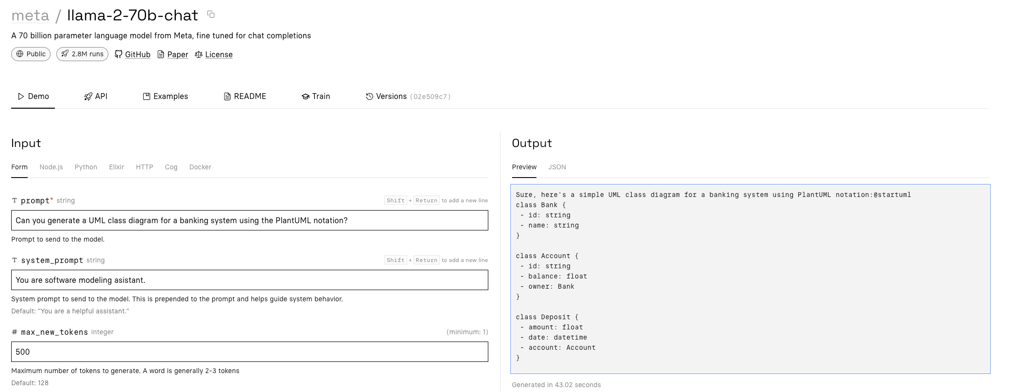
LLaMa

Slide 26
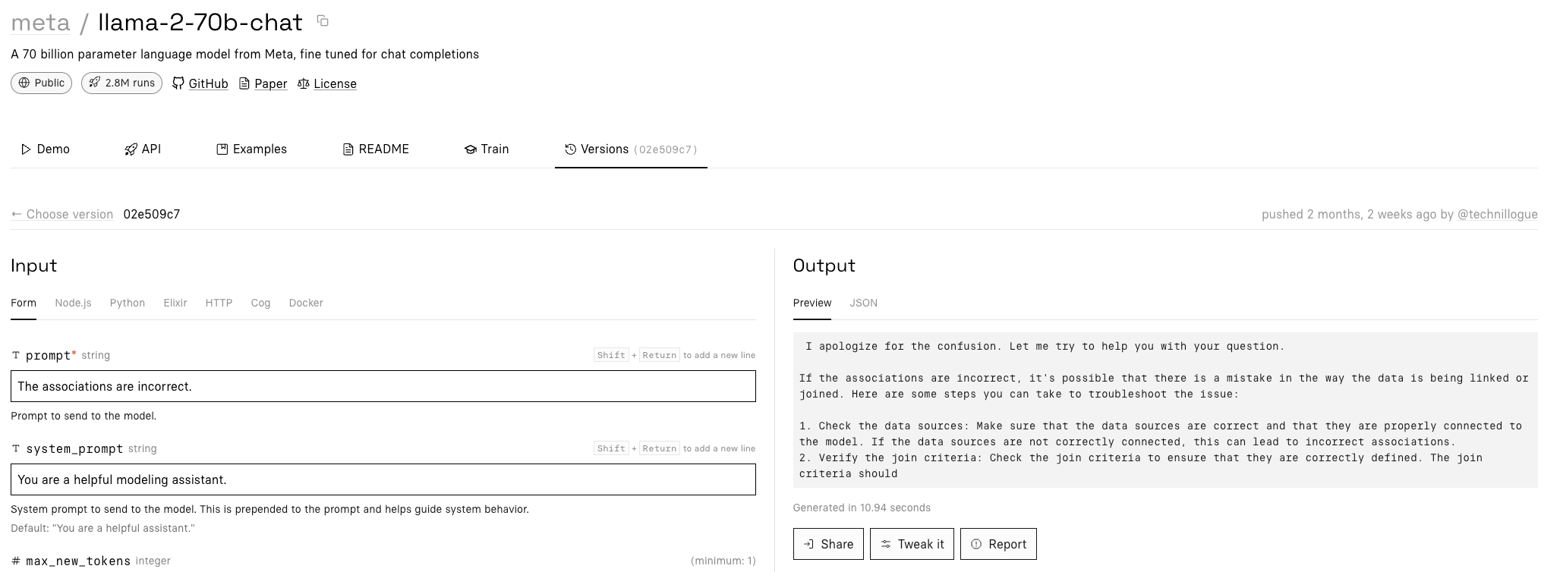
LLaMa
Hallucination / Useless

Slide 27
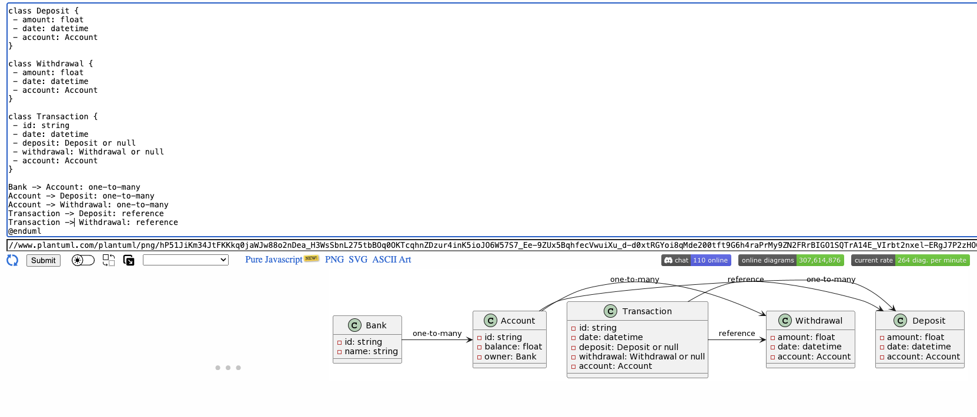
LLaMa
Give up
LLaMa gave a good starting point
We fix the error and finish the model

Slide 28
Generative AI for Software Modeling
GPT-4
GPT-3.5
LLaMa
(after human corrections)

Slide 29
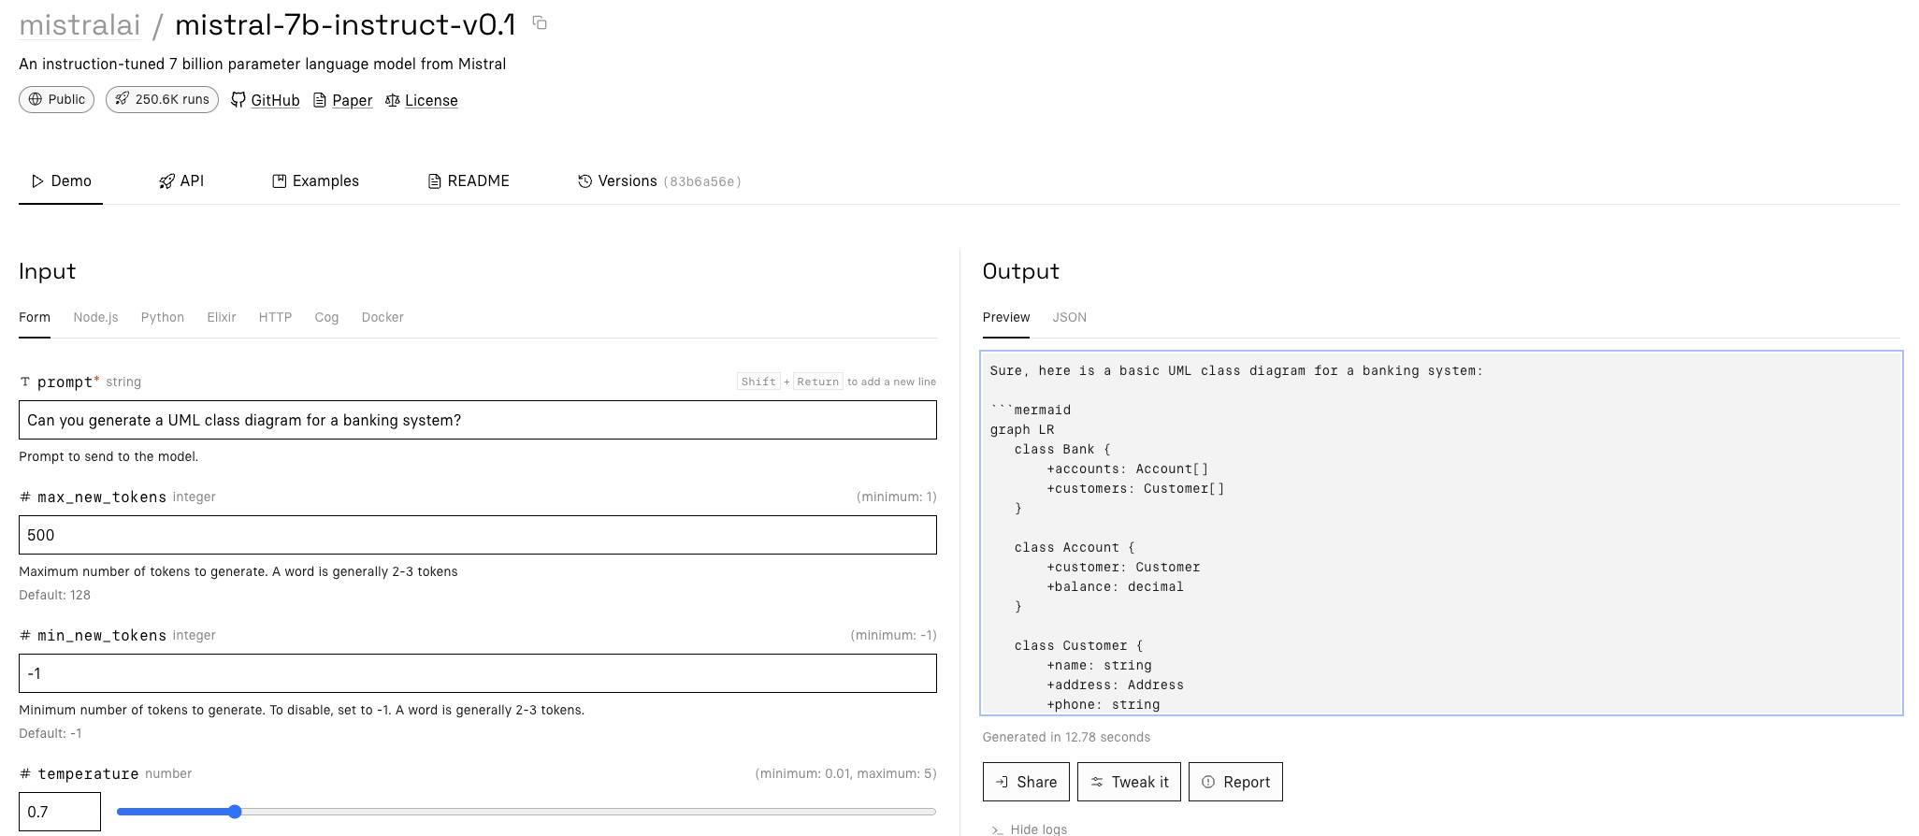
Mistral

Slide 30
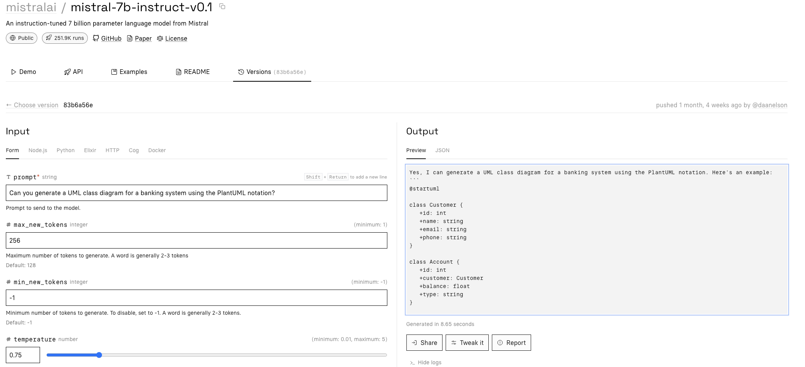
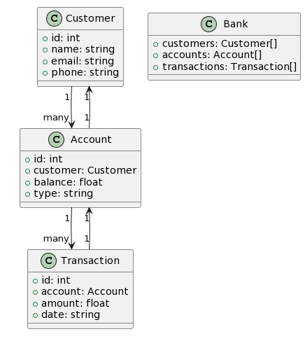
Mistral

Slide 31
Generative AI for Software Modeling
Mistral
GPT-4
GPT-3.5
LLaMa
(after human corrections)

Slide 32
What about
Integrity Constraints?

Slide 33
Integrity constraints
Mistral
LLaMa

Slide 34
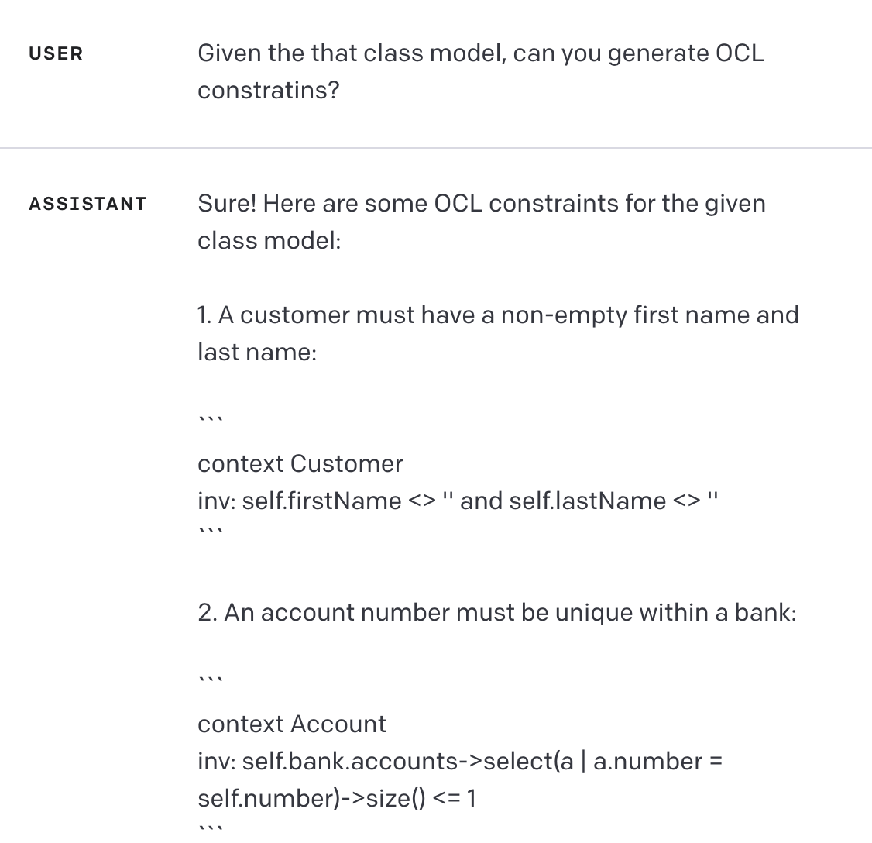
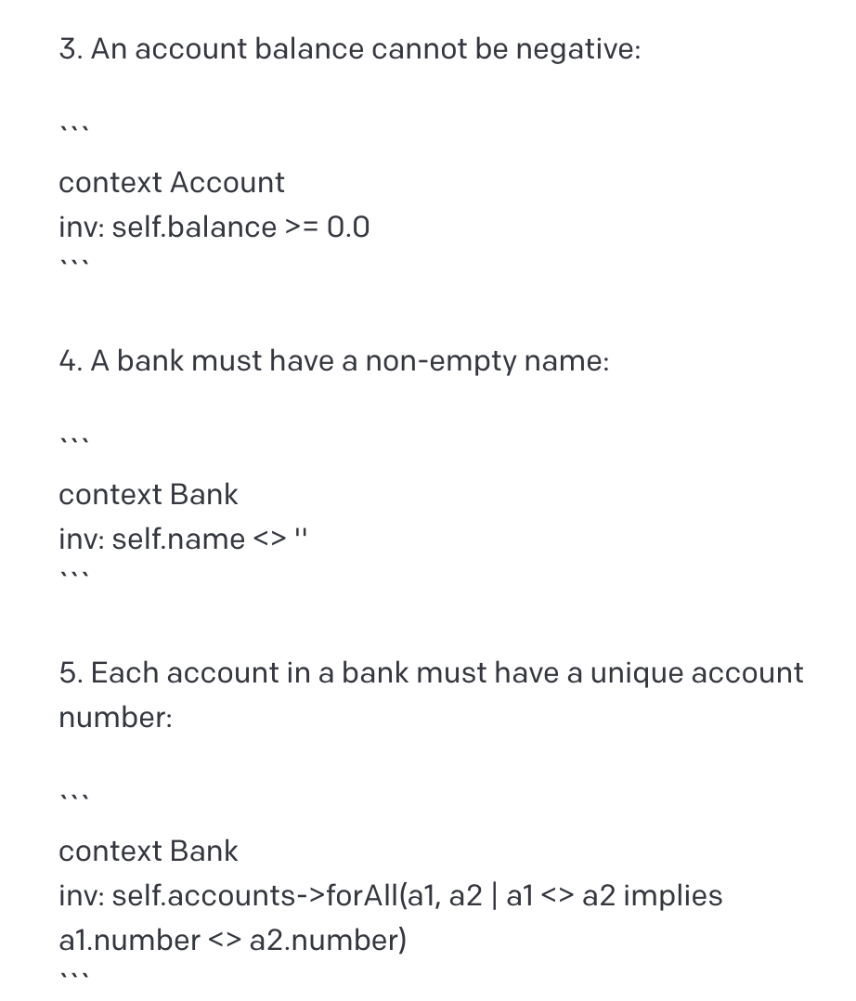
Integrity constraints

Slide 35
Integrity constraints

Slide 36
If we want to represent the integrity constraints of a UML class model using OCL
It is better to develop the model without constraints,
then explicitly ask the LLM to generate the constraints in OCL
GPT works significantly better with OCL than with UML
Notes:
We suspect that this is possibly due to the fact that the data sources used for the construction of OCL expressions are usually SQL, Rust, and other declarative languages for which there is a much larger corpus than for UML.

Slide 37
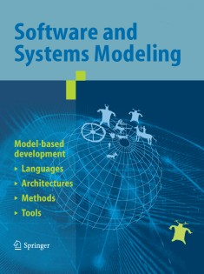
Generative AI for Software Modeling
Investigate issues such as:
the correctness of the produced models;
how to write prompts to build correct and complete software models;
coverage of different modeling concepts and mechanisms;
expressiveness;
sensitivity to context and problem domains
Javier Cámara, Javier Troya, Lola Burgueño, Antonio Vallecillo. “On the assessment of generative AI in modeling tasks: An experience report with ChatGPT and UML”. Softw. Syst. Model. 22(3): 781-793 (2023)

Slide 38
Generative AI for Software Modeling
How:
Experiment. Two phases:
exploratory tests
systematic tests
Eight research questions

Slide 39
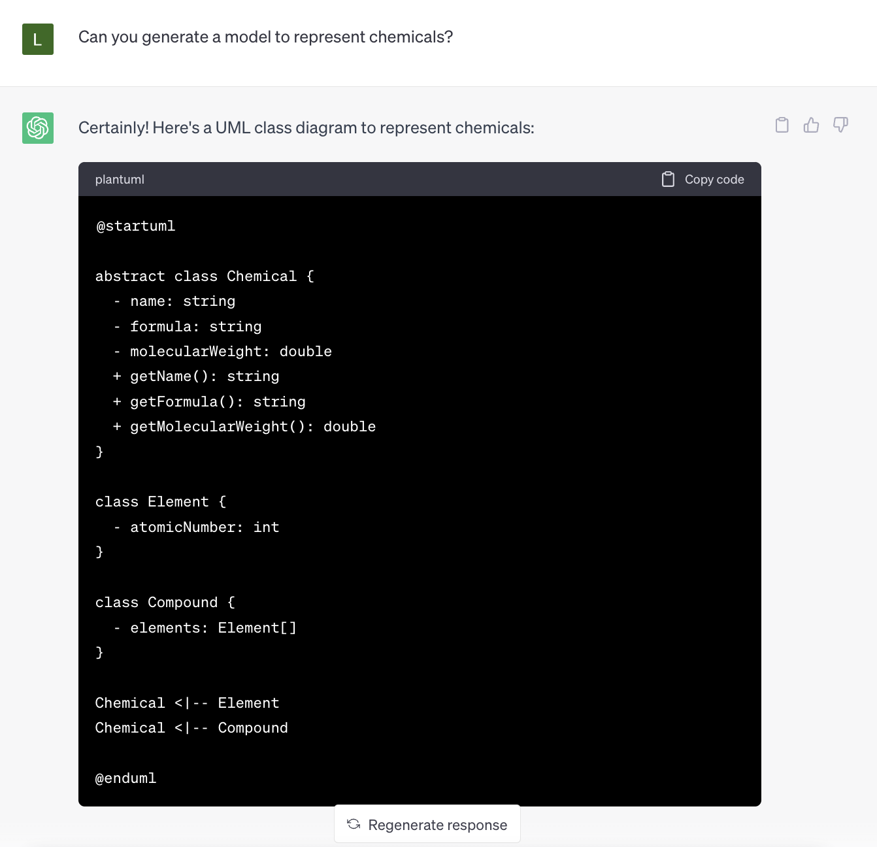
Research Questions
RQ1.: Does ChatGPT generate syntactically correct UML models?
The UML models produced by ChatGPT are generally correct,
although they may contain small syntactic errors, which depend on the notation used (PlantUML, USE, plain text, etc.).
Notes:
Although we did not test it thoroughly, the level of syntactic correctness of the models produced in PlantUML was much higher than those generated in USE, for example.

Slide 40
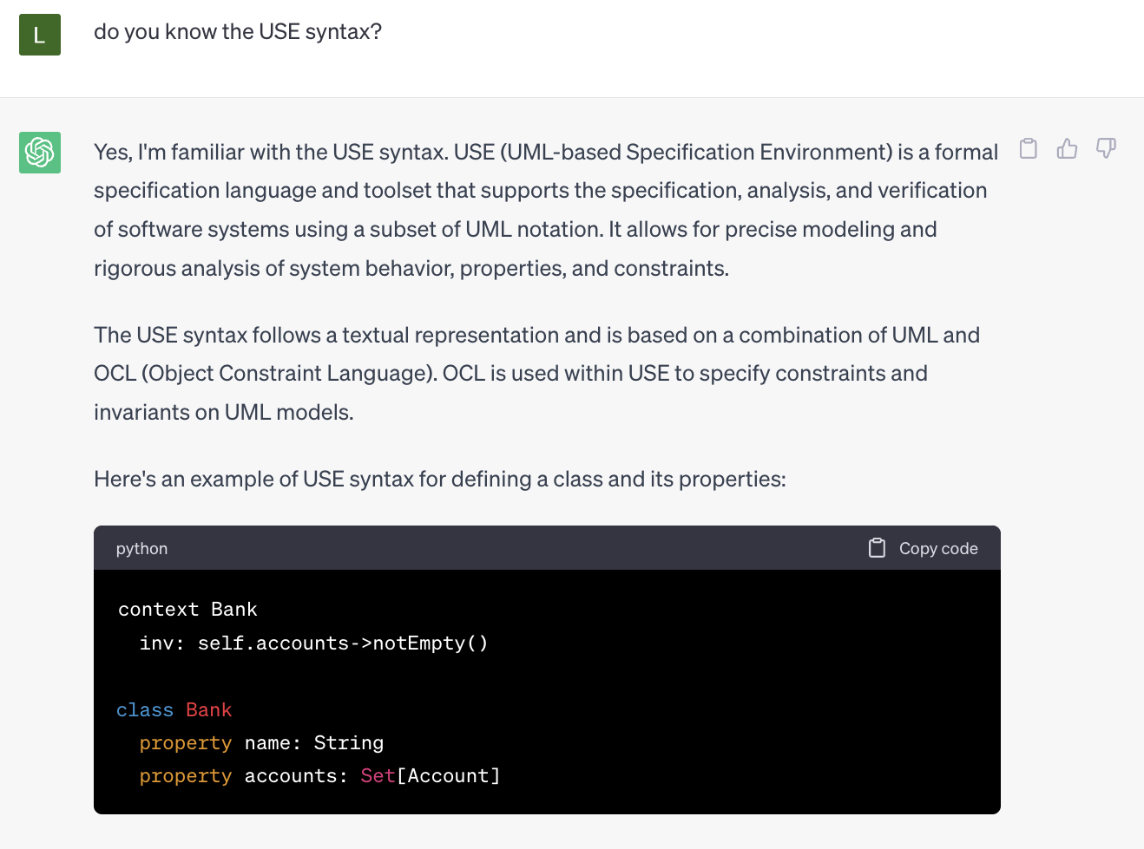
Research Questions
RQ1.: Does ChatGPT generate syntactically correct UML models?
The UML models produced by ChatGPT are generally correct,
although they may contain small syntactic errors, which depend on the notation used (PlantUML, USE, plain text, etc.).
Notes:
Although we did not test it thoroughly, the level of syntactic correctness of the models produced in PlantUML was much higher than those generated in USE, for example.

Slide 41
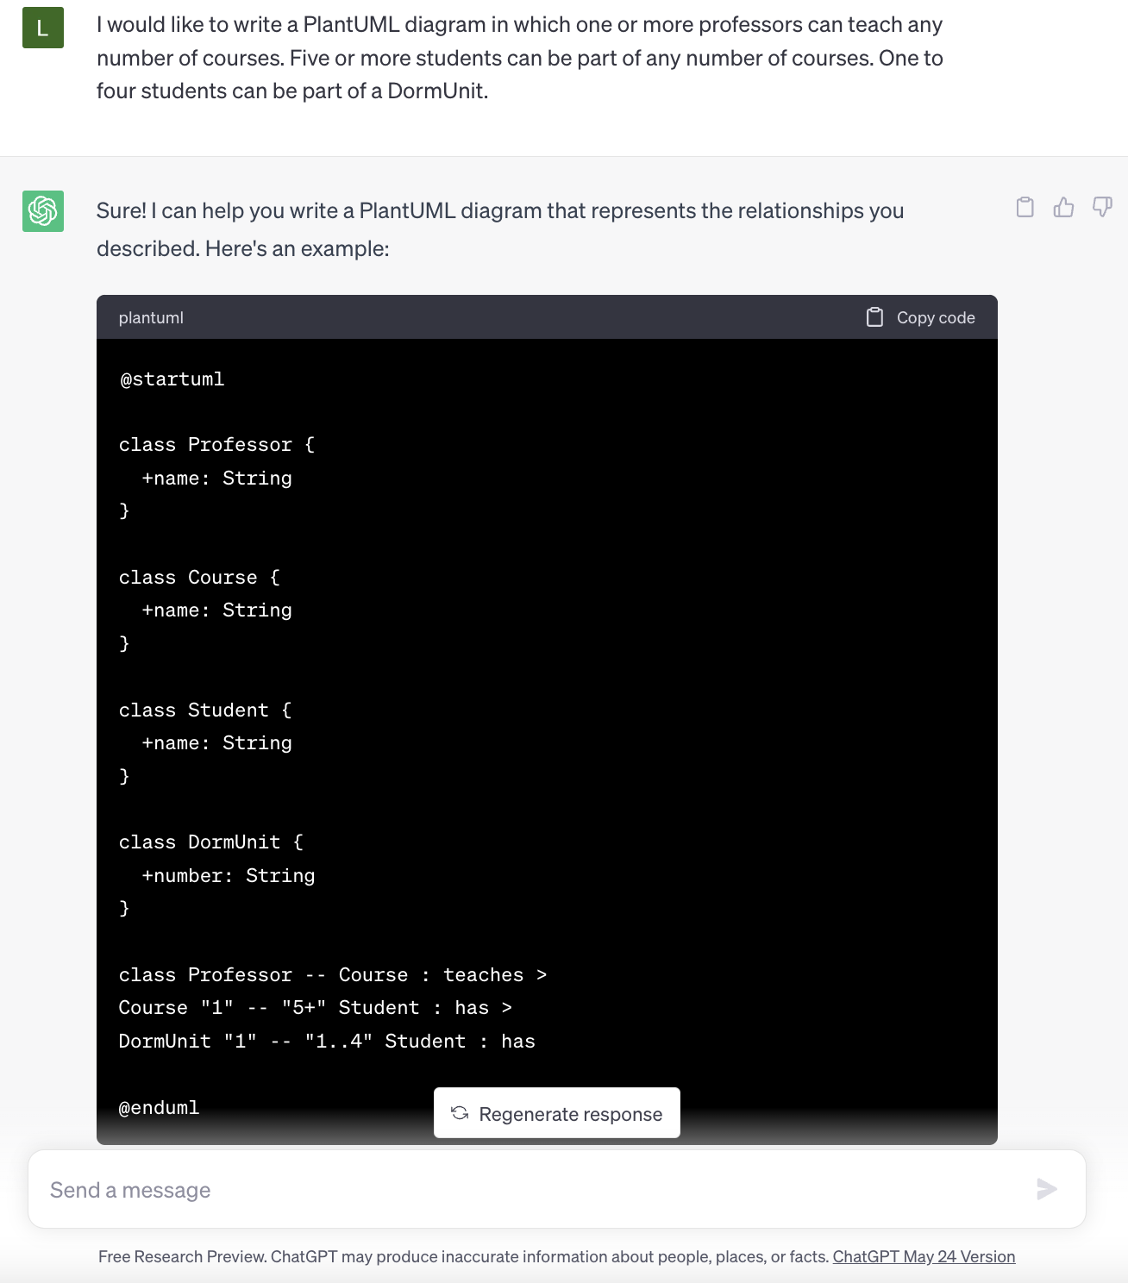
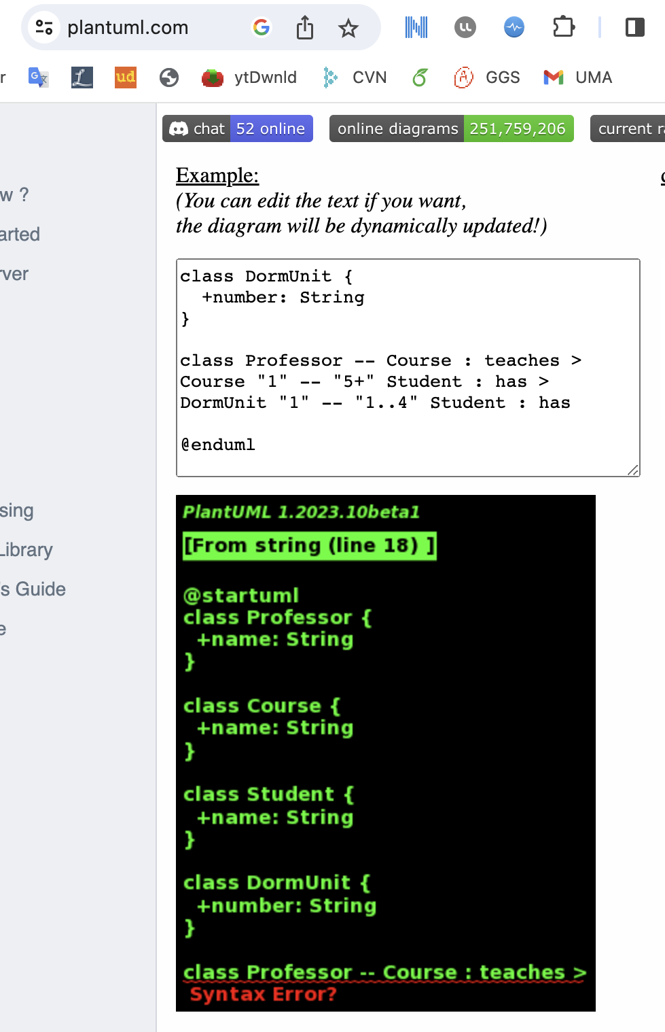
Research Questions
RQ1.: Does ChatGPT generate syntactically correct UML models?
The UML models produced by ChatGPT are generally correct,
although they may contain small syntactic errors, which depend on the notation used (PlantUML, USE, plain text, etc.).
Notes:
Although we did not test it thoroughly, the level of syntactic correctness of the models produced in PlantUML was much higher than those generated in USE, for example.

Slide 42
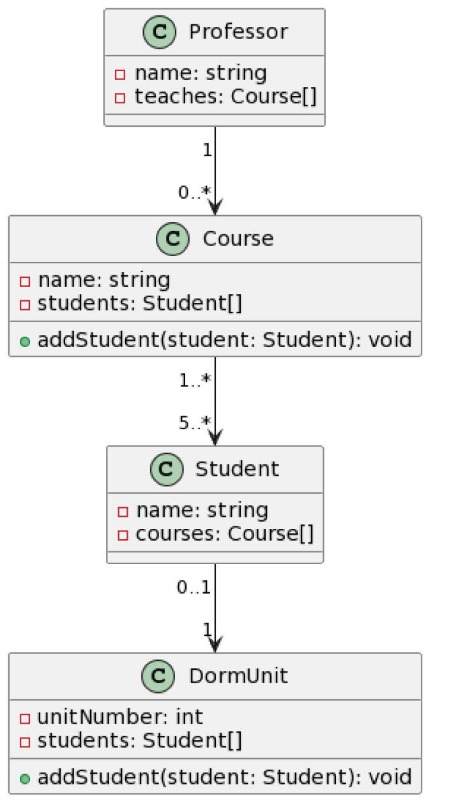
Research Questions
RQ2.: Does ChatGPT generate semantically correct models, i.e., semantically aligned with the user’s intent?
Weakest point
Not surprising: LLMs are better at syntax than producing semantically correct results
This includes errors in both the semantics of the language and the semantics of the domain
NOT BAD!
but the cardinalities were not captured
LET’S INSIST

Slide 43
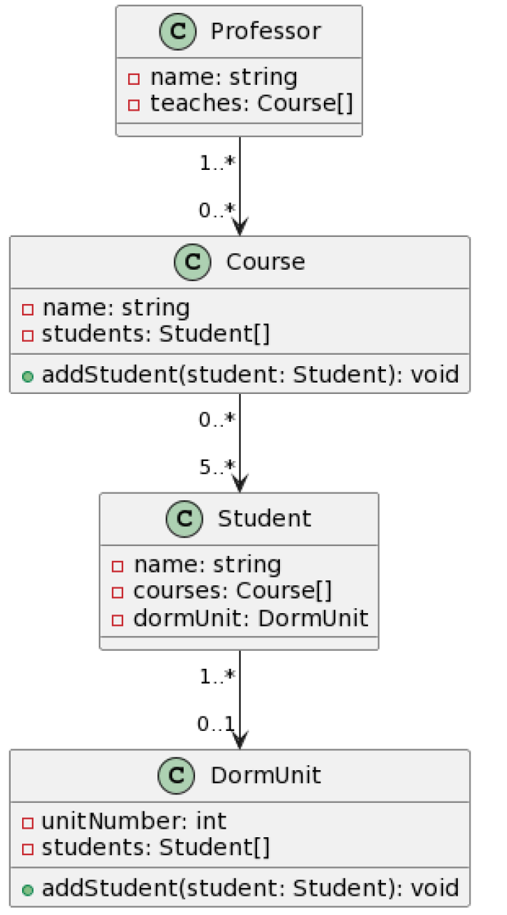
Research Questions
RQ2.: Does ChatGPT generate semantically correct models, i.e., semantically aligned with the user’s intent?
Weakest point
Not surprising: LLMs are better at syntax than producing semantically correct results
This includes errors in both the semantics of the language and the semantics of the domain

Slide 44
Research Questions
RQ5.: Which modeling concepts and mechanisms is ChatGPT able to effectively use?
High degree of variability
Associations
Aggregations
Compositions
Simple inheritance
Role names
Enumerations
Mult. Inheritance
Integrity Constraints
Abstraction
Assoc. Classes
Notes:
We analized 16 modeling concepts
Some of them as simple as classes and attributes, and some of them more advanced such as OCL constraints and or association classes

Slide 45
Research Questions
RQ6.: Does prompt variability impact the correctness/quality of the generated models?
Variability when generating responses to same prompt
Users need knowledge about hyper-parameters
Notes:
Hyperparameters such as temperature

Slide 46
Research Questions
RQ7.: Do different use strategies (e.g., prompt partitioning) result in different outcomes?
YES:
The size of the models forces an iterative process
The variability and randomness force to repeat conversations
Prompt strategies are necessary

Slide 47
Research Questions
RQ8.: How sensitive is ChatGPT to the UML notation used to represent the output models?
Supports several notations (PlantUML, Ecore, …)
It is much better with OCL than with UML

Slide 48
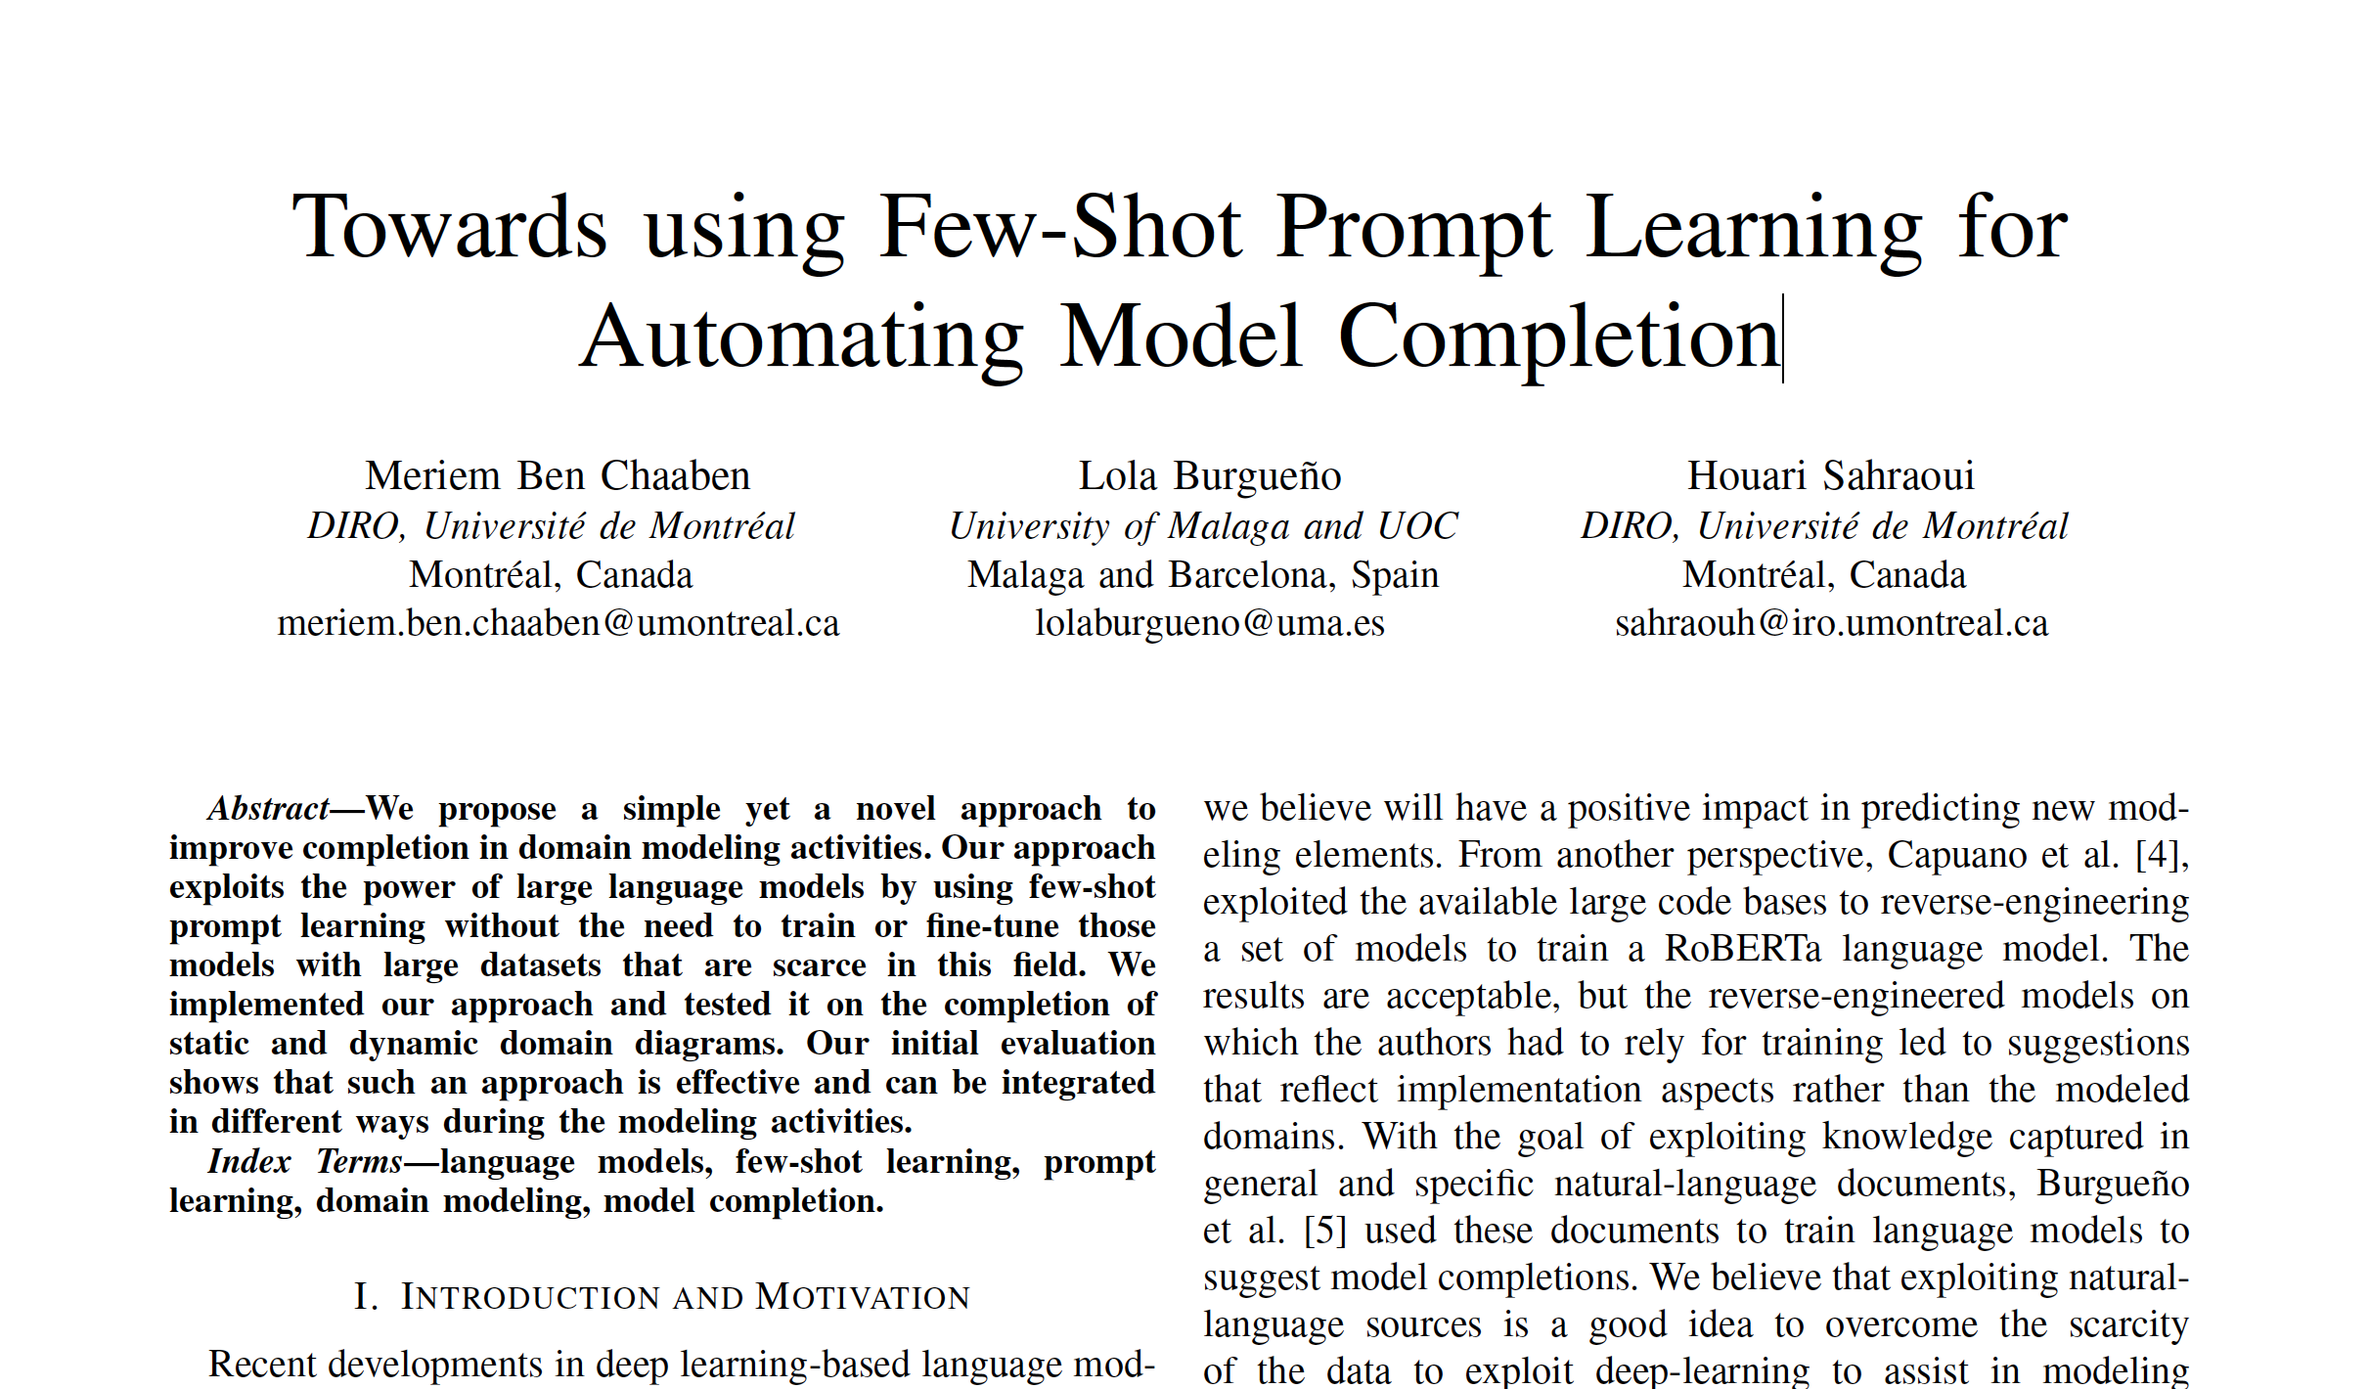
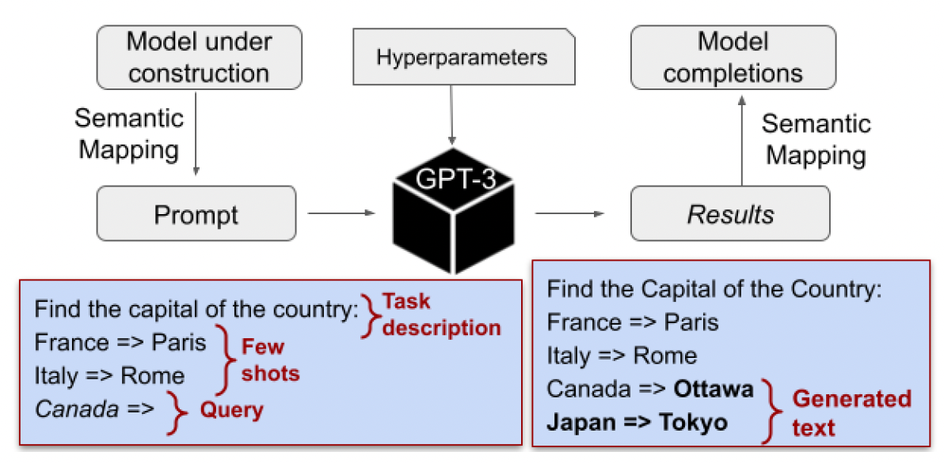
LLM for Model Completion
Meriem Ben Chaaben, Lola Burgueño, Houari Sahraoui: Towards using Few-Shot Learning for Automating Model Completion. In Proc. of ICSE 2023.
Notes:
- We need to adapt the semantics of the general concepts represented in GPT-3 to the semantics of modeling formalisms
- These semantic mappings rely heavily on the targeted modeling formalisms

Slide 49
Large Language Models for Model Completion
Structural Diagram
Semantic
Mapping
Semantic
Mapping

Slide 50
Tool Demo: Model completion assistant
* work to be submitted soon!

Slide 51
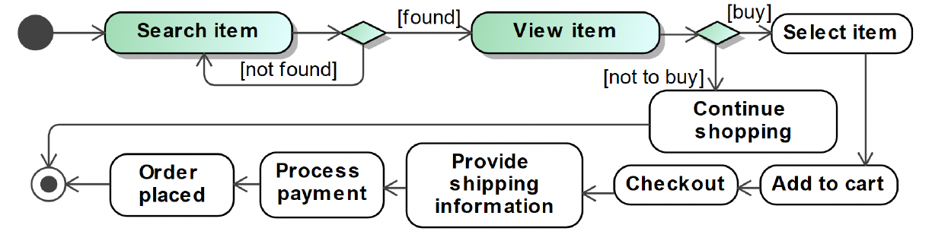
Large Language Models for Model Completion
Behavioural Diagrams:
Specific challenges such as precedence/sequence constraints (i.e., to represent time)
We need to define and provide shots that preserve these constratins

Slide 52
Large Language Models for Model Completion
Behavioural Diagrams:
Specific challenges such as precedence/sequence constraints (i.e., to represent time)
We need to define and provide shots that preserve these constratins

Slide 53
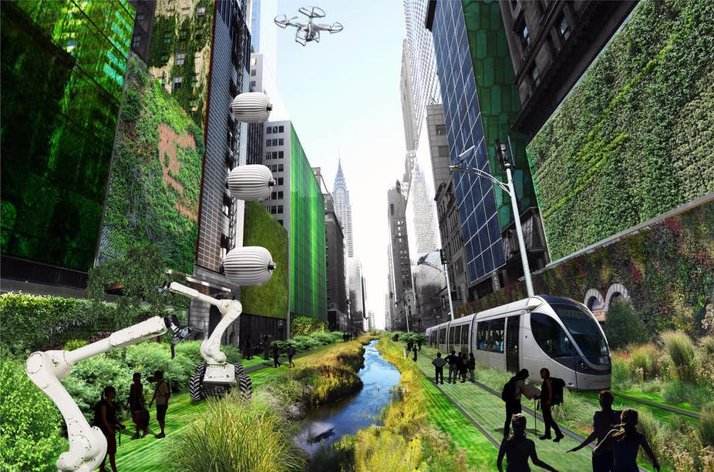
To conclude…
LLMs are not a reliable tool yet
Should discard them (or wait to see how it evolves)?
NO! We should start working now to strengthen the modeling skills of the LLMs to come
- Beyond UML

Slide 54
Discussion & Conclusions
LLMs are not a reliable tool yet
Should discard it (or wait to see how it evolves)?
NO! We should start working now to strengthen the modeling skills of the LLMs to come
- Beyond UML
LLM can be of invaluable help in many areas of MBSE
Complement the current work of software modelers,
letting them focus on the tasks for which h they really provide value
LLMs have the potential to revolutionize software modeling engineering and education
More accessible, personalized and efficient
We will need to improve the quality of the models produced / suggested
We will need to change the way in which models are developed and taught

Slide 55
Revolutionizing
Model Development with
Large Language Models
Lola Burgueño
MDENet Annual Symposium 2023
London, United Kingdom
December 5th, 2023

Slide 56
Generative AI for Software Modeling
Experiment. Two phases:
exploratory tests (not systematic)
systematic tests
become acquainted with ChatGPT’s modeling capabilities
general characteristics such as hyperparameters (e.g., number of tokens)
each author independently proposed ten UML models
3-6 classes (so that ChatGPT can handle them) representing different user intents
tried to cover the most important modelling concepts and mechanisms
for each one of them, the exercise consisted in asking ChatGPT to produce the corresponding UML model using one or more prompts

Slide 57
Generative AI for Software Modeling
Experiment. Two phases:
exploratory tests (not systematic)
systematic tests
become acquainted with ChatGPT’s modeling capabilities
general characteristics such as hyperparameters (e.g., number of tokens)
each author independently proposed 10 UML models
3-6 classes (so that ChatGPT can handle them) representing different user intents
tried to cover the most important modelling concepts and mechanisms
for each one of them, the exercise consisted in asking ChatGPT to produce the corresponding UML model using one or more prompts

Slide 58
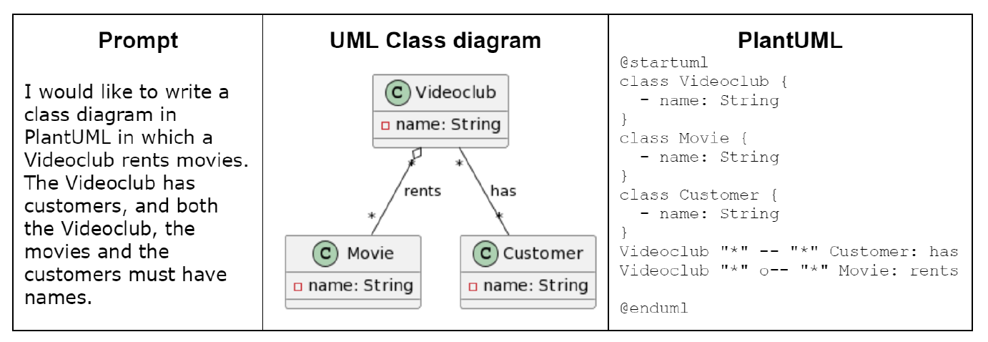
Generative AI for Software Modeling
Example: Prompt used to generate the intended model in PlantUML
! Most of the times, several prompts were needed to obtain the intended model
!! Sometimes we were not able to make ChatGPT generate the intended model

Slide 59
Generative AI for Software Modeling
Experiment. Two phases:
exploratory tests (not systematic)
systematic tests
become acquainted with ChatGPT’s modeling capabilities
general characteristics such as hyperparameters (e.g., number of tokens)
each author independently proposed 10 UML models
3-6 classes so that ChatGPT can handle them) representing different user intents
tried to cover the most important modelling concepts and mechanisms
for each one of them, the exercise consisted in asking ChatGPT to produce the corresponding UML model using one or more prompts
from the complete set of 40 exercises, we selected two from each author

Slide 60
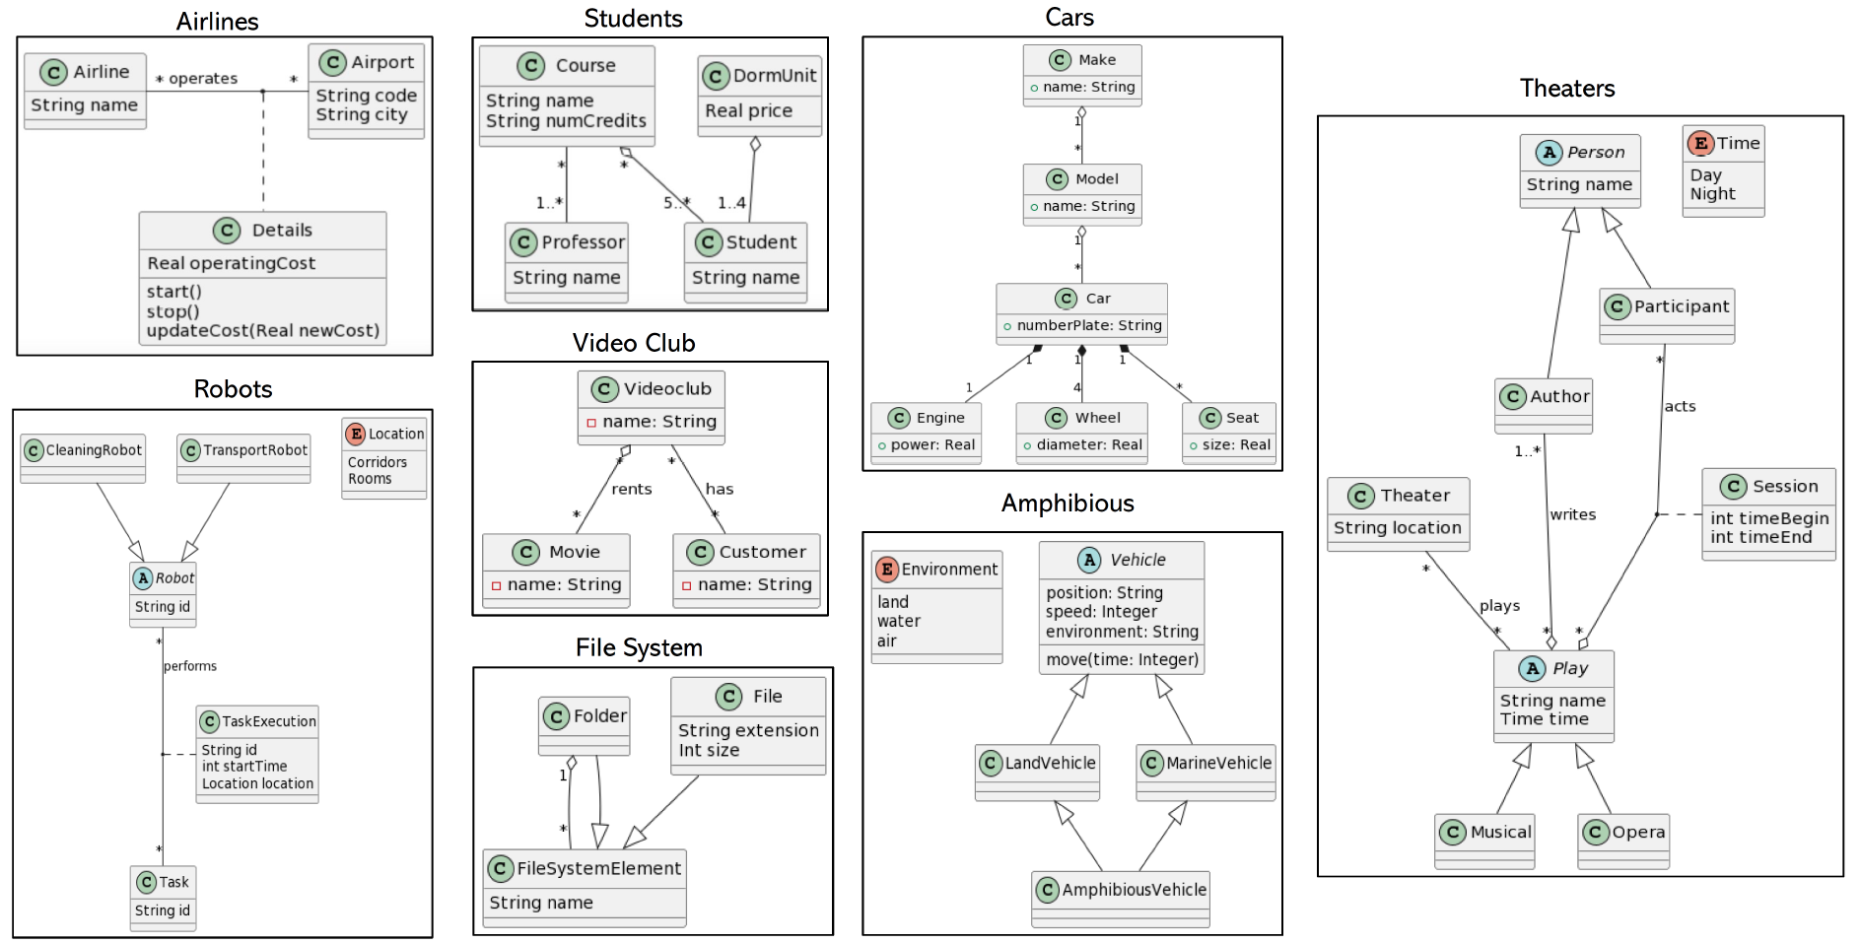
Experiment: 8 intent models

Slide 61
Experiment: Properties of each intent model

Slide 62
Generative AI for Software Modeling
Experiment. Two phases:
exploratory tests (not systematic)
systematic tests
become acquainted with ChatGPT’s modeling capabilities
general characteristics such as hyperparameters (e.g., number of tokens)
each author independently proposed ten UML models
3-6 classes so that ChatGPT can handle them) representing different user intents
tried to cover the most important modelling concepts and mechanisms
for each one of them, the exercise consisted in asking ChatGPT to produce the corresponding UML model using one or more prompts
from the complete set of 40 exercises, we selected two from each author
each author tried to make ChatGPT generate these UML intent models as faithfully as possible, using different strategies to create the prompts

Slide 63
Generative AI for Software Modeling
How:
Experiment. Two phases:
exploratory tests to gain a basic understanding of how ChatGPT works with software models, as well as its main features and limitations;
systematic tests that aimed to further characterize ChatGPT’s modeling capabilities.
Eight research questions

Slide 64
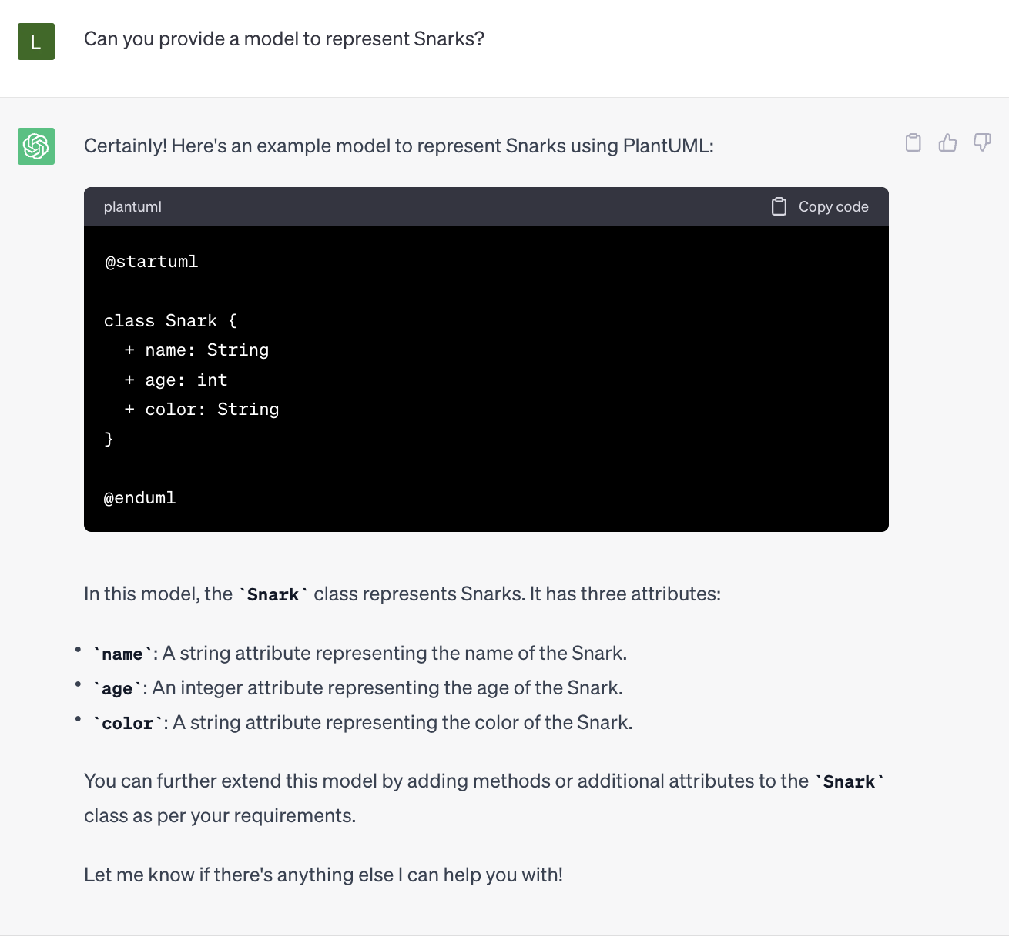
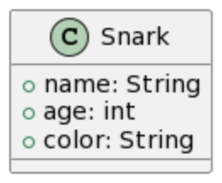
Research Questions
RQ3.: How sensitive is ChatGPT to the context and to the problem domain?
The problem domain influences the resulting models …
Data about a domain during training

Slide 65
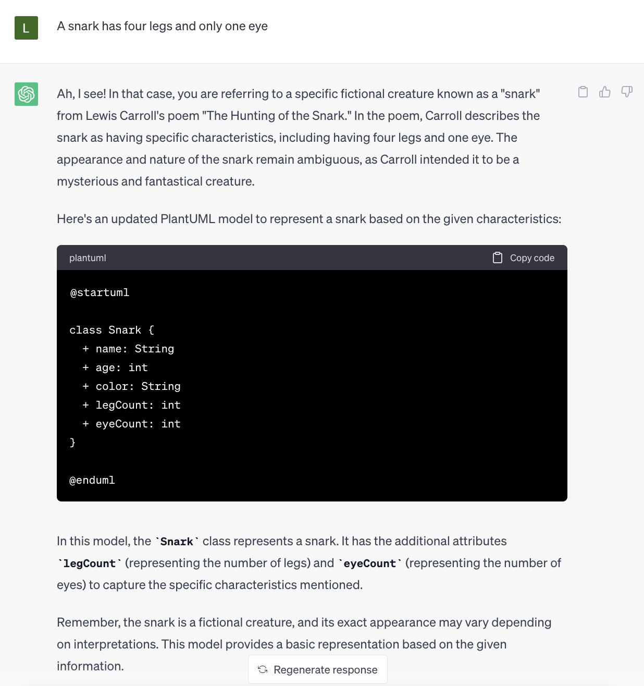
Research Questions
RQ3.: How sensitive is ChatGPT to the context and to the problem domain?
The problem domain influences the resulting models …
Data about a domain during training
… and also the information exchanged during the dialogues with ChatGPT

Slide 66
Research Questions
RQ4.: How large are the models that ChatGPT is able to generate or handle?
ChatGPT currently has strict limitations on the size of the models it can handle
10-12 classes

