Slide 1
Enhancing LLM Code Generation with domain-specific UML models
Real-world examples from industry
Marc North
CS, Durham University
Durham, UK
marc.north@durham.ac.uk
marc.north@methodgrid.com
Nelly Bencomo CS, Durham University Durham, UK nelly.bencomo@durham.ac.uk
Amir Atapour-Abarghouei CS, Durham University Durham, UK amir.atapour-abarghouei@durham.ac.uk
Notes:
My name is…
Senior developer at Method Grid, we are a project and knowledge management platform, primarily working in the engineering consultancy sector for major project.
I am also a postgrad researcher at Durham University in the UK, so I have a foot in each camp, research and industry.
And today I am going to be talking about current use, and some potential future uses, of AI, specifically natural language processing, within software engineering.

Slide 2
6
Maintain
1
Planning
Software Engineering Cycle
5
Test
2
Analysis
4
Implement
3
Design
Notes:
Just to orientate ourselves in the world of software engineering, because I know everyone here is going to have different research interests or different parts of software engineering that they work in…
I’m a developer, so I spend most of my time down here, writing code. And it’s this area, specifically the link between these two areas, that I’m going to be focusing on today.

Slide 3
6
Maintain
1
Planning
Software Engineering Cycle
5
Test
2
Analysis
4
Implement
3
Design
Notes:
And increasingly, when I’m coding these days, I’m doing so with the assistance of a large-language model. And what we have found at Method Grid, is that while these code-generating LLMs can be a big productivity boost for myself, and our other developers, they can also sometimes be a distraction. Because they will create code that, while syntactically correct, doesn’t conform to our domain models. Or they’ll use variables and function names that don’t follow the language of our domain.

Slide 4
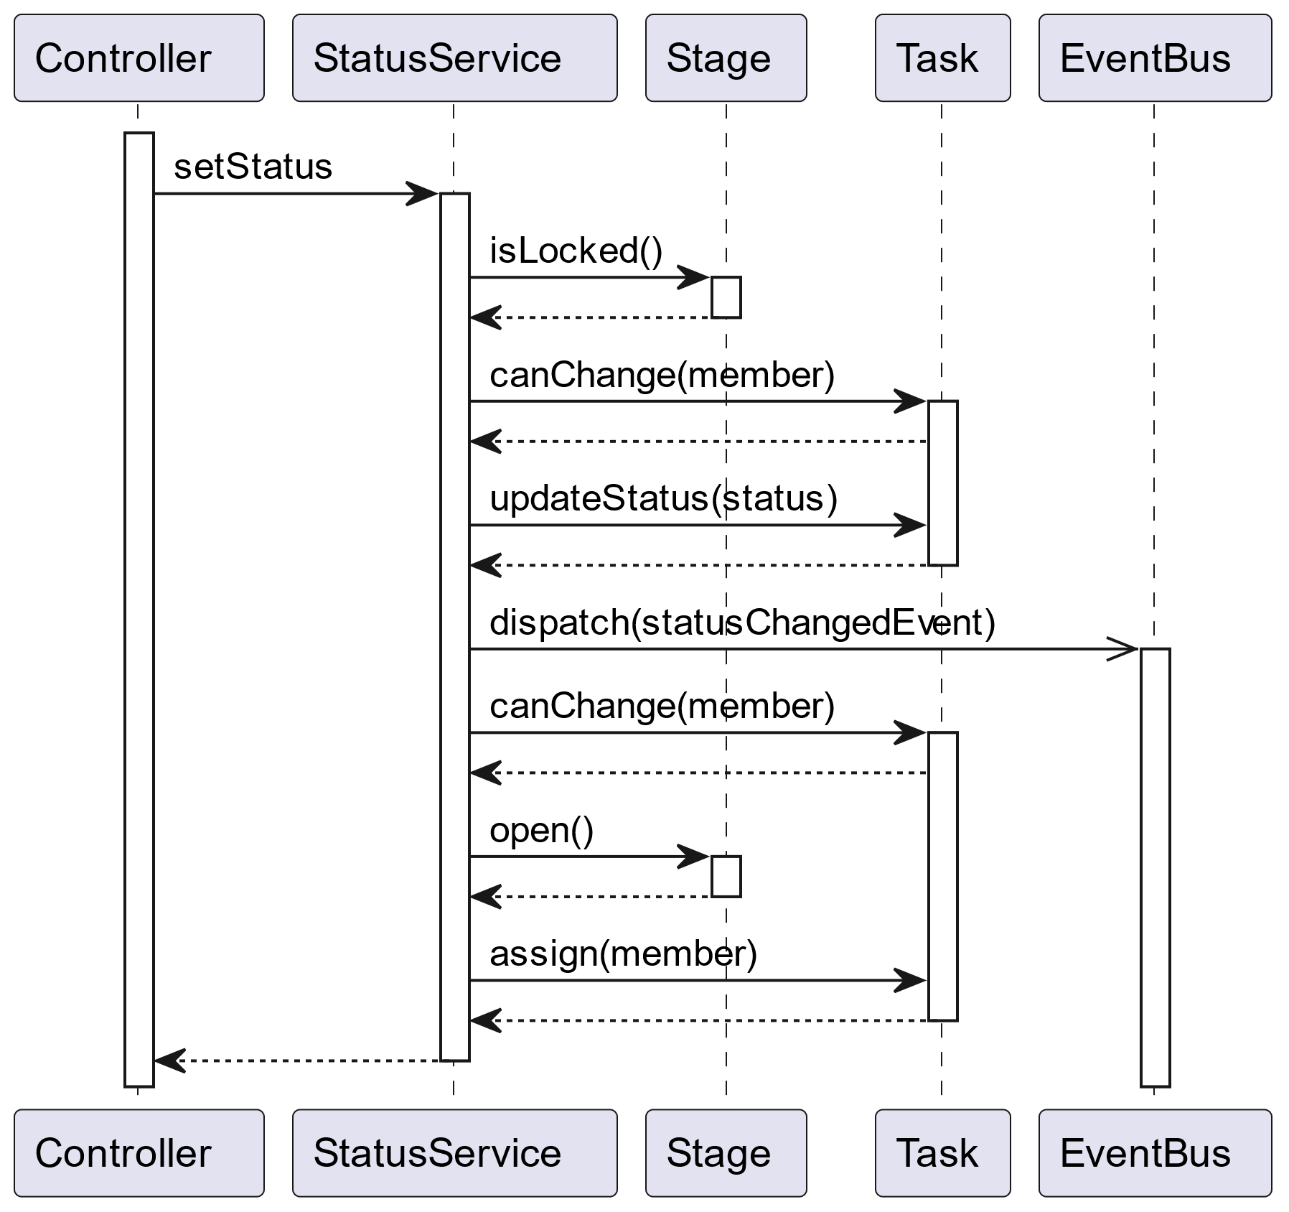
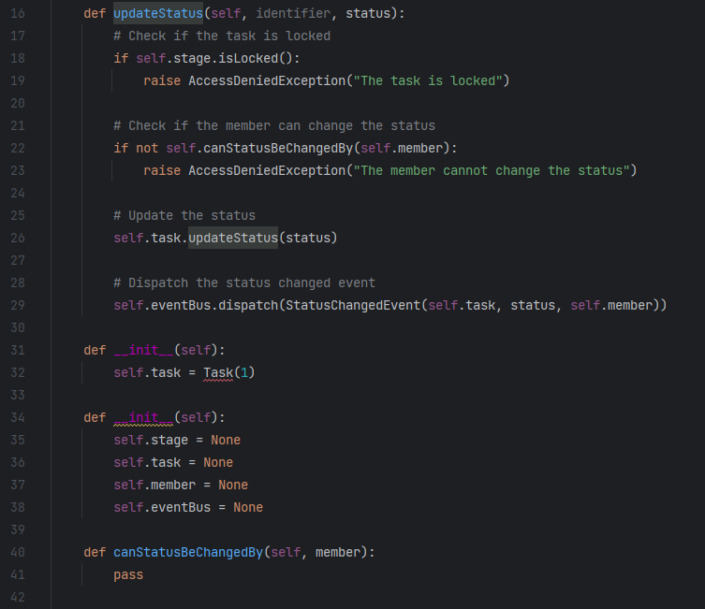
3
Design
4
Implementation
Notes:
So naturally that raises the question: What if they did know about our domain? What if the LLMs we are using to generate code knew about the requirements of a feature we’ve currently working on, or about the structure and the language of our domain?
Because while we often like to think that our code and our models are closely linked to one another, in reality these are two separate *discrete* things. We can verify that our code’s functionality matches our domain models, but they are two separate things produced by separate processes.
So, how can we strengthen this link between or high-level models and are low-level code. I’m going to talk about two things.

Slide 5
3
Design
4
Implementation
Notes:
Firstly, if we give our LLMs access to these higher-level abstractions of our domain: sequence diagrams, class diagrams, requirement documents. Are they able to use that higher-level abstraction to generate lower-level code that conforms to our requirements and our domain?
Now, spoilers, the answer is yes.

Slide 6
3
Design
4
Implementation
Notes:
And secondly, I’m going to talk about what’s going on inside our LLM when it’s generating code from these high-level abstractions. And using that, we’re going start creating a *continuous* mapping between our generated code and our high-level abstractions.
And to demonstrate this, we’re going to go through the process of implementing a feature within Method Grid. We’re going to write some code – or, rather, we’re going to ask an LLM to write the code for us – to create this new feature. And then we’ll dive into some neural network internals.

Slide 7
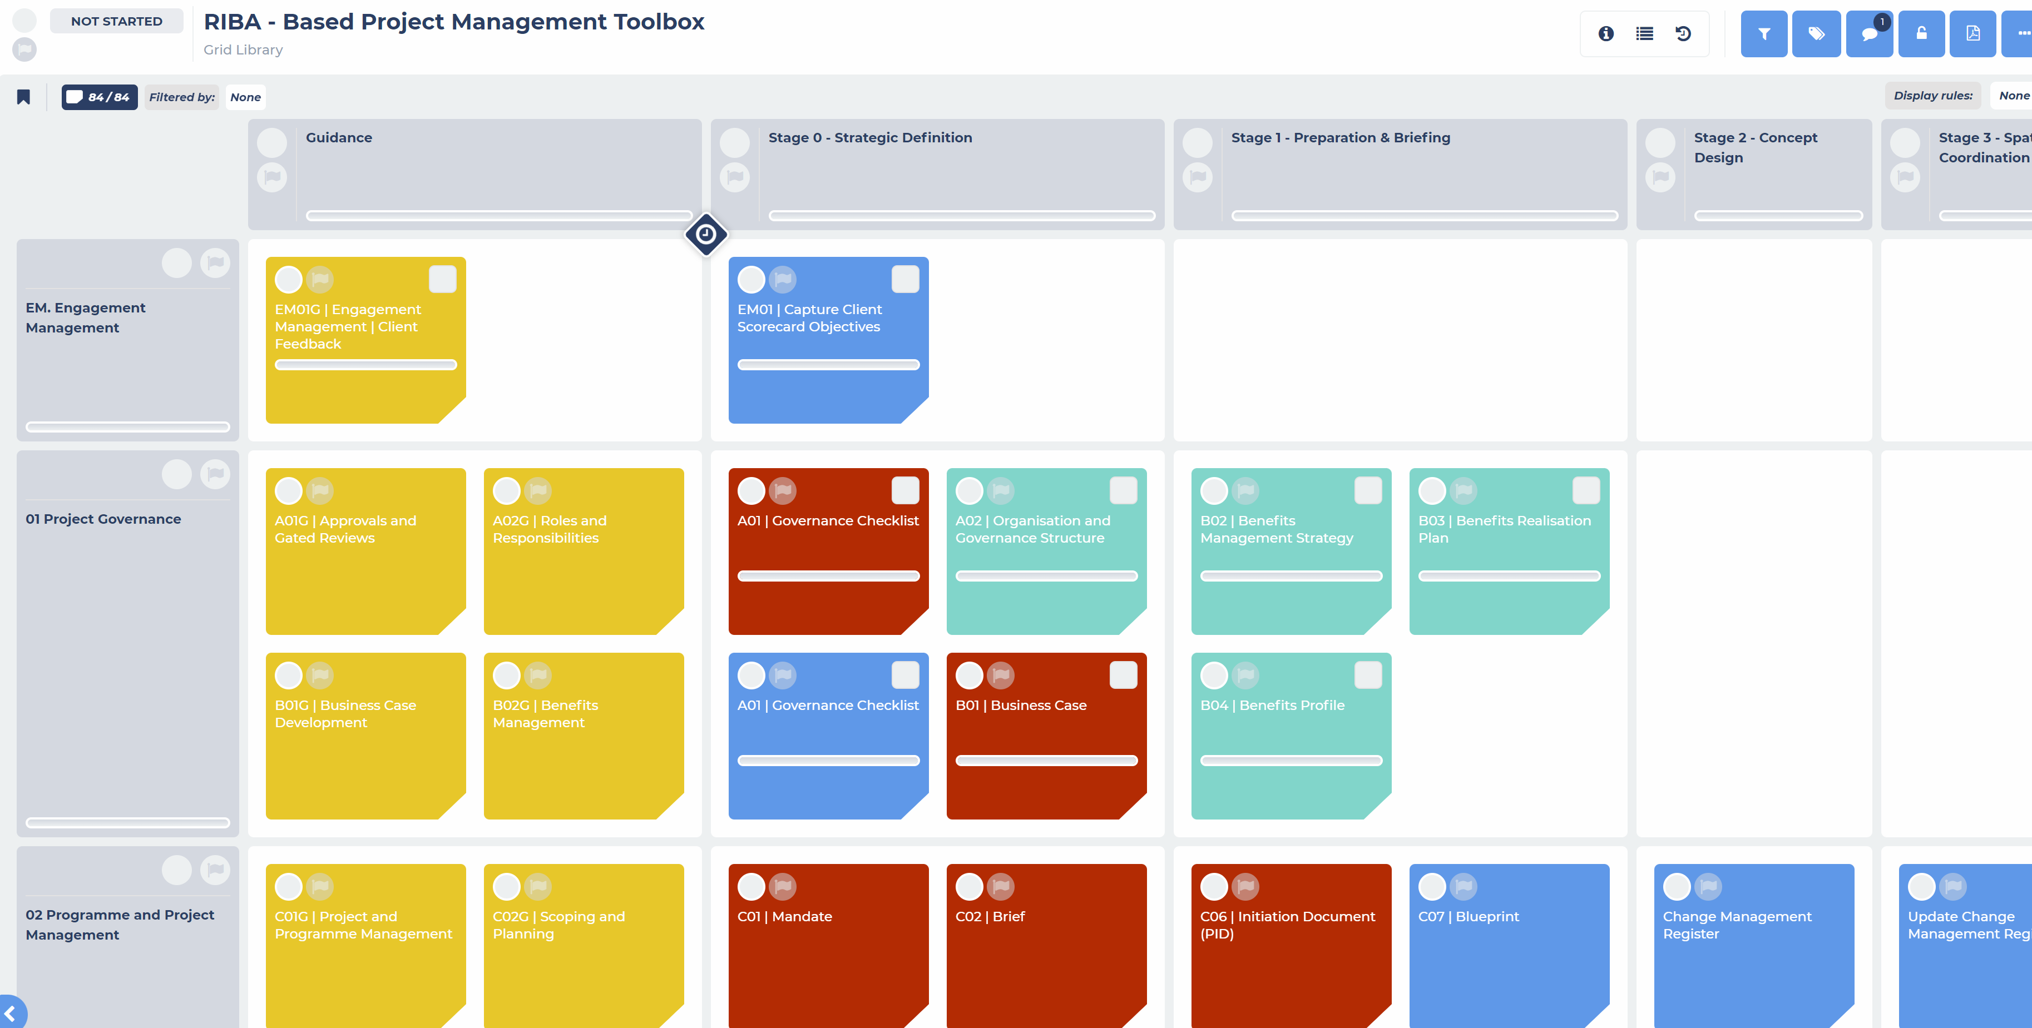
3
Design
4
Implementation
3
Design

Slide 8
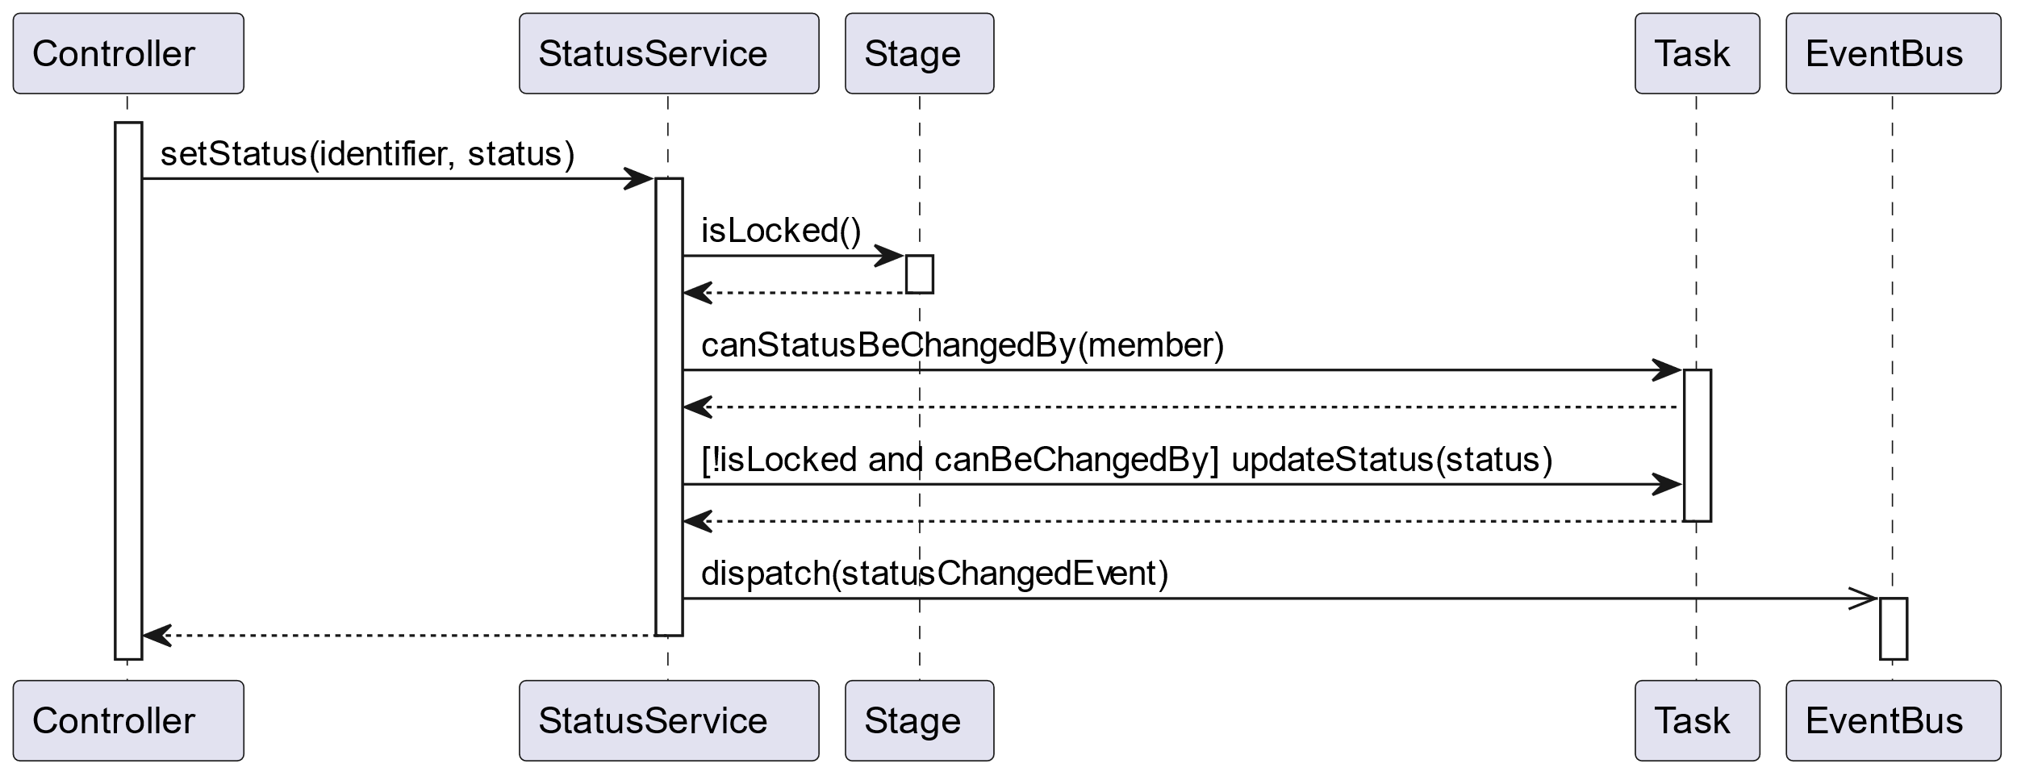
3
Design
4
Implementation
Notes:
Being good software engineers, we create some models to explain and communicate our new feature. Here’s a sequence diagram. After discussion with our domain experts and developers we produce this sequence diagram. (Briefly explain diagram).

Slide 9
1. Prompt Only
3
Design
4
Implementation
“Write a Python method called updateStatus(identifier, status) in a class called StatusService.”
Notes:
So, we jump forward to the next step of the development cycle, and we have to take on a different persona in our hypothetical scenario. We’re now imagining ourselves to be the developer who has been tasked with translating these requirements and models into code. Being a modern, enterprising developer, we’re using a large language model to boost our productivity when we’re coding. Now, in reality this would be integrated into an IDE, but we’re just going to be directly interfacing with the LLM.

Slide 10
3
Design
4
Implementation
2. With Sequence Diagram

Slide 11
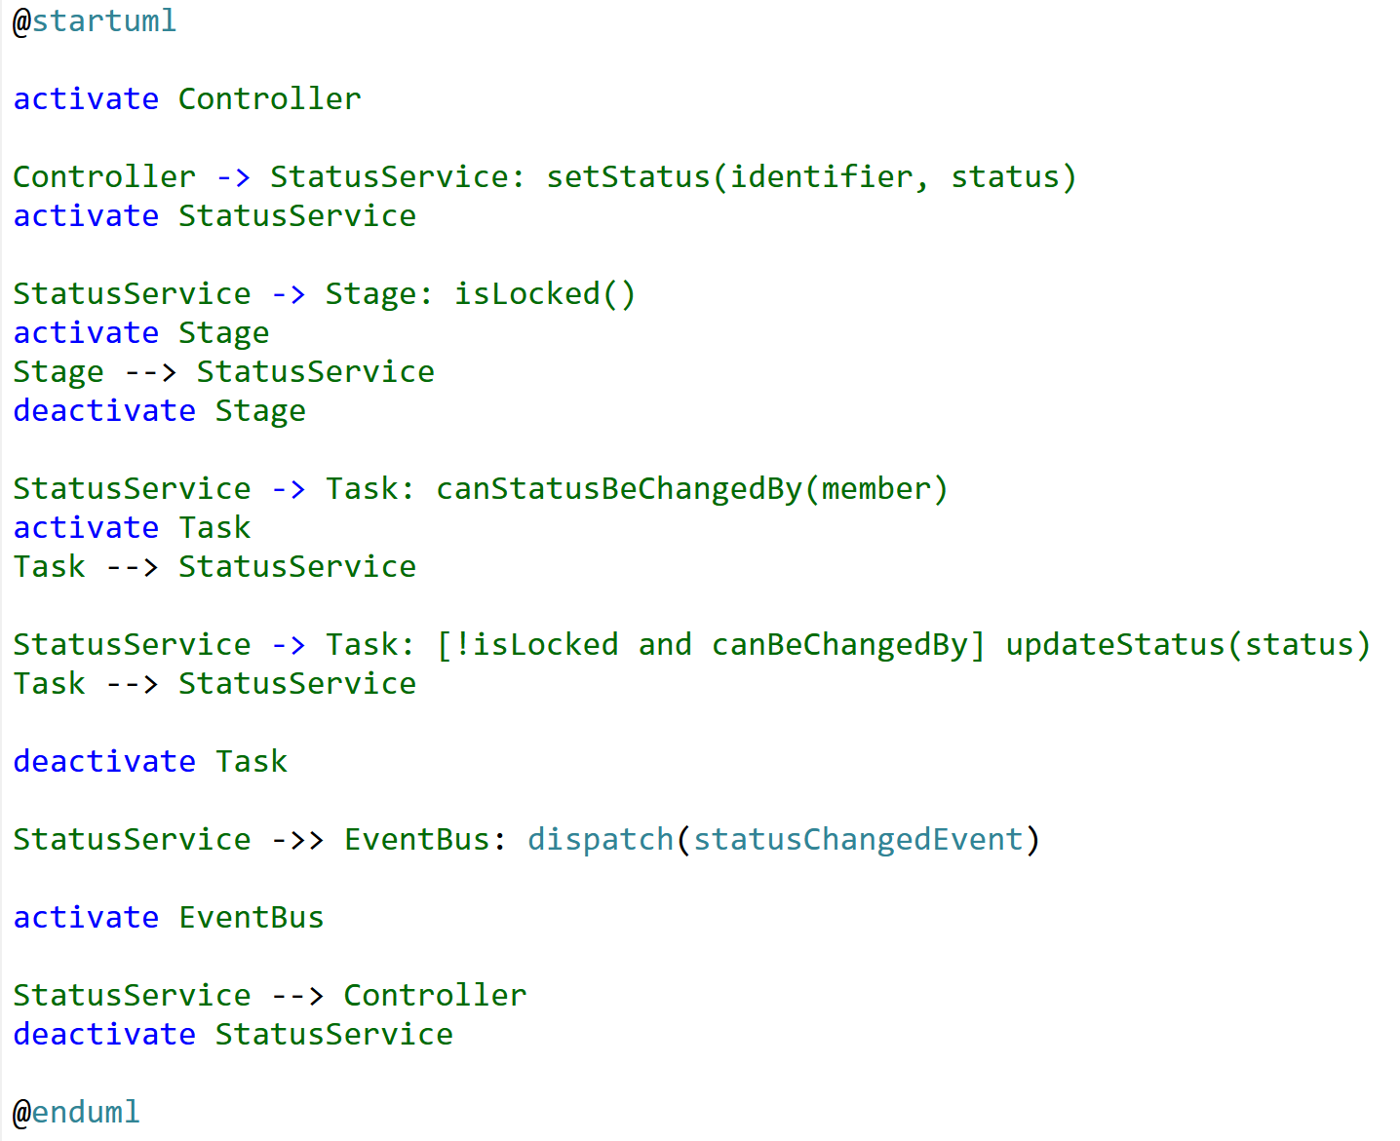
3
Design
4
Implementation
2. With Sequence Diagram

Slide 12
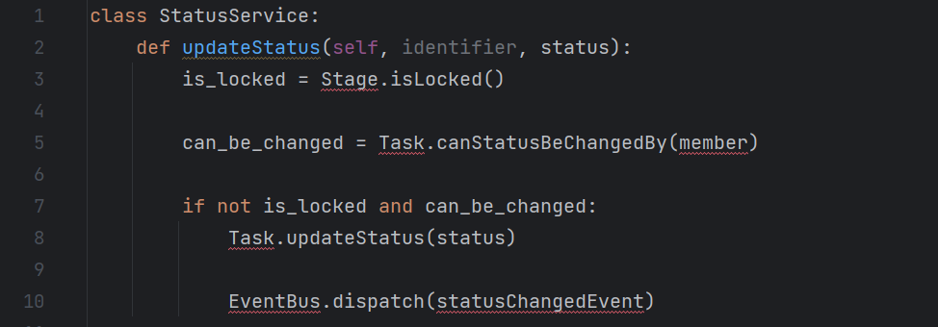
3
Design
4
Implementation
2. With Sequence Diagram
Notes:
Task.canStatusBeChangedBy(member) – it’s just using this ‘member’ variable that it’s plucked from nowhere.
Mention exception

Slide 13
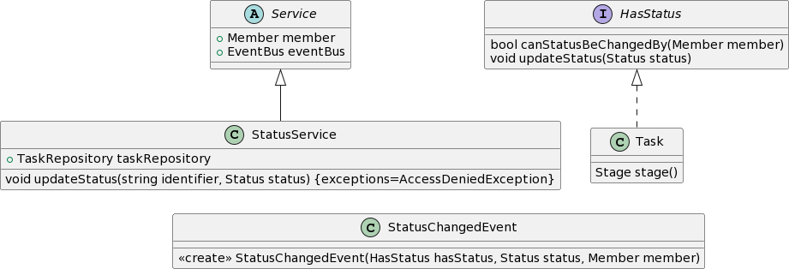
3
Design
4
Implementation
3. Sequence & Class Diagram

Slide 14
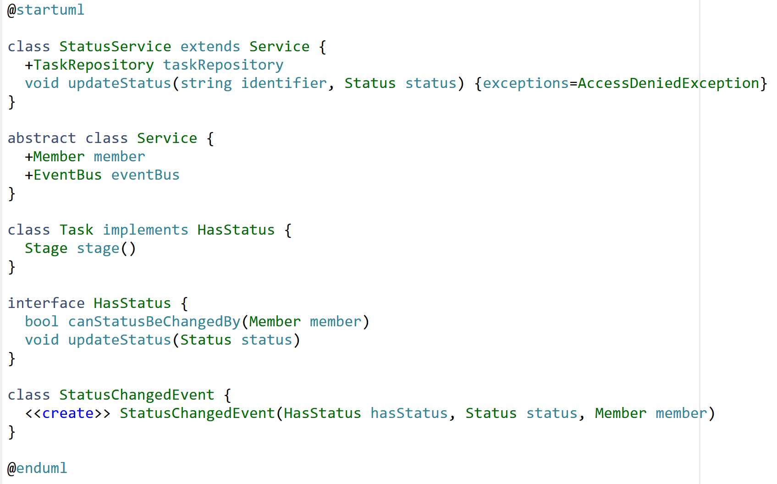
3
Design
4
Implementation
3. Sequence & Class Diagram

Slide 15
3
Design
4
Implementation
3. Sequence & Class Diagram

Slide 16
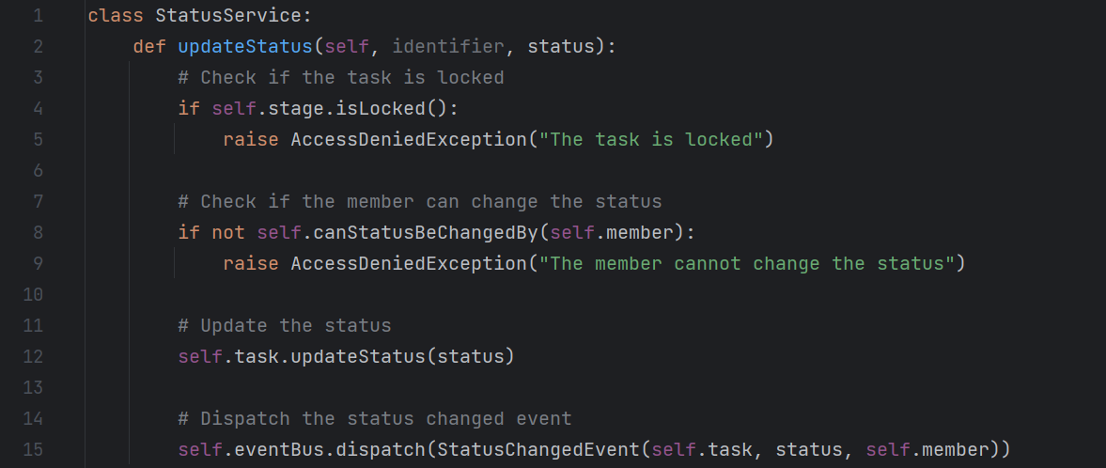
3
Design
4
Implementation
3. Sequence & Class Diagram
Notes:
This is the end of our feature implementation coding. I’m going to dive into some technical details of what’s going on in our LLM in a minute, but first I hope this quick example has conveyed the point that LLMs understand domain-models and there is a lot of potential gains in including these domain models in an AI-assisted development workflow.
As a developer, this by itself is very interesting, and worthy of further exploration. Similarly, if you’re not a developer but you do work at a higher level of abstraction, I hope it’s encouraging for the future that the models you produce can potentially be better integrated into the development processes with these tools.
This LLM wasn’t specifically fine-tuned to understand sequence diagrams.
Other thing to say, this isn’t about CodeLlama or any other specific model…
Okay, let’s dive into some technical neural network details.

Slide 17
Neural Network Explainability
SMILKOV, D., THORAT, N., KIM, B., VI\'EGAS, F. & WATTENBERG, M. 2017. SmoothGrad: removing noise by adding noise.
Notes:
So just as a very quick overview for anyone not familiar, one of the ways we can try to understand what a neural network is doing when it makes a decision is to look at the gradients of the output with respect to each of the inputs. This is a bit more intuitive with images that with natural language, which is why I’m showing this image before we dive into our natural language model. The basic idea is that after we feed forward through the network, we then backpropagate to get the gradients, and if draw a picture of the gradient magnitudes, we can see which pixels in the input had the greatest impact on the network’s prediction. So in this example, which is an image classification network using SmoothGrad…
And we’re going to do something similar with the code we’ve just generated.

Slide 18
$$\frac{\left\|\frac{∂y_{1}}{∂x_{1}}\right\|}{\sum_{i=1}^{n}{\left\|\frac{∂y_{i}}{∂x_{1}}\right\|} }$$
Write a Python method…
Notes:
So here we have the first output of our network, the word ‘class’. Now with generative language models, unlike the image model we were just looking at, are sequential…
The actual gradient w.r.t each input token is a ~3,000 element vector.
And you can do things with this by itself.

Slide 19
$$\frac{\left\|\frac{∂y_{1}}{∂x_{1}}\right\|}{\sum_{i=1}^{n}{\left\|\frac{∂y_{i}}{∂x_{1}}\right\|} }$$
Write a Python method…
[0.2946969230706546
Notes:
This is actually normalized.

Slide 20
$$\frac{\left\|\frac{∂y_{1}}{∂x_{2}}\right\|}{\sum_{i=1}^{n}{\left\|\frac{∂y_{i}}{∂x_{2}}\right\|} }$$
Write a Python method…
[0.2946969230706546, 0.0871793431140461
Notes:
This is actually the magnitude of the gradient w.r.t each input token. The actual gradient w.r.t each input token is a ~3,000 element vector.

Slide 21
$$\frac{\left\|\frac{∂y_{1}}{∂x_{3}}\right\|}{\sum_{i=1}^{n}{\left\|\frac{∂y_{i}}{∂x_{3}}\right\|} }$$
Write a Python method…
[0.2946969230706546, 0.0871793431140461, 0.007443366459201984
Notes:
This is actually the magnitude of the gradient w.r.t each input token. The actual gradient w.r.t each input token is a ~3,000 element vector.

Slide 22
$$\frac{\left\|\frac{∂y_{1}}{∂x}\right\|}{\sum_{i=1}^{n}{\left\|\frac{∂y_{i}}{∂x}\right\|} }$$
Write a Python method…
[0.2946969230706546, 0.0871793431140461, 0.007443366459201984, 0.005233688524478838, 0.0024658724778794526, 0.0033785655378737955, 0.0014639688180360386, 0.001967208099235927, 0.0019031594634468503, 0.0017418941483350679, 0.0017224508124705268, 0.0012260738851051823, 0.0010373591546552242, 0.0010585180789784013, 0.0010173439559711377, 0.0015897786383360108, 0.0007948893191680054, 0.0015874911870578294, 0.000630192827138951, 0.0020312567350250035…
…

Slide 23
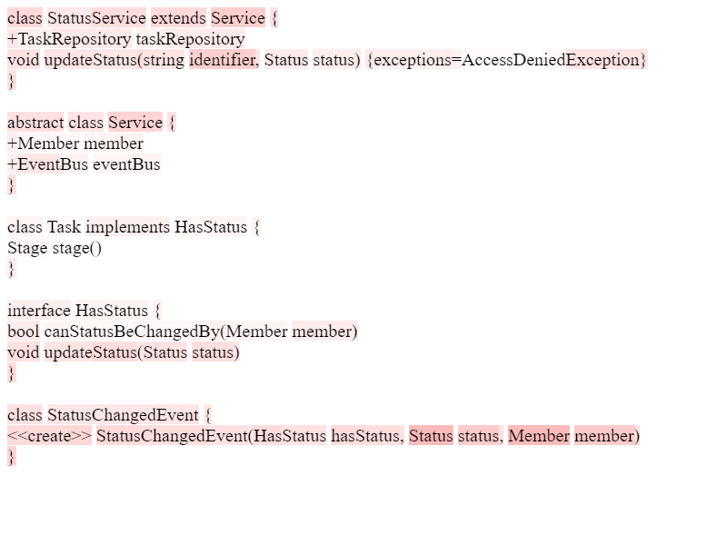
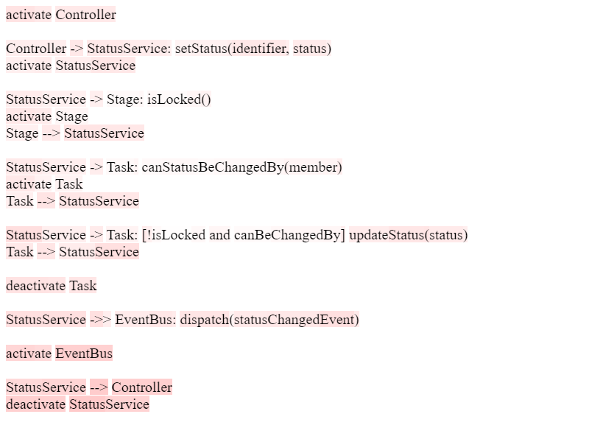

Slide 24
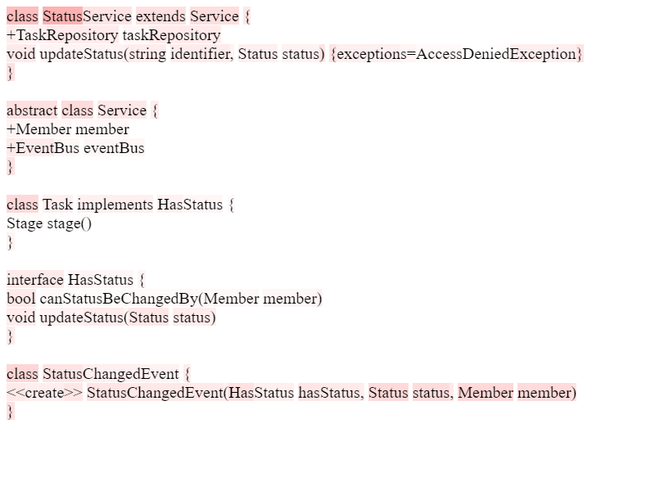
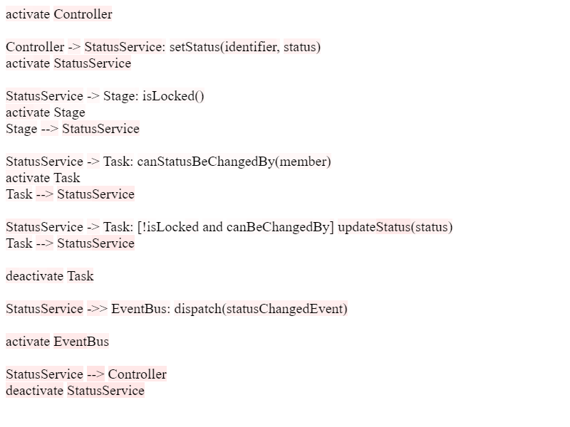

Slide 25
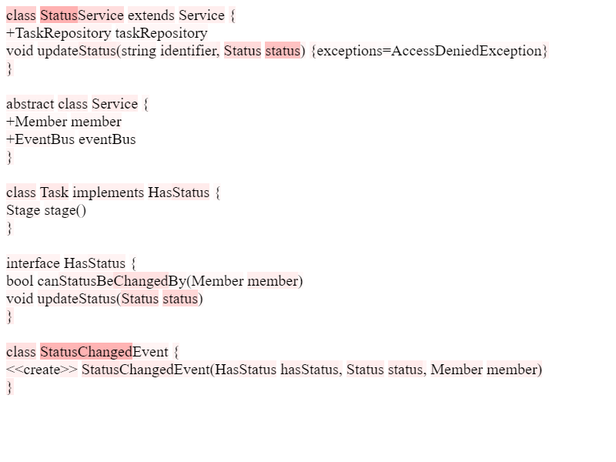

Slide 26
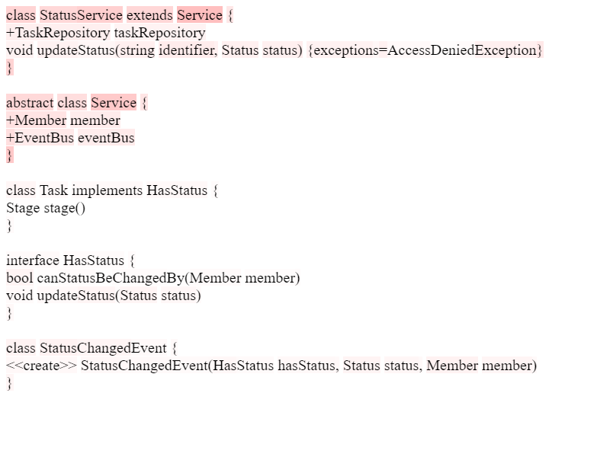

Slide 27
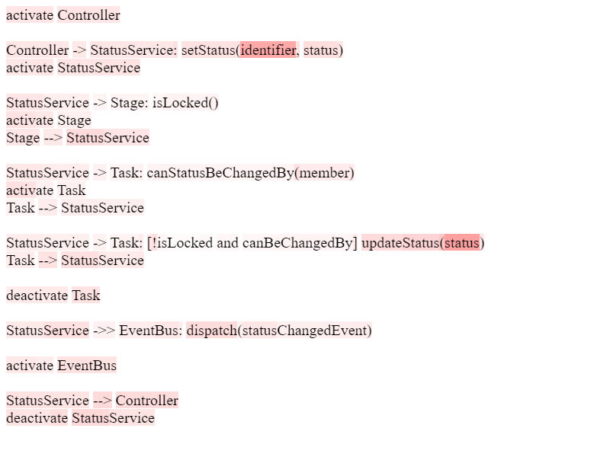

Slide 28
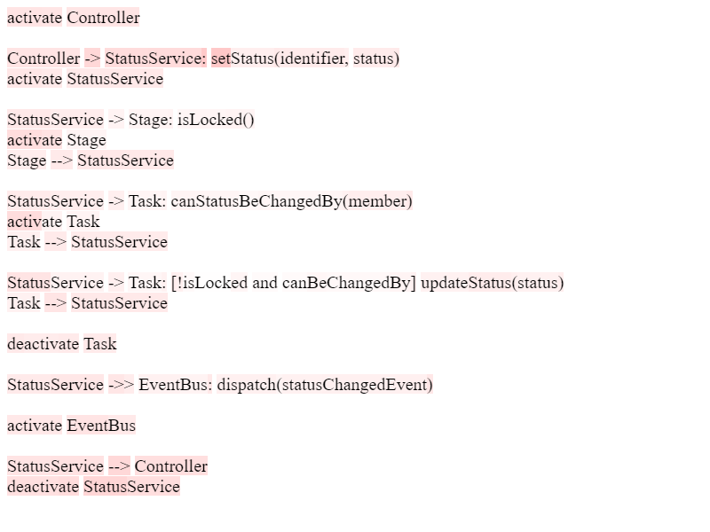

Slide 30
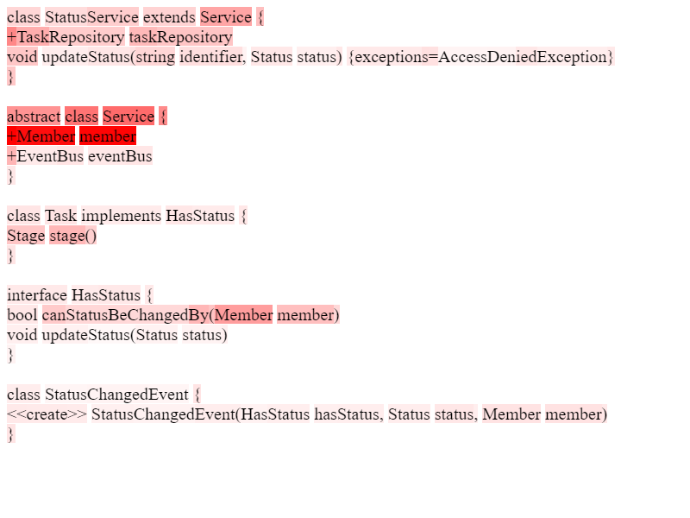
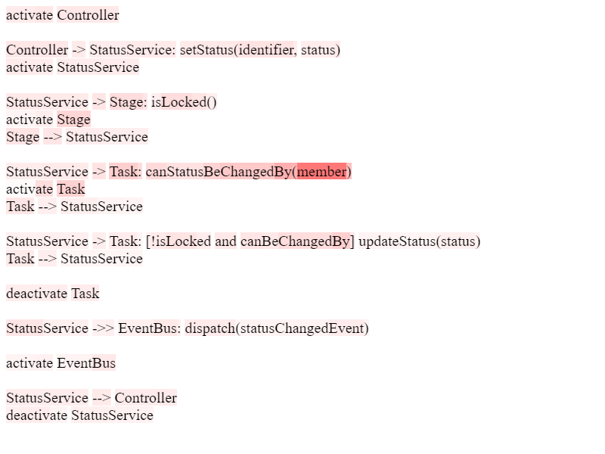

Slide 31
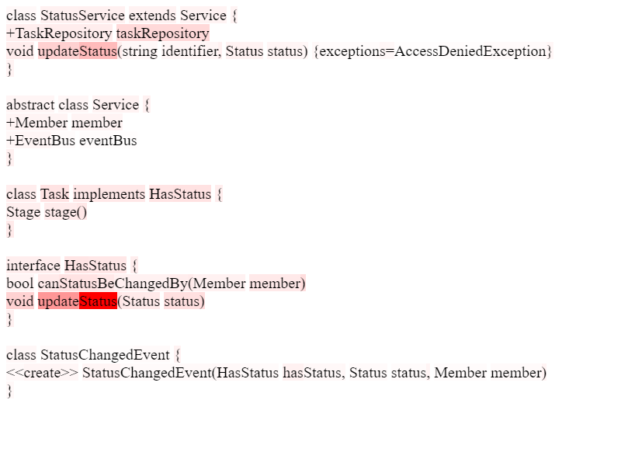
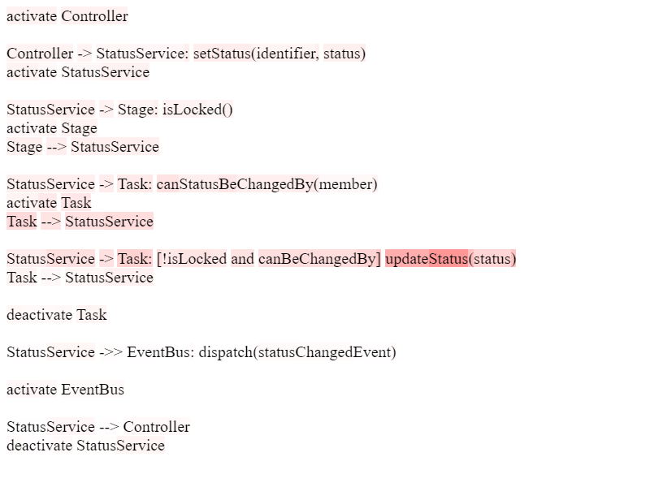

Slide 32
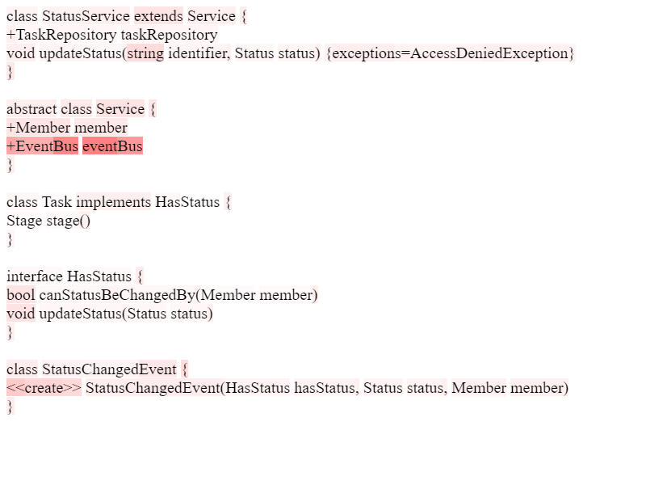
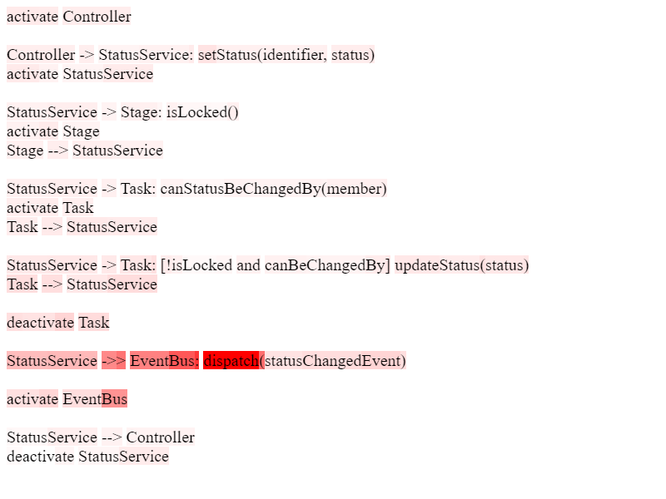
Notes:
So, as we can see, by backpropagating through the network as it generates our code, we can start to build up these continuous mappings between these two different levels of abstraction, between our lower-level code and our and high-level models.

Slide 33
Notes:
TODO: Talk about use-cases. In an IDE… git etc.

Slide 42
Notes:
In the future, we’re making some changes to our system models. Previously we had this ‘member’ property on a service, which told us who was updating the status. Let’s say instead we want to replace that ‘member’ with a more abstract concept of a ‘principal’, which can be a ‘member’ but could also be a system that’s updating the status.
We might want to know which parts of our code might be impacted by that change. Well, if we have our domain model under version control and we consult our mappings, we can see which parts of our code might be impacted, and we can act accordingly.
Now in the case of a small change to a class diagram like this, static analysis of the code would probably be the way to go, but hopefully you get the idea that this could be any sort of input to our LLM, it could be a sequence diagram or a requirements document.

Slide 43
Future Work & Research Challenges
Computation speed
Scaling
Fine-tuning models specifically for domain-model-to-code generation
Can we backpropagate and create continuous mappings between different stages of software engineering?
Neural Network explainability techniques
Coding education
IDE integration
Notes:
I’ve finished talk about our main idea, so let’s talk about the directions that we are going to continue exploring and also possible suggestions for anyone interested to jump on, and also some of the challenges, what are the barriers to using these ideas in the real world.
Computation speed – 80GB A100: Generating code without gradients takes a few seconds. With the gradients takes about an hour. Maybe a separate network
Scaling: This works well for a relatively small example with a few domain models, but
Other areas: I’ve talked about the link between domain models and code, but are similar things possible at different stages of the software engineering pipeline? Can we generate sequence diagrams from requirements documents, or use them to generate tests that are code will be run against, recording similar mappings between all these different artifacts and levels of abstraction? Then when we have all these mappings that span the whole development cycle, and we want to make a change to our requirements, can we that propagate that change through our mappings and see what effects that change would have through the whole development cycle.
NN explainability: Explainability in AI is often talked about in one of two ways:
Either as a purely academic question, like it’s interesting to us as researchers to understand what’s going on inside a neural network, but we usually aren’t thinking about the practical uses of it.
Or it’s in the context of trust. We talk about needing to understand what influences an AI systems decisions so that the users can trust the system.
And while both of those things are very important, I think that there are also potentially practical applications of neural network explainability. Knowing how an AI system made its decision is itself useful data that could be put to practical use. I’m also say with neural network explainability generally, it has traditionally tended to be the image-based neural networks that have led the way in terms of explainability. And there is good reason for that, it’s easier to show explainability in an image. And also images naturally provide continuous input to a network, which makes them a lot more intuitive to do maths with. But, with continuous word embeddings that we have in LLMs these days, I don’t see a reason why Natural Language Processing can’t catch up, perhaps with some software engineering specific explainability.
Coding education: This is more general point, but should be we including AI code generation as a fundamental part of software engineering education? In the future, should we be teaching programming at a higher level of abstraction than we currently are? Is the future of programming going to look more like a combination of domain-model-building and prompt engineering?
IDE integration: One thing you need to know about developers is that we are very lazy. If we have to go out of our way to do something, especially something that is repetitive, we just won’t do it.

Slide 44
Key points
LLMs understand domain models
We can create mappings between different levels of abstractions
Neural network explainability has practical application
Marc North
marc.north@durham.ac.uk
marc.north@methodgrid.com
Notes:
We saw earlier that when we generated code with and without using our domain models that the generative LLM knows how to use domain models and incorporate them into the code it outputs. Acknowledging the challenges I’ve just talked about, this is something we incorporate into our software engineering workflows.
I’ve focused here on code and domain models, but as I said, I think this is a concept that could work in other areas of software engineering. Perhaps the future direction of software engineering is closer connection between these different levels of abstraction at each stage of the development cycle.
It’s not just the output of a neural network that is of practical use, what’s going on inside could be just as interesting.

