Slide 1
Development of a Cloud-Based Modelling Environment for Controls and Monitoring Systems
Joe Newton, Qurat ul ain Ali

Slide 2
Agenda
01
Background
02
CaMCOA Studio
03
CaMCOA Cloud
04
Challenges

Slide 3
Background – Rolls-Royce
Rolls-Royce Control Systems supplies engine control and monitoring systems for aerospace and other applications
Leverage Model-Driven Engineering to allow Rolls-Royce to develop safe and robust systems which continue to increase in complexity

Slide 4
CaMCOA
CaMCOA (Controls and Monitoring Component Oriented Architecture)
To support future generations of RR control and monitoring systems
Component Oriented Architectures (COAs)
Functionality encapsulated within a component
AUTOSAR - automotive software
ECOA – defence mission system software components
SAVOIR – space applications

Slide 5
CaMCOA
Application Layer
Modelled in Simulink
Runtime Config Layer
Entry point, start-up initialization and scheduling
Data Distribution Layer
Data between the platform and application layer
Platform Abstraction Layer
Real-Time Operating System (RTOS)
Microcontroller Abstraction Layer (MCAL)
Device Drivers (NAL)

Slide 6
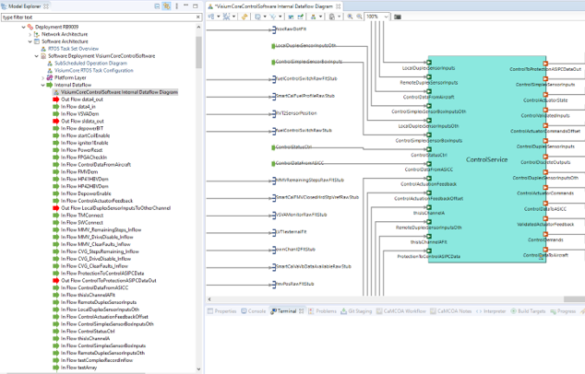
CaMCOA Studio
CaMCOA Studio since 2017
Motivation
DSML for Rolls Royce engineers
Integration with MATLAB/Simulink
Traceability b/w CaMCOA and Simulink models
Support for model management
Epsilon
Avoid vendor lock-in

Slide 7
CaMCOA Studio
J. Cooper et al., "Model-Based Development of Engine Control Systems: Experiences and Lessons Learnt," 2021 ACM/IEEE 24th International Conference on Model Driven Engineering Languages and Systems (MODELS), Fukuoka, Japan, 2021, pp. 308-319, doi: 10.1109/MODELS50736.2021.00038.

Slide 8
Challenges of CaMCOA Studio
Parallel working
Collaboration on the same model
Diagram comparison and merging
EMF compare – tree based – Low-level details
Model Reviewing
Reviews on browser serialized to XMI level
Comparing models conforming to evolving metamodels
EMFCompare
DiffMerge

Slide 9
Move to a cloud and web based solution

Slide 10
Why move to cloud/web based solution?
Cloud based environment
No installation
Easy access
Automatic updates
Resource sharing
Usability
Modern UI look and feel
HTML5
SVG

Slide 11
CaMCOA Cloud
Develop modelling capability based on open-source infrastructure, providing the following features in particular
Collaborative Model Development
Multi-Domain Modelling
Cloud-Based Integration

Slide 12
CaMCOA Cloud
Sirius Web
Open-source low-code platform by Obeo
To define custom web applications supporting your specific visual languages
Eclipse GLSP
Developed by EclipseSource
Client-server architecture for diagram editors

Slide 13
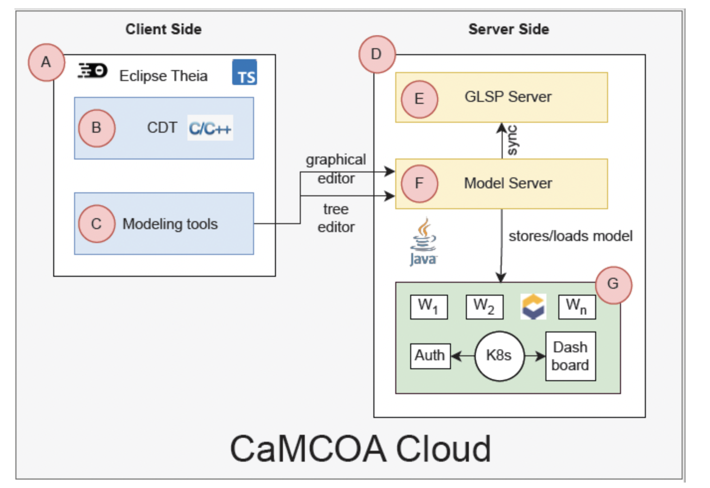
CaMCOA Cloud Architecture

Slide 14
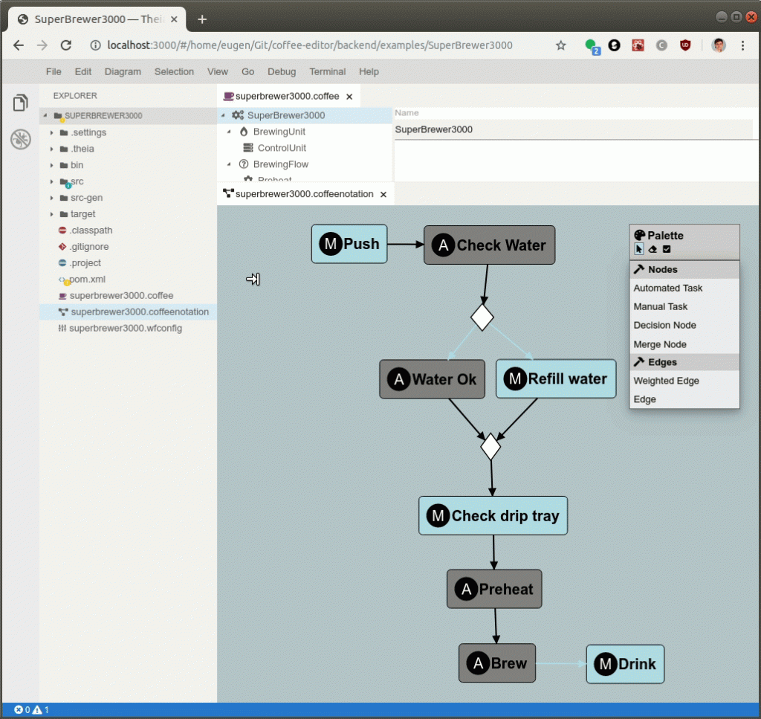
Eclipse Theia
Web based IDE
Open Source
Extensible architecture
Inspired by VS Code using VS Code technology
Monaco Code Editor

Slide 15
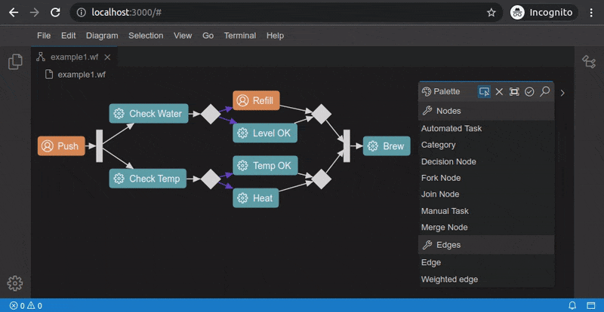
Eclipse GLSP
Inspired by LSP for graphical modelling
Browser-based diagram clients
Language smarts on server

Slide 16
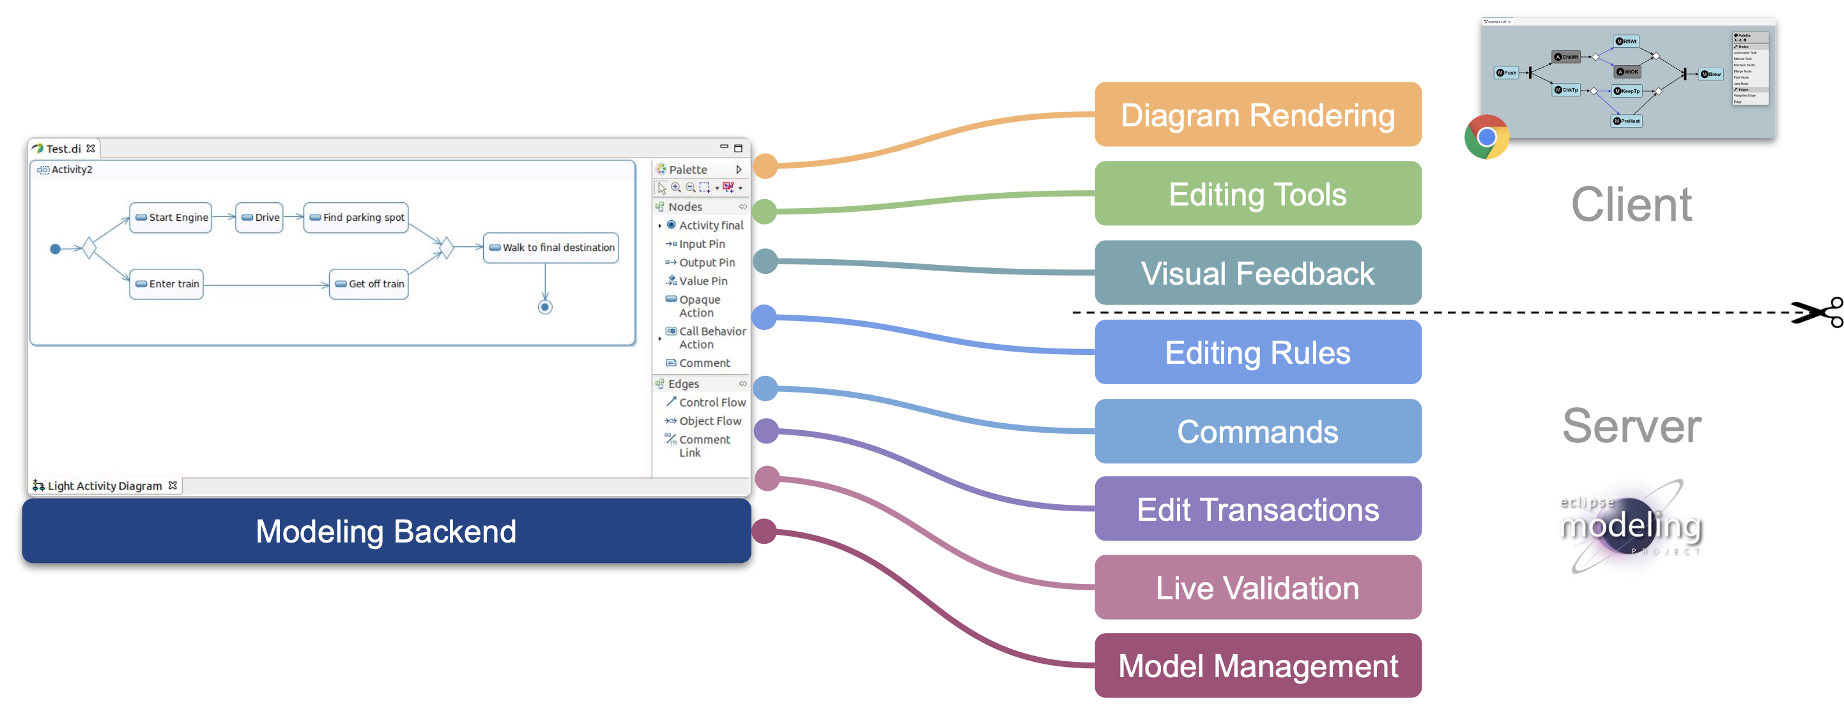
Eclipse GLSP

Slide 17
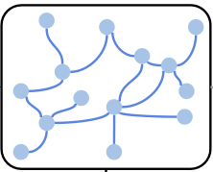
Model Server
Java-based server
Single source of truth for models
Runtime state of loaded models
Serializes models into JSON or XMI format
JSON
Forms
GLSP
Model
Server
LSP

Slide 18
Eclipse Che
Workspace management server
Kubernetes based

Slide 19
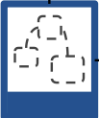
Client/server communication
Initialization with parameters
URI
Diagram type
init
GLSP
Client
GLSP
Server

Slide 20
Client/server communication
Server obtains the source model
init
Source model
GLSP
Client
GLSP
Server

Slide 21
Client/server communication
Model can be anything
EMF
JSON
M1
M2
init
Mn
Model Server
GLSP
Client
GLSP
Server

Slide 22
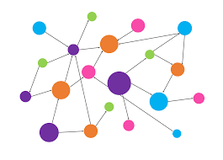
Client/server communication
Server maps source model to graph model
M1
M2
Graph
model
Mn
Model Server
GLSP
Client
GLSP
Server

Slide 23
Client/server communication
Server maps source model to graph model
M1
M2
Graph
model
Mn
Model Server
GLSP
Client
GLSP
Server

Slide 24
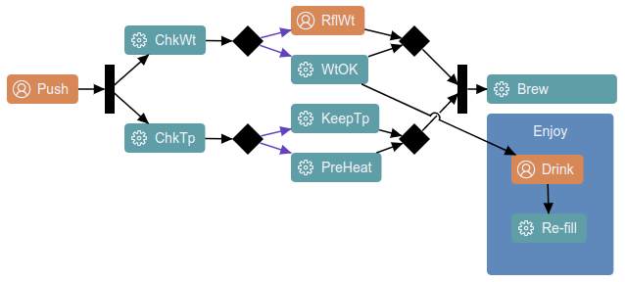
Client/server communication
Client converts graph model to SVG via Eclipse Sprotty
M1
M2
Graph
model
Mn
Model Server
GLSP
Client
GLSP
Server

Slide 25
Client/server communication
Editing tools on the client
Communicate with server with actions
Operation,
Graph updates,
palette actions
M1
M2
Mn
Model Server
GLSP
Client
Action
handlers
GLSP
Server

Slide 26
Challenges
Less documented
Setting up issues
Coding for low-level features
Testing of individual components

Slide 27
CaMCOA Cloud Demo

Slide 28
Current/Future Work
Advanced features
Moving across containers
Tree editor
Property view
Model management
Deployment on K8s
Workspace management

Slide 29
Feedback/Comments or Questions?

