Slide 1
Domain-specific modelling in aerospace digital twins
MDENet 2023
Simon Miles

Slide 2
Requirements
Non-technical users in a domain need to generate forecasts plausibly reflecting the constraints of their specific enterprise
They need to both ask what will realistically happen under possible circumstances/strategies and what the best plan is under the current strategy
We can realistically only maintain and expand a few rich software bases but there is both commonality and diversity in customers’ enterprises and modelling needs
There is a need for results and models to be accessible to diverse skills within any one customer organisation
The users need to be judge to what extent they can rely on a forecast
How can thinking about domain-specific modelling languages help?

Slide 3
Forecasting and planning in Aerogility
OPERATE REALISING BEST POSSIBLE BUSINESS OR MISSION OUTCOMES FROM THE ASSETS
PLAN REFINING AND VALIDATING STRATEGIES AND BUSINESS CASES
ACQUIRE PROCURING / SUPPLYING THE RIGHT ASSETS MEET BUSINESS / OPERATION NEED WITH OPTIMUM RISK - REWARD
DISPOSE ENSURING ASSETS ARE RETIRED FROM SERVICE TO BEST MEET OPERATIONAL, FINANCIAL AND ENVIRONMENTAL DEMANDS
SUSTAIN MAINTAINING & UPGRADING ASSETS TO BEST MEET CONTRACTUAL, COST, ENVIRONMENTAL, MISSION ETC TARGETS
PREDICT
OPTIMISE
PLAN
Understanding the likely outcomes of a range of operational scenarios
Finding the option that best meets the business objectives (KPI)
Automatically generating an implementation plan for the chosen option
Enhanced Decision Making

Slide 4
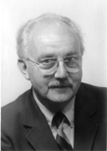
Computer simulations
Simulations enact abstracted models of real dynamic phenomena in a computer
Gain evidence for the potential effects of interventions (e.g. changes to strategy or structure) without the cost of implementing them
Simulations generate data describing a hypothetical realistic world
Models are abstractions: they simplify the world, and in doing so they leave a lot out
Models are based on assumptions or theories of what is relevant to the phenomena under study
All models are wrong but some are useful.
George Box
Make your theory as simple as possible, but no simpler.
Albert Einstein

Slide 5
Agent-based models as simulations
Distinguishing characteristics of agent-based models
Bottom-up modelling technique: natural, intuitive analogy to enterprise
Models constituent agents individually and separately
Agents can be heterogeneous
Agents interact and from these interactions, emergent properties and behaviour arise
Allows us to test agent-based interventions to see their effects
Agent actions and environment effects are often probabilistic
Interaction is commonly limited by the model structure:
Spatial: Environment is spatial location, interaction is limited by spatial adjacency/distance
Network: Agents connected by links across which they can interact

Slide 6
Typical simulation business approaches
Requirement 1: Flexibility for non-technical users
General purpose simulation engine
Customisable domain engine
Generic process simulation
Consultant creates highly tailored model for customer
Software company supports tailoring over time
Off the shelf software with supported configuration
Low flexibility: limited to initial model scope
Higher flexibility: limited to domain scope
Highest flexibility: limited by generic concept scope
High usability and fine granularity
Medium but increasing usability and granularity
Low usability and granularity

Slide 7
Domain-specific modelling languages
Requirement 1: Flexibility for non-technical users
Domain-specific modelling language: custom modelling language using vocabulary and notations found in a target user domain
Defined by:
Concrete syntax: the language grammar as it appears to the user
Abstract syntax: a meta-model defining the language concepts
Semantics: how the language should be understood and interpreted
Benefits
Productivity
Communication
Execution abstraction

Slide 8
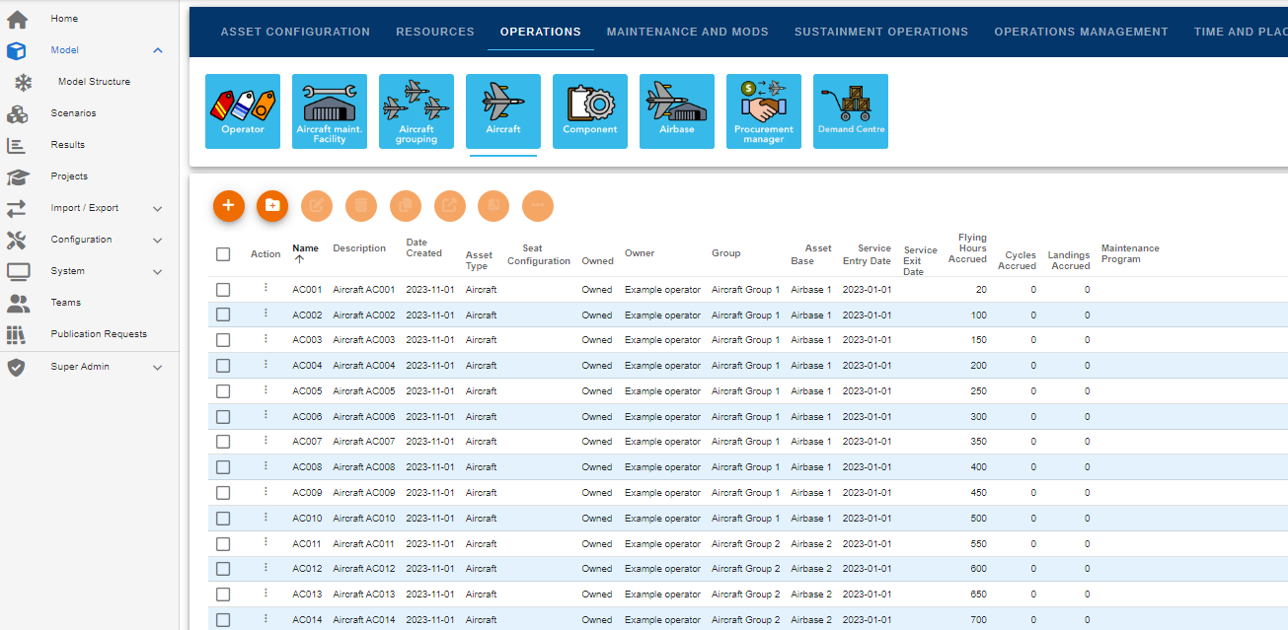
Aerogility scenario creation as DSML
Requirement 1: Flexibility for non-technical users
Agent-based systems as foundation for concrete syntax
Areas of responsibility
Conceptual distinction of logic, motivation, interaction and state

Slide 9
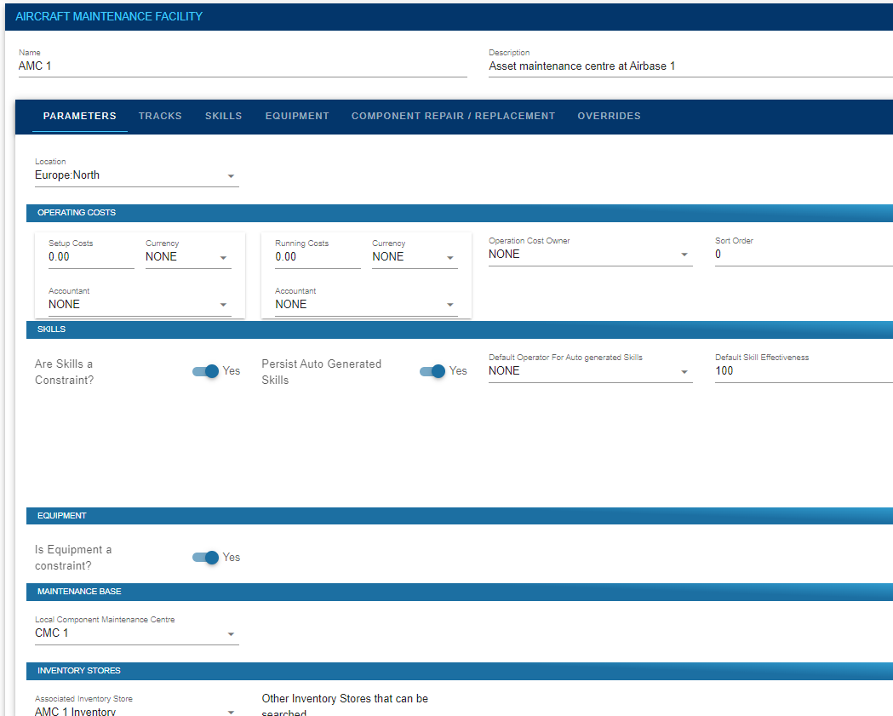
Aerogility scenario creation as DSML
Requirement 1: Flexibility for non-technical users
Abstract syntax: translated to internal structure on scenario execution

Slide 10
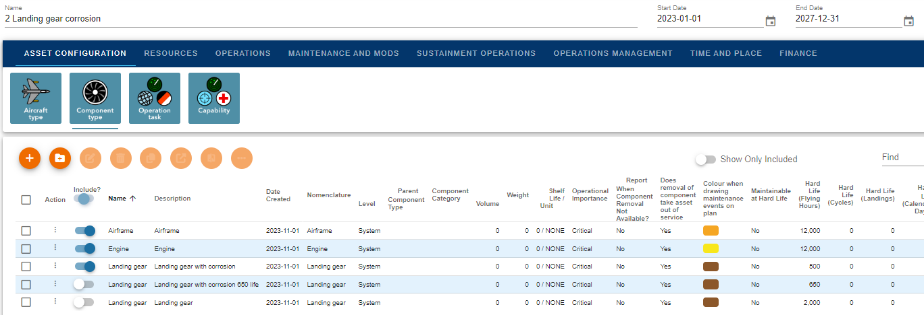
Aerogility scenario creation as DSML
Requirement 1: Flexibility for non-technical users
Semantics
Flexibility of language allows invalid combined configurations
Validation of scenario before execution

Slide 11
What value can models bring?
Requirement 2: Planning and forecasting
Predict
Explore
Optimise Performance
Generate Hypotheses
Explain
Provide a Locus for Discussion
Structure Thinking
Discover New Questions
Education and Training
Challenge Prevailing Wisdom
Illuminate Core Dynamics
Guide Data Collection
Characterise Uncertainties
Epstein J. 2008. Why model? Journal of Artificial Societies and Social Simulation. 11(4)

Slide 12
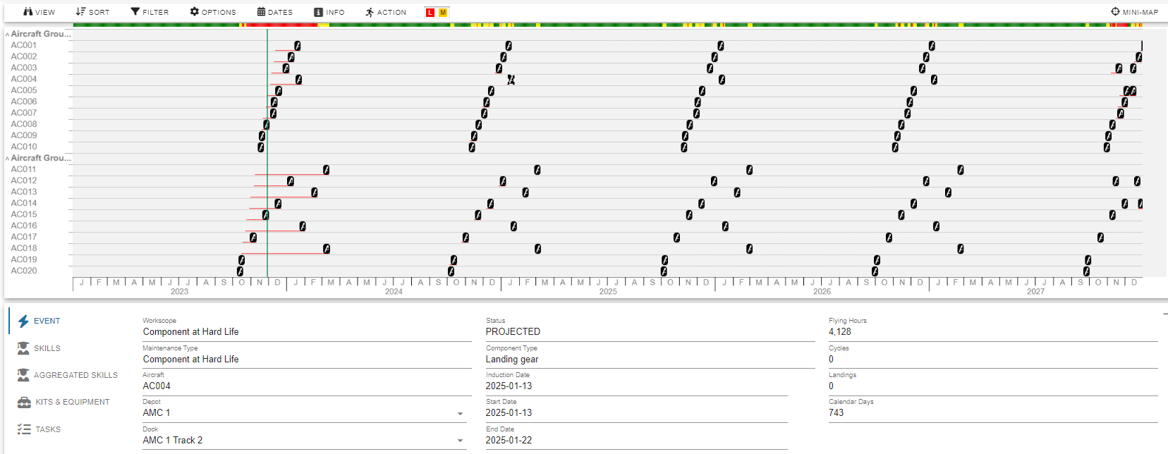
Execution contexts
Requirement 2: Planning and forecasting
One language compiled to two alternative executions
Scheduling: What is the best plan I could follow given constraints?
Forecasting: What will realistically occur given a plan/strategy?

Slide 13
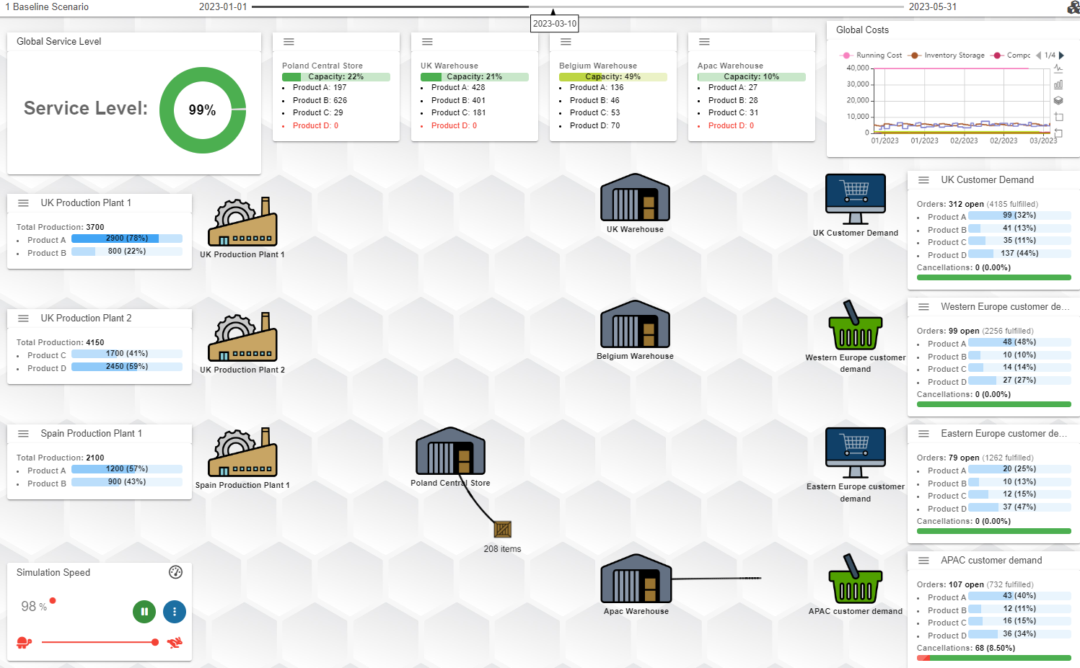
Scope of domain
Requirement 3: Commonality and diversity
Diversity within one language: maintenance, supply chain, training…
Not everything makes sense in combination
Edges of domain scope?
When is it no longer one domain?

Slide 14
Declarative and procedural
Requirement 3: Commonality and diversity
Aerogility’s DSML is very declarative
Advantage in that the non-technical user does not need to be concerned with how the simulation works
Most of process is in code, can be revised on demand by developers
Disadvantage where a process is something the user wants to configure
Potential to have more flexible DSMLs for encoding processes

Slide 15
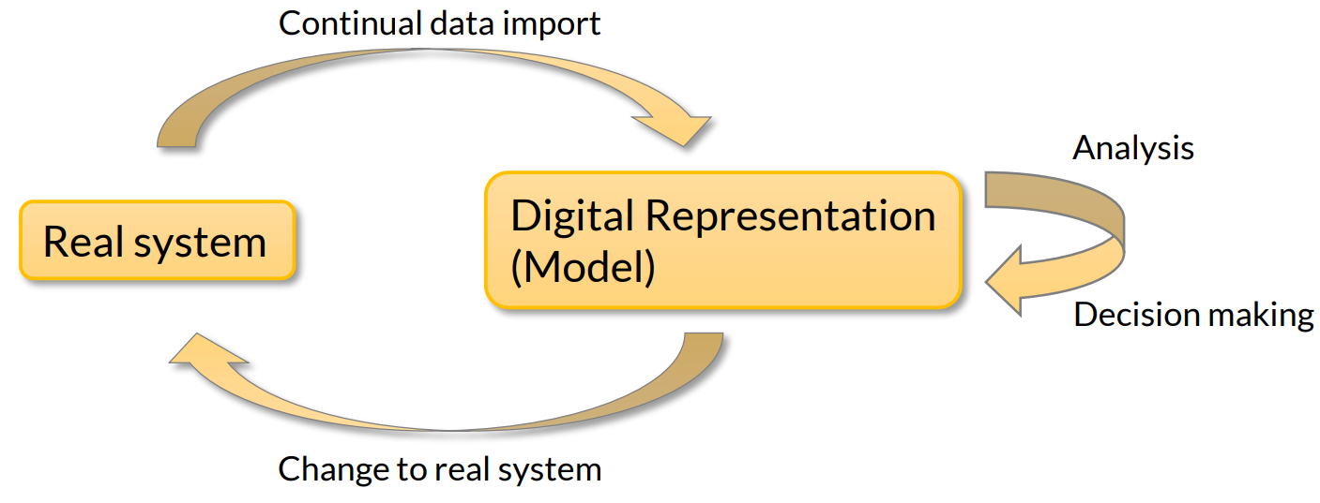
Simulation as a digital twin
Requirement 4: Intra-organisation accessibility
Forecasts need to be based on the current state of the enterprise
Data is imported from other databases and systems
Schedules are then exported as work orders to be carried out
As such, the software acts as a digital twin
There is a social process accompanying this, e.g.
Technical planning, financial oversight by different departments
Strategic business view communicated up to management staff
The model acts as a means of communication between departments

Slide 16
Domain languages and data import
Requirement 4: Intra-organisation accessibility
Simulation data import also requires a language
Data import can vary as with execution context
CSV files, web services…
This is for a fleet of aircraft owned by the RAF. There are 40 aircraft in the fleet, half are Typhoons in the Coningsby Fighter Squadron based at RAF Coningsby, and half are F35 aircraft in the Marham Fighter Squadron at RAF Marham. The aircraft entered service on dates distributed across 2021 and 2022 and will leave service at the end of 2030. Their prior flying hours should vary between 0 and 2000, while other life parameters should all be zero.
Scenario generation
Predictive maintenance
Inspection date | Equipment ID | Age | Operator | Region | Fault?
2023-08-21 14:03 | K345 | 3 | EasyJet | Greece | 0
2023-08-26 09:30 | K200 | 25 | EasyJet | Spain | 0
2023-08-26 16:03 | K123 | 27 | SAS | Norway | 1
How long until an engine with these features requires maintenance? What is the distribution of probabilities by which the engine will require maintenance over time? How long will the maintenance take? Will it be successful? What resources will it require? …

Slide 17
Common ABM validation
Requirement 5: Reliability
Does the output accurately represent what the world looks like?
Face validation
Expert opinion of whether the model output mirrors what is plausible
If you know what you should see, why do you need a model?
Historical recreation
If the model is run on data from a past period, does it output a good approximation to what actually transpired in that period?
What if the past is not representative of the future?
Independent corroboration
Do two independent models produce the same output?
What if both using same misunderstanding of reality?
Sensitivity analysis
If an output changes substantially when an input parameter is changed, then the model output may be unreliable given limits on how precise inputs can be
What if an output is genuinely sensitive to an input?

Slide 18
Validity of forecasts
Requirement 5: Reliability
We care about a particular ABM use case: forecasting
What does it mean for a forecast to be assured to be correct?
Absolute match to reality is often not a useful test
By the time you can compare a 5-year forecast to reality, it is too late to be of use
A forecast is not expected to exactly match reality, only presents likely informative trends and possible rare situations to prepare for
A forecast is valid if there’s evidence the trends it presents are plausible
The forecast can be convincingly explained from the starting point and the reasoning of the model (explainability)
The reasoning of the model is plausible (internal validity)

Slide 19
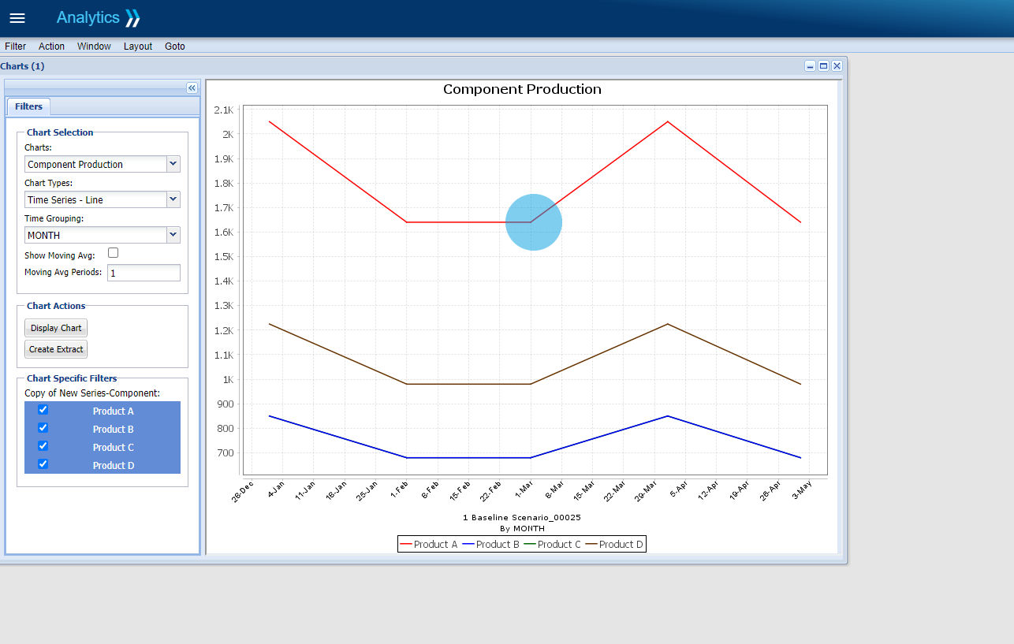
Explainability
Requirement 5: Reliability
An ABM models (and is) a complex system
There is vast, complicated reasoning from inputs to outputs
Explanations of output trends requires a domain language
Causal Graph Navigation
Agent:
From:
To:
RAF Marham
2018-05-14
2018-05-14
Current Event:
Cancelled Mission: F35 Level 4 Sortie
Causal Event Chains:
Before:
Sorted by: Importance
After:
Insufficient assets: 1 out of 4
Rescheduling mission
Insufficient skills: 1 out of 2
Unreserved assets
Preparing mission
…
…
…
…
…
…
…

Slide 20
Conclusions
Viewing a domain-focused simulation platform as using a domain-specific modelling language implies useful future approaches
Agent-based modelling provides a conceptual structure within which to create a simulation domain language
A forecast simulation can be viewed as a form of digital twin
Forecasting and scheduling are two complementary execution contexts
Post-hoc verification is a way of enforcing semantics
We need to keep things as declarative as possible for non-technical users but certain elements are procedural
The scope of a language becomes stretched with more customers, but the unity of the platform is valuable for business
Data import and export share a language with the declarative simulation configuration
Generating explanations of simulation also needs a language

Slide 21
Thanks for your attention!

