Slide 1
Customised computerised clinical protocol guidelines for medical education: the case of Chronic Kidney Disease (CKD) using domain-specific languages
Sofia Meacham, Principal Academic, Computing & Informatics, Bournemouth University
smeacham@bournemouth.ac.uk
Linkedin: https://www.linkedin.com/in/sofiameacham/
Simon Fraser, Professor of Public Health, Faculty of Medicine, University of Southampton
s.fraser@soton.ac.uk
Abiodun Adedeji, PG student of Computing & Informatics, Bournemouth University
S5425588@bournemouth.ac.uk
https://www.linkedin.com/in/Abiodun-oluwabusola-adedeji
Godwin Ukeje, PG student of Computing & Informatics, Bournemouth University
S5526474@bournemouth.ac.uk
https://www.linkedin.com/in/drgodwinukeje

Slide 2
Presentation Outline
MDEnet project description¹
Problem:
CKD clinical protocol
Education perspective for CKD clinical protocol
Developed CKD protocol flow-chart
DSL solution and evaluation
Proforma
CDG
Evaluation
Conclusions
¹Funded by MDEnet EPSRC project managed by King’s College in London (https://mde-network.com/ ) - seedcorn funding.

Slide 3
MDEnet project description
Primary Goal: To critically evaluate the effectiveness and efficiency of domain-specific languages (DSLs) in the development of computerized clinical guidelines for Chronic Kidney Disease (CKD).
Key Focus: Utilization of PROforma and Guideline Definition Language 2 (GDL2) as examples.
Secondary goal/Impact: To assess the applicability and adaptability of these guidelines in real-world clinical and educational settings.
Notes:
Presenter's Note: Briefly mention that this study aims to bridge the gap between clinical knowledge and practice by leveraging the structured approach of DSLs, which could potentially transform CKD management and education.

Slide 4
Presentation Outline
MDEnet project description¹
Problem:
CKD clinical protocol
Education perspective for CKD clinical protocol
Developed CKD protocol flow-chart
DSL solution and evaluation
Proforma
CDG
Conclusions
¹Funded by MDEnet EPSRC project managed by King’s College in Londonb (https://mde-network.com/ ) - seedcorn funding.

Slide 5
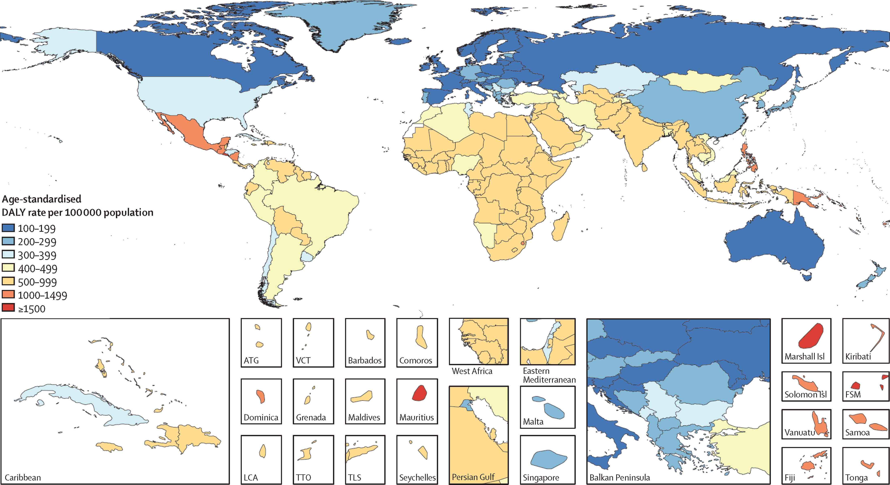
INTRODUCTION: CKD AND ITS IMPACT ON HEALTHCARE.
What is CKD?: A long-term condition where the kidneys do not function effectively, It's progressive, often developing over many years.
Stages of CKD:: CKD is categorized into five stages, from mild (stage 1) to complete kidney failure (stage 5).
Prevalence: Affects approximately 10% of the global population and is more common in older adults and those with conditions like diabetes and hypertension. Increasing prevalence and impact in many regions globally
Impact on Healthcare:
Major contributor to morbidity and mortality.
Increases the risk of hospitalizations and healthcare utilization.
Significant impact on the quality of life for patients.
Economic Burden: Management of late-stage CKD is costly due to dialysis and transplantation needs, Preventive care and early intervention can reduce long-term costs.
Importance of Management:: Early detection and management can slow progression, Guideline adherence is crucial for improving patient outcomes
Age-standardised rate of Disability Adjusted Life Years for chronic kidney disease in 2017*
*GBD Chronic Kidney Disease Collaboration. Global, regional, and national burden of chronic kidney disease, 1990-2017: a systematic analysis for the Global Burden of Disease Study 2017. Lancet. 2020;395(10225):709-733. doi: 10.1016/S0140-6736(20)30045-3
Notes:
Note: Emphasize the importance of effective management protocols to mitigate the impact of CKD. Highlight the role of DSLs in creating these protocols to enhance clarity and standardization in CKD management.

Slide 6
CKD education in University environments – University of Southampton case
In clinical settings, CKD is often under-diagnosed as it requires samples of both blood and urine and includes consideration of time (‘chronic’).
Converting theoretical understanding of clinical concepts into logical steps for identifying and managing a disease is not straightforward.
There is a risk to patients if guidelines and protocols are not followed correctly.
In addition, during both initial training and in later professional development, professionals need to adapt to changing clinical guidelines and emerging findings from research.

Slide 7
Part of CKD protocol – diagnosis part
National Institute for Health and Care Excellent (NICE) CKD guidance is very complex (77 pages), and lacks specificity on the detail of the practicalities of the initial diagnosis. We therefore focused on this diagnosis aspect.
The further clinical management of the condition was omitted for complexity.
We combined both NICE (UK) and KDIGO (international) guidelines as they complement each other at points and are used by clinicians.
Novel aspect: practicalities of CKD diagnosis.
We are extending the team with more feedback from Nephrologists and Primary Care physicians.

Slide 9
Computerised Clinical Protocols
Model the protocol in an information system and apply it in other information systems if possible.
Final outcome: doctors to get “correct” and “adhering to the protocol” recommendations by the Information System.
To achieve that, advanced technical solutions such as DSLs will be introduced.

Slide 10
Technical Challenges with Computerised Clinical Protocols
Need for Validation and Verification of the developed protocol.
Correct-by-construction requirements.

Slide 11
Presentation Outline
MDEnet project description¹
Problem:
CKD clinical protocol
Education perspective for CKD clinical protocol
Developed CKD protocol flow-chart
DSL solution and evaluation
Proforma
CDG
Conclusions
¹Funded by MDEnet EPSRC project managed by King’s College in Londonb (https://mde-network.com/ ) - seedcorn funding.

Slide 12
DSLs as a solution to technical challenges
Domain-specific languages – customised solutions by creating new programming languages to address specific problems
They allow “correct-by-construction” software development
Non-technical domain users to interface with complex technological systems bringing technology to non-technical audiences - doctors in our case

Slide 13
PROforma

Slide 14
Detailed Modeling in PROforma DSL
Translation: Encoding CKD management protocols into PROforma DSL code.
Key Elements: Tasks (e.g., patient assessment), decisions (e.g., serum creatinine results), and plans (e.g., CKD management in primary care).
Functionality: Ensuring clinical decisions are evidence-based and adaptable to individual patient scenarios.
Fox, J., Patkar, V. and Thomson, R., 2023. Decision Support for Health care: the PROforma Evidence Base. Journal of Innovation in Health Informatics [online], 14 (1), 49–54. Available from: https://doi.org/10.14236/jhi.v14i1.616 [Accessed 3 Nov 2023].

Slide 15
Each of the rectangles in the flow-chart are actions taken for the CKD protocol.
This is captured in the PROforma task structure with clear directives for action and specified outputs:

Slide 16
Decisions points are modelled with the PROforma decision notation.

Slide 17
Challenges in the Absence of a PROforma IDE
Issues: Difficulty in writing, testing, and validating code without a dedicated Integrated Development Environment (IDE).
Workarounds: Manual code review, peer collaboration, limited real-world testing.
Impact: Hurdles in integrating PROforma code into existing healthcare IT systems.
Openclinical (https://www.openclinical.net/ ) associated with University of Oxford – got in touch and secured support.
However, that is outside the scope of the project as it required advanced development before the system would be usable.

Slide 18
PROforma Evaluation
(-) Big problem the IDE integration, was not possible to use it
(+) Very formal so it is solving the “correct-by-construction”
(-) The usability and the technical skills required make it difficult to use for domain users.

Slide 19
Guideline Definition Language (GDL)

Slide 20
GDL protocol development steps
Step1: Create a new Archetype or use an existing one from openEHR (https://ckm.openehr.org/ckm/ )
Step2: Import all required Archetypes in the GDL tool
Step3: Define elements on each archetype
Step4: Define Rules, Actions and Conditions
Step5: Execute

Slide 24
GDL Evaluation
(+) Many open-source Archetypes from OpenEHR – big community that reviews them.
(-) Need to be adjusted to particular needs – 50%-60% changes in our case to meet the requirements for CKD.
(-) If you need to create new archetypes you have to move to a different tool.
(-) A lot of details are necessary to implement your protocol.
(+) Graphical interfaces.
(-) Lack of proper documentation, training, tutorial.

Slide 25
DSL evaluation research
Performed research on the matter and the results can be summarised as follows:
There is a need for standardising the quality criteria for DSLs
And that needs to be a community effort (most likely lead by academia)
We have followed work by Geylani Kardas, Izmir-Turkey (http://akademik.ube.ege.edu.tr/~kardas/publications/journal_articles/2021_jcl_01.pdf ) in our DSLs and it is quite suitable
Our first findings/direction:
More on quality through collaborative effort
Specific section that is relevant to the problem domain as DSLs are tailored to specific domain problems. Very general quality criteria will not offer much value in our opinion
We devised a section in the questionnaires that is co-developed between language engineers and domain users

Slide 26
Overall Conclusions
More work is required to make this tools usable for medical professionals
A lot of difficulties:
IDE,
Support,
Usability and
Documentation
Definitely useful but medical professionals need to be consulted.

Slide 27
[1] “Overview | Chronic kidney disease: assessment and management | Guidance | NICE”.
[2] S. D. Fraser and T. Blakeman, “Chronic kidney disease: identification and management in primary care,” Pragmatic Obs. Res., vol. 7, p. 21, Aug. 2016, doi: 10.2147/POR.S97310.
[3] S. D. S. Fraser, J. Parkes, D. Culliford, M. Santer, and P. J. Roderick, “Timeliness in chronic kidney disease and albuminuria identification: A retrospective cohort study,” BMC Fam. Pract., vol. 16, no. 1, pp. 1–10, Feb. 2015, doi: 10.1186/S12875-015-0235-8/TABLES/3.
[4] S. D. S. Fraser et al., “Suboptimal blood pressure control in chronic kidney disease stage 3: baseline data from a cohort study in primary care,” BMC Fam. Pract., vol. 14, 2013, doi: 10.1186/1471-2296-14-88.
[5] V. C. Pereira, S. N. Silva, V. K. S. Carvalho, F. Zanghelini, and J. O. M. Barreto, “Strategies for the implementation of clinical practice guidelines in public health: an overview of systematic reviews,” Heal. Res. Policy Syst., vol. 20, no. 1, pp. 1–21, Dec. 2022, doi: 10.1186/S12961-022-00815-4/TABLES/4.
[6] J. Duarte De Sousa Barroca, “Bachelor’s degree Project Verification and validation of knowledge-based clinical decision support systems: a practical approach A descriptive case study at Cambio CDS”.
[7] D. Ratiu, B. Schaetz, M. Voelter, and B. Kolb, “Language engineering as an enabler for incrementally defined formal analyses,” 2012 1st Int. Work. Form. Methods Softw. Eng. Rigorous Agil. Approaches, FormSERA 2012 - Proc., pp. 9–15, 2012, doi: 10.1109/FORMSERA.2012.6229790.
[8] H. S. Borum, H. Niss, and P. Sestoft, “On Designing Applied DSLs for Non-Programming Experts in Evolving Domains,” Proc. - 24th Int. Conf. Model. Eng. Lang. Syst. Model. 2021, pp. 227–238, 2021, doi: 10.1109/MODELS50736.2021.00031.
[9] “Guideline Definition Language (GDL) – Assisting health care personnel and patients.” https://gdl-lang.org/ (accessed Jun. 24, 2023).
[10] “Cambio CDS Clinical Decision Support - Cambio.” https://www.cambiogroup.com/our-solutions/cambio-cds-clinical-decision-support/ (accessed Jun. 24, 2023).
[11] J. Fox, V. Patkar, and R. Thomson, “Decision support for health care: the PROforma evidence base,” Inform. Prim. Care, vol. 14, no. 1, pp. 49–54, 2006, doi: 10.14236/JHI.V14I1.616.
[12] “Voluntis - Digital Therapeutics.” https://www.voluntis.com/ (accessed Jun. 24, 2023).
[13] I. Poltronieri, A. F. Zorzo, M. Bernardino, and M. De Borba Campos, “USA-DSL: USAbility evaluation framework for domain-specific languages,” Proc. ACM Symp. Appl. Comput., pp. 2013–2021, Apr. 2018, doi: 10.1145/3167132.3167348.
[14] A. (Professor in computer science) Wąsowski and T. Berger, “Domain-specific languages : effective modeling, automation, and reuse,” p. 485.
[15] “MDENet – Home of the MDE community.” https://mde-network.com/ (accessed Jul. 23, 2023).

Slide 28
Questions and Contact
Abiodun Adedeji, PG student of Computing & Informatics, Bournemouth University
S5425588@bournemouth.ac.uk
https://www.linkedin.com/in/Abiodun-oluwabusola-adedeji
Godwin Ukeje, PG student of Computing & Informatics, Bournemouth University
S5526474@bournemouth.ac.uk
https://www.linkedin.com/in/drgodwinukeje
Sofia Meacham, Principal Academic, Computing & Informatics, Bournemouth University
smeacham@bournemouth.ac.uk
Linkedin: https://www.linkedin.com/in/sofiameacham/
Simon Fraser, Ass. Professor, Medical school, University of Southampton
s.fraser@soton.ac.uk

