Slide 1
MDE Use Case: ISO20022
Financial Messaging – EMF and MPS
5th December 2023
Tom Beadman

Slide 2
ISO20022
What is ISO20022?
"The ISO20022 Model is a single standardization approach (methodology, process, repository) to be used by all financial standards initiatives." It covers several domains including Payments, Assets, Securities, FX etc. The Registration Authority website is the main resource
https://www.iso20022.org/
XML Messages with certain rules being exchange in certain choreographies for a defined business process (e.g. an outbound credit transfer transaction).

Slide 3
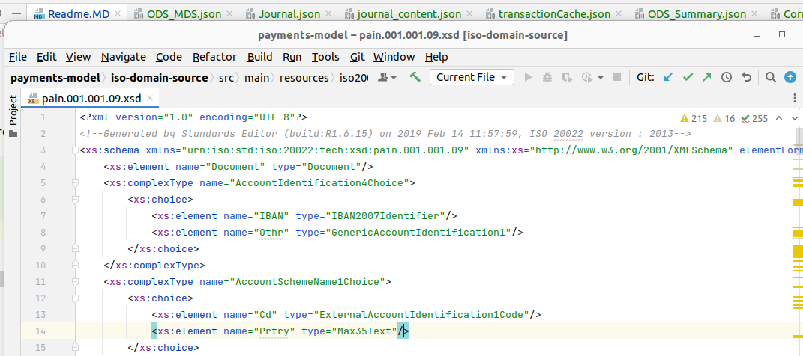
ISO20022 Adoption
XSDs
XML Schema Definitions (XSD) are often the main representation of Message Definitions for downstream application developers.

Slide 4
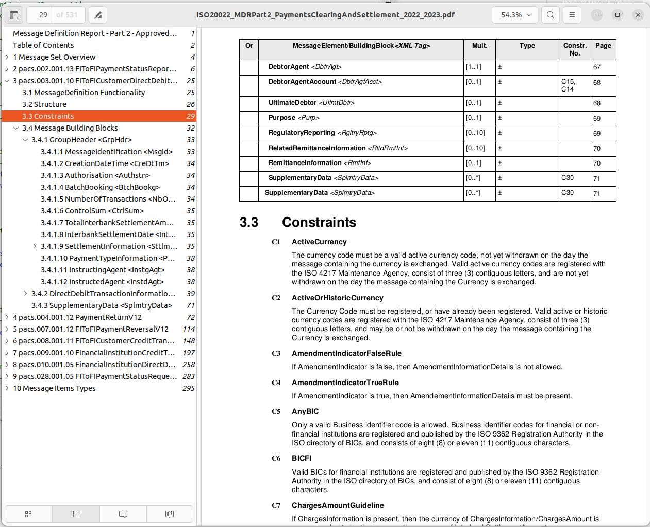
ISO20022 Adoption
Supporting "prose "documentation
The ISO20022 RA also provides Message Definition Reports contain supporting information about Message Definitions alongside the XSDs
This includes contextual information and additional rules that cannot be entirely expressed through the XSD.

Slide 5
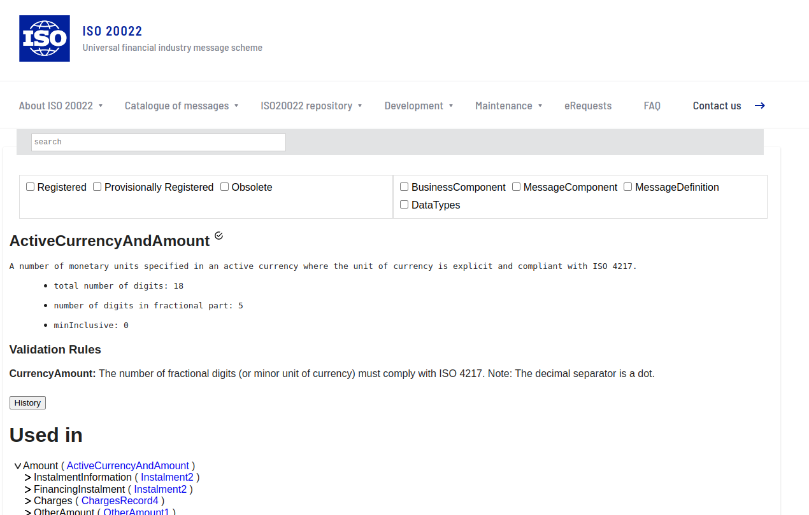
ISO20022 Adoption
ISO20022 Online Portal
The ISO20022 RA also provides an online search tool which can be used to inquiry on message components, a Data Dictionary.

Slide 6
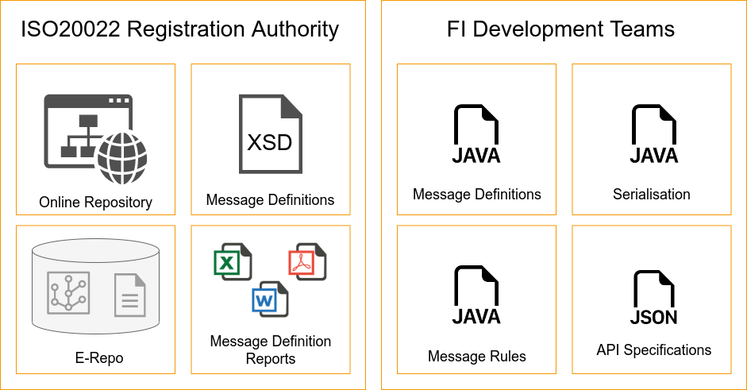
ISO20022 Adoption
How do teams build software leveraging the ISO20022 model

Slide 7
ISO20022
Limitations of the XSD approach
1. Each XSD is self-contained, therefore you end up with "duplicate" complex types (duplication rate is ~50%).
2. It is difficult to customize the generated code beyond very basic additions (adding annotations, changing field names)
3. It is not possible to programmatically leverage or generate artefacts based on any of the content that is provided in the documentation, but not in the XSDs.

Slide 8
ISO20022
ISO20022 Meta Model
Defined with Eclipse Model Framework (EMF), Meta Model + Data Repository
Level | Concern | Key Elements
Scope | Achieving a thorough understanding of the business objectives of the considered BusinessArea and its relevant Business Processes. | Business Area Business Role Business Process
Conceptual | Formalizing the semantics and discovering the communication and interaction requirements related to these Business Processes by defining the BusinessTransactions, BusinessActivities and Message Choreographies related to these Business Processes. | Business Component Business Element Business Association DataType
Logical | Creating a precise description of the messages and systems, without regard to technology, focusing on MessageDefinitions, MessageBuildingBlocks, MessageElements. | Message Definitions Message Building Blocks Message Components Message Elements
Physical | Creating a precise description of the messages and systems in a technology that can be used for implementation. | Syntax Message Scheme

Slide 9
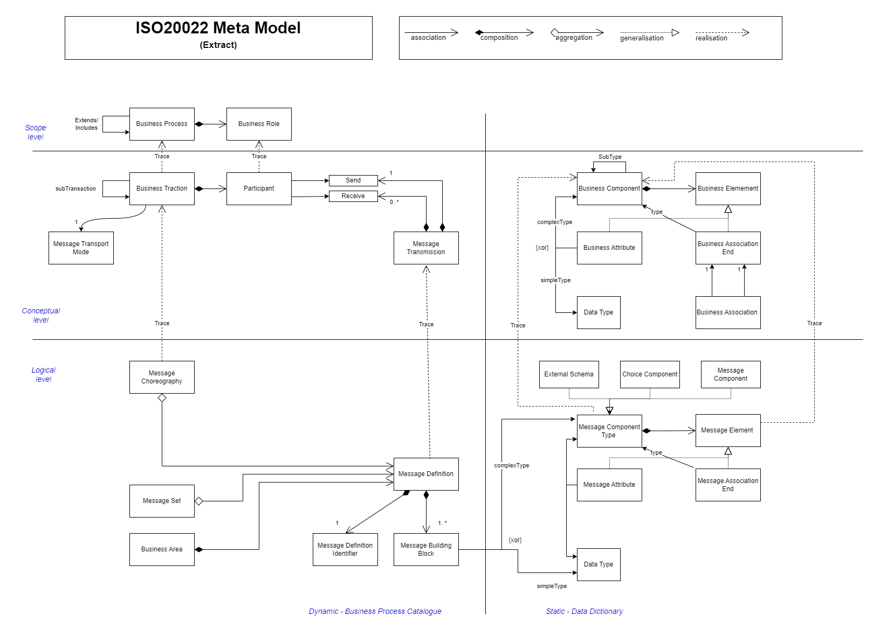
ISO20022
ISO20022 Meta Model

Slide 10
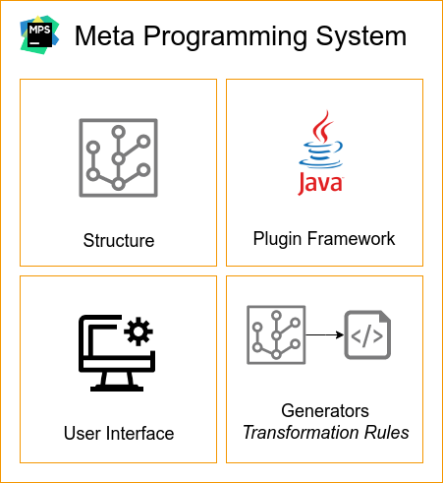
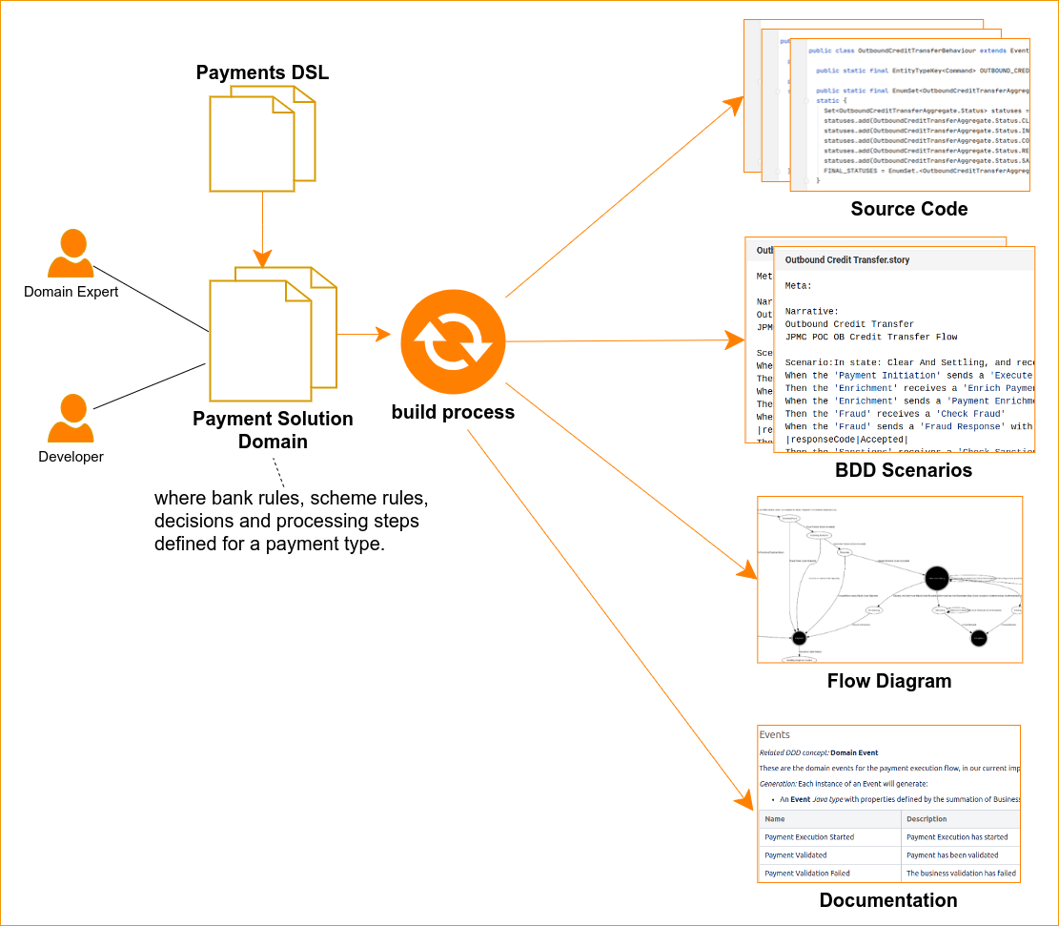
MPS Overview
A Language Workbench for modeling and model transformation

Slide 11
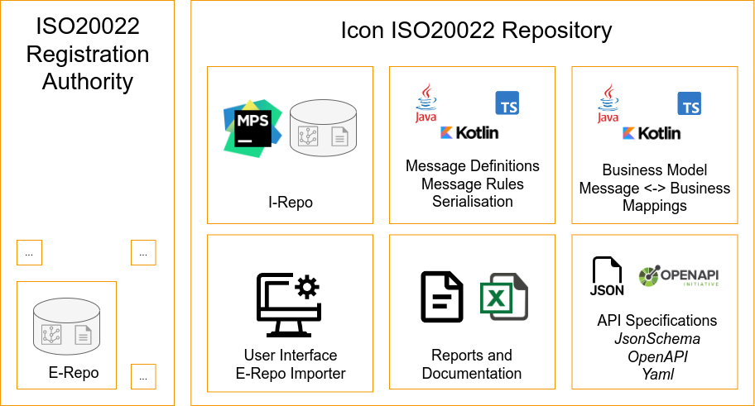
Proposed ISO20022 Adoption
Leveraging MPS, we implement the ISO20022 Meta-Model as a language and importing/convert the E-Repo

Slide 12
Process
Getting started Importing data into MPS from an EMF bases repository
Create ISO20022 MPS Language*
Generate Java representation of the ISO20022 MM, from EMF.
Create Java utility to read an EMF ISO20022 repository file
Reference the Java utility within an MPS "Importer" plugin
Write "Import" framework
Write MPS generators to generate Java model
Compare output java model with that generated by XSD

Slide 13
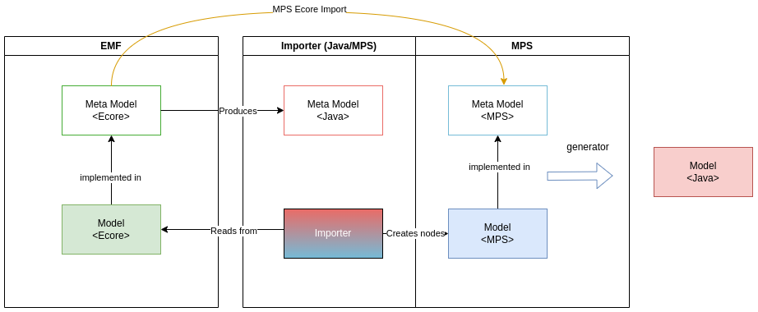
Meta-Model and Model representations

Slide 14
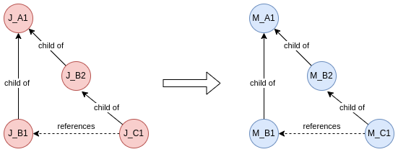
Import Process
Traverse twice, first for tree creation and containment, second for reference associating references
Create()
J_A1, create M_A1
Populate M_A1 attributes
For each Jx child:
create(Mx...)
Add Mx as child
Associate()
J_A1, get M_A1
Add references
For each J child:
Associate(Mx..)

Slide 15
Import Process
Useful things to keep track of when doing this

Slide 16
Outcome
Everything is done and working
Proven parity with existing XSD-based output model
The application code is smaller, richer, more consistent.
Generated Java implementation of the constraints that were described by the "prose" documentation.
Gain insights into the "higher" levels of the model
We can automate/generate everything!
We can integrate the ISO20022 MPS language with other languages

Slide 17
Learnings
Useful things to keep track of when doing this
EMF models have support for inverse references, MPS does not, Ecore ->MPS conversion will introduce redundant associations that need to be checked and removed.
It is simpler to separate instantiation of the target object from population.
Twice traversal solves the problem of reference nodes not having yet been created in the output model
Maintaining Maps of source object, target object, identifiers and types enables "lookup"
A Java meta model is more convenient to use during the MPS import process, rather than using raw E-Objects

Slide 18
Resources
Link | Description
https://github.com/BentleyJOakes/EcoreImport | Ecore -> MPS Language creator
https://github.com/bukodi/tools20022-root | ISO20022 Ecore + java poet generation
https://www.prowidesoftware.com/development-tools/iso20022 | ISO20022 Java model based on XSD consolidation
https://www.iso20022.org/iso20022-repository/e-repository | The ISO20022 E-Repository
https://docs.ipfdev.co.uk/core/IPF_RELEASE_2023.2.0/iso20022-model/concepts/iso20022-concepts.html | Icon Solutions Technical Documentation

Slide 19
Thanks for listening!

